Slide 1
Lab Trends
Alicia Pandimos Maurer, AIA, LEED-ap BD&C
September 2018

Slide 2
Lab Trends Overview
Traditional Planning:
Using Benchmarking
Telling end users what they need
New Trends in Planning:
Interactive planning / Group polling
Enhanced Lab Planning
Equipment Planning
“Active Listening”
Other New Trends:
Efficiency - Operations Improvement/Integrated Project Delivery
Strategic Planning

Slide 3
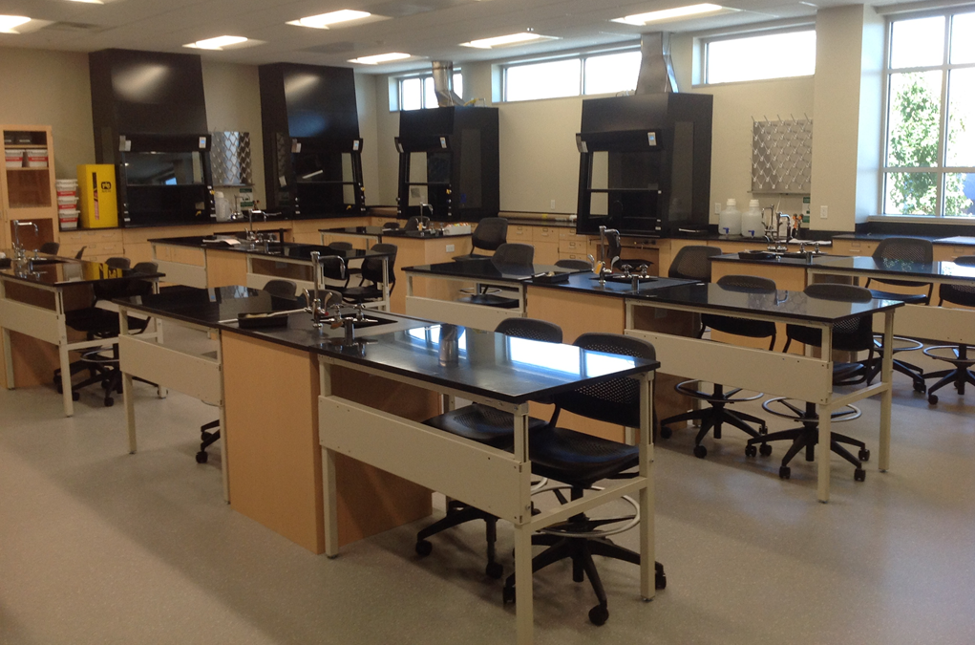
Traditional Planning
Benchmarking
Historical data and matrices
Confined to existing data
Use Typical Layouts
Base layouts on historical lab layouts

Slide 4
Traditional Planning
Benchmarking
2 Historical data and matrices
Confined to existing data

Slide 5
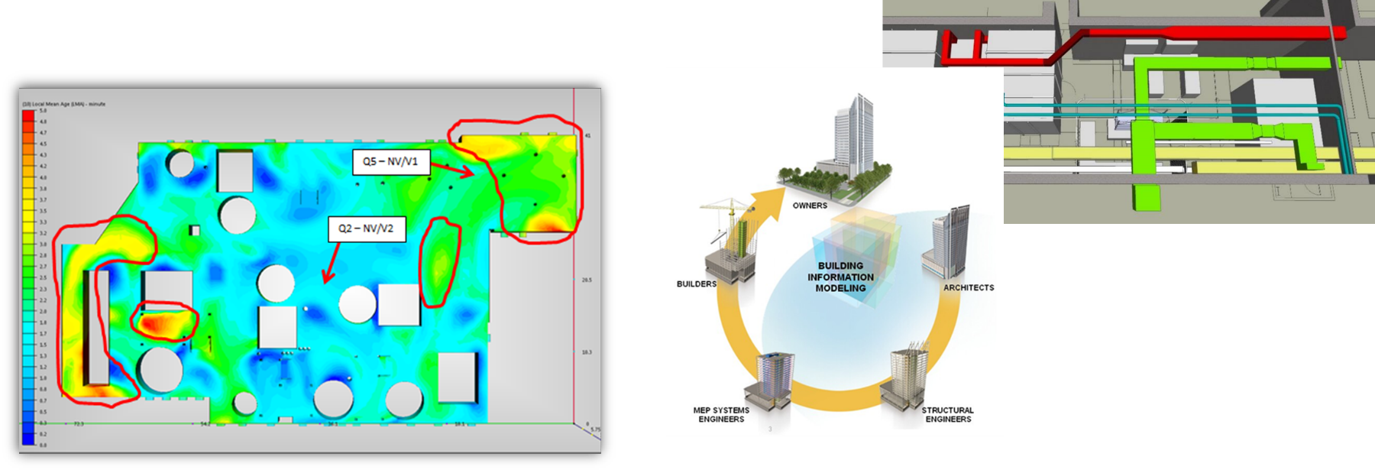
Enhanced Lab Planning
Components of Enhanced Lab Planning:
Operations Improvement (OI)
Interactive Project Delivery (IPD) for increased project efficiency
Engineering Modeling
Efficiency through equipment planning
Interactive planning and real-time polling

Slide 6
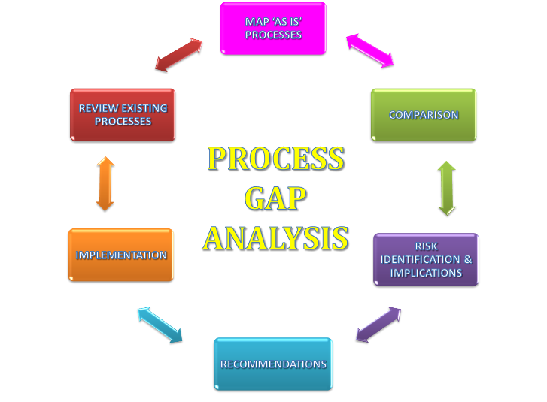
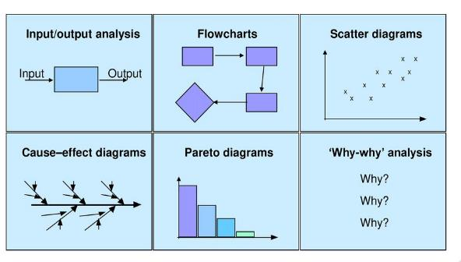
Operations Improvements
Breakdown your operations
Do more with same footprint (see below)
Perform Post Occupancy Studies to see where efficiencies can be found
Influence utility consumption
Design lean operations

Slide 7
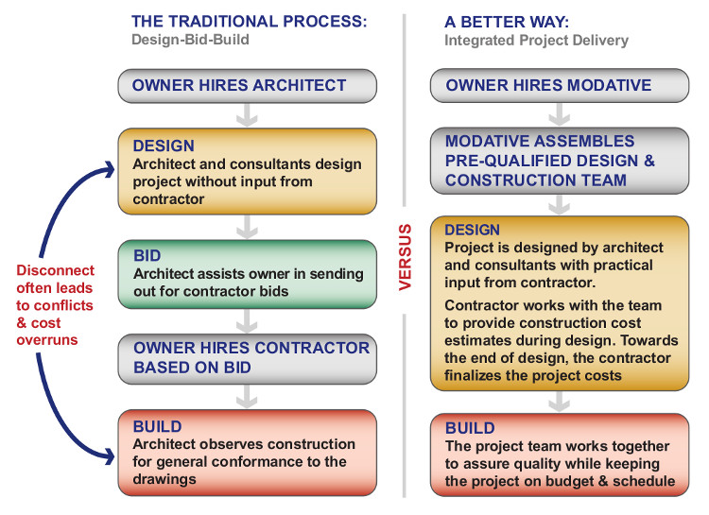
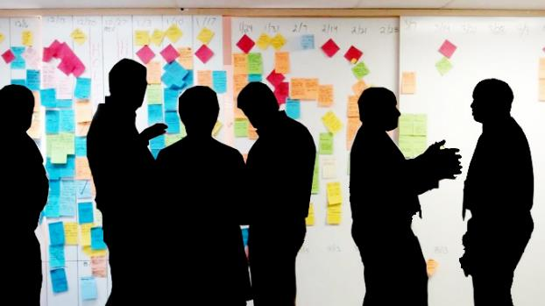
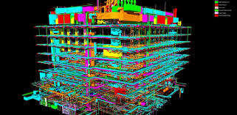
Integrated Project Delivery
IDP
Initial 3D Visualization
Improved Coordination
Lean Construction
Lowered Project Cost

Slide 8
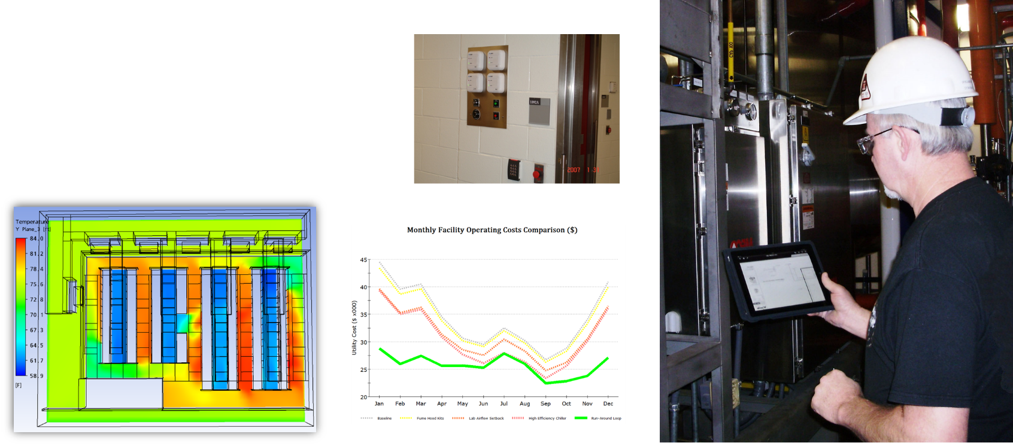
Engineering modeling
Monitoring | record keeping
Animal watering
Lighting control
Security
Controls Automation
Validation
CFD analysis

Slide 9
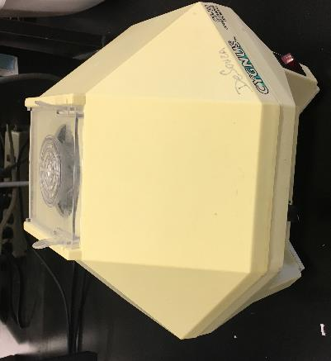
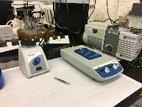
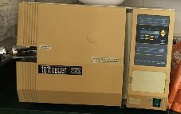
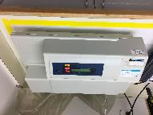
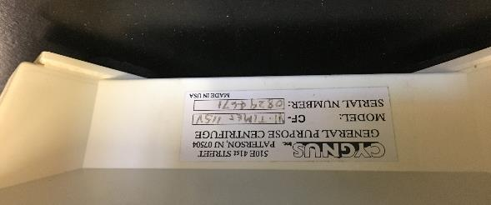
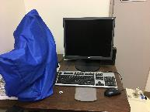
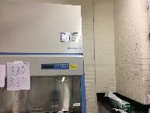
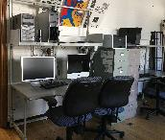
Equipment Planning
Field Survey
List
MEP Requirements
Physical
Access, Operation, Location
FRONT
BACK

Slide 10
Equipment Planning - Efficiency

Slide 11
Equipment Planning - Efficiency

Slide 12
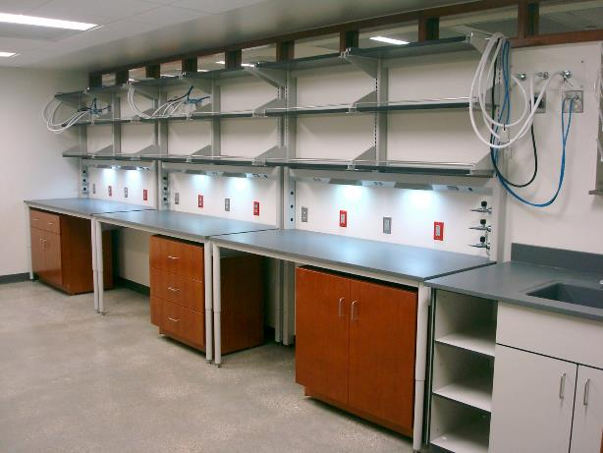
Adaptable Utilities

Slide 13
Lab Zones

Slide 14
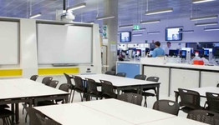
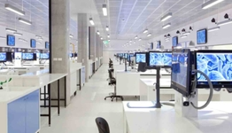
“Super Lab” Concept
Built at University of Technology Sydney in 2015
Can host more than 200 students in up to five different lab classes simultaneously
Cut SF significantly
“A key advantage of building one Super Lab instead of five smaller labs is that it eliminates separation walls and corridors,” says Booth of University of Technology Sydney). “Every wall means loss of lab bench space, since there are bench-to-wall thoroughfare and egress distances to apply to either side of the wall.”

Slide 15
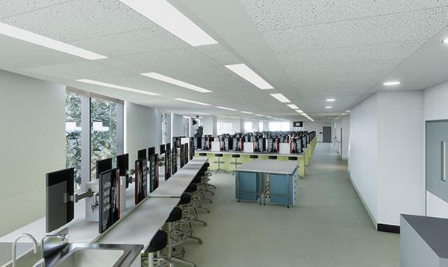
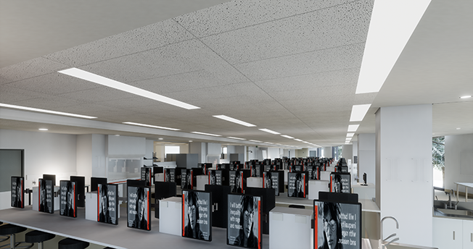
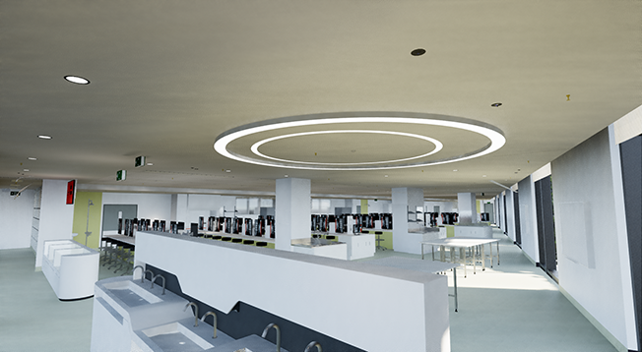
“Super Lab” Concept
London Super Lab

Slide 16
Interactive Planning

Slide 17
Planning Strategies

Slide 18
Planning Strategies

Slide 19
Questions?
Thank you
apmconsultingco.com

