Slide 1
^{Relationships: the WD-40® of}
Success-Metrics in Design-Build Labs
^{August 28, 2018}

Slide 2
How to assemble a high performing design-build team.
Use collaborative project delivery for laboratory design-build projects.
Understand tools and techniques to improve cost and schedule control.
Learn about special considerations for laboratories such as flexibility and adaptability.
LEARNING
OBJECTIVES

Slide 3
Executive Summary
Design-build construction spending anticipated to grow 18% from 2018 to 2021 and reach over $320 billion.
Design-build is anticipated to represent up to 44% of construction spending in the assessed segments by 2021. Design- build spending in Manufacturing, Highway/Street and Education represent the greatest percentage of design-build construction spending by segment over the 2018-2021 period.
The Mountain (6.3%), Pacific (6.1%) and South Atlantic (6.2%) census divisions are anticipated to yield the highest growth rates over the 2018-2021 period.
Owners have traditionally employed design-bid-build as the project delivery method of choice. As owner needs and project demands have changed, owners have become increasingly likely to assess the option to employ alternative delivery methods.
Overall, owners identified “delivery schedule" as the greatest influence of project delivery method selection. Owner goals and objectives were also identified to be highly influential
A continued emphasis toward educating owners and project stakeholders on the process and benefits associated with design-build will facilitate continued adoption and greater utilization.

Slide 4
Executive Summary Cont.
From an industry perspective, alternative project delivery methods have become a more frequent option for both public and private owners. On the public side, enabling design-build legislation has been put in place to facilitate increased use. Private owners indicated utilizing design-build on projects presenting unique challenges.
Overall, owners indicated receiving significant value from design-build when employed on larger and more complex projects. These projects allowed for greater opportunity to provide project innovations and subsequent cost savings.
In addition to larger and more complex projects, design-build utilization continues to expand into project sizes <$25 million as owners continue to gain exposure to the benefits of design-build.

Slide 5
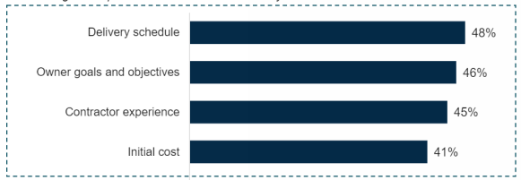
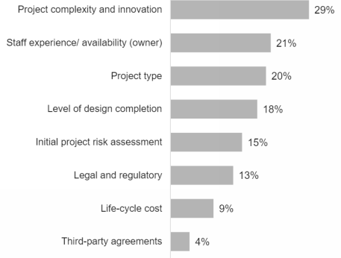
Delivery schedule, owner goals and objectives, contractor experience and initial cost were indicated to be extremely influential in the selection of a project delivery method.
Characteristics that were indicated to be extremely influential in the selection of a project delivery method.
Questions were answered on a 1 to 5 scale (1=not influential, 5=extremeIy influential) Source(s): FMI Survey
Percentage of respondents that indicated extremely influential
The critical nature of the project has a major impact to selection, and owner’s want to ensure that a timely delivery schedule is understood and provides adequate time to successfully deliver the project.
Initial cost is always a key factor in project delivery selection. The use of alternative delivery methods was indicated to provide the best avenue to achieve the originally identified cost.

Slide 6
Delivery schedule, owner goals and objectives, contractor experience and initial cost were indicated to be extremely influential in the selection of a project delivery method.
Characteristics that were indicated to be extremely influential in the selection of a project delivery method.
Questions were answered on a 1 to 5 scale (1=not influential, 5=extremeIy influential) Source(s): FMI Survey
Percentage of respondents that indicated extremely influential
Understanding the needs of owners is highly important for industry participants. The ability to get in early and develop strong communication and understanding of what the owner values provides a solid foundation for successful project delivery. Alternative delivery methods provide the ability to work with the owner early on and identify key areas of importance.
Experience is also a key factor in project delivery method selection. Having a stable of available firms to perform the work allows the owner to achieve the greatest results. A limited pool of experienced firms does not provide the owner with the added advantages of early firm involvement.

Slide 7
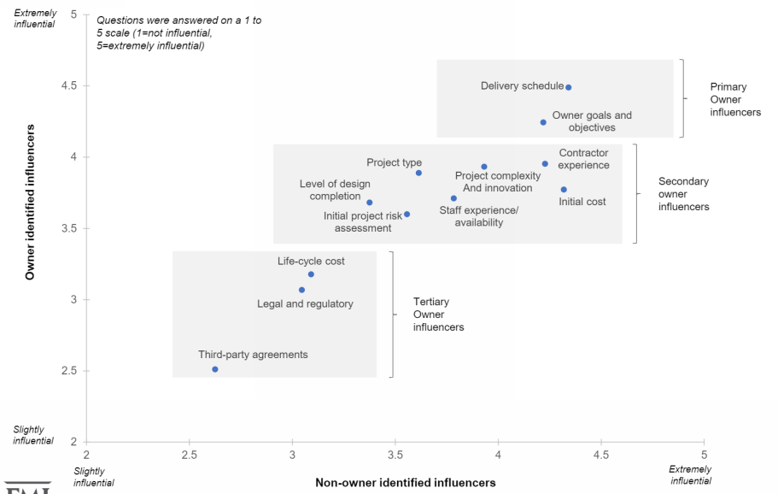
Delivery schedule was the most influencing factor for owners when selecting a project delivery method.
Project delivery method influencing characteristics
Weighted average of responses
Source(s): FMI Survey

Slide 8
Typical Project Performance
Only 30% of capital projects meet owner expectations of budget and delivery date
60% of projects miss expectations
Actions that best support project success:
Team Integration
Team Cohesion
Penn State University
Computer Integrated Construction Research Group
Lean Construction Institute

Slide 9
Collaborative Project Delivery
Approach to the delivery of a new facility: Business Case Perspective
The new facility = Start up company
Lean Principles inform design & construction
Work for the good of the ‘company’ (the project)
Cohesive Team – Durable Decisions
Integrated Team – Costs ‘owned’ by team
First step to become an Indispensable Business Partner

Slide 10
The Four Big Challenges
Every project is a unique assembly of functions and PLAYERS
‘I’ll make my part the best I can…’
Technology never sleeps
New people, new knowledge, repeat
Missed schedules, Busted budgets, low productivity

Slide 11
Your Project is a Start-Up Company – Organize it Around Value

Slide 12
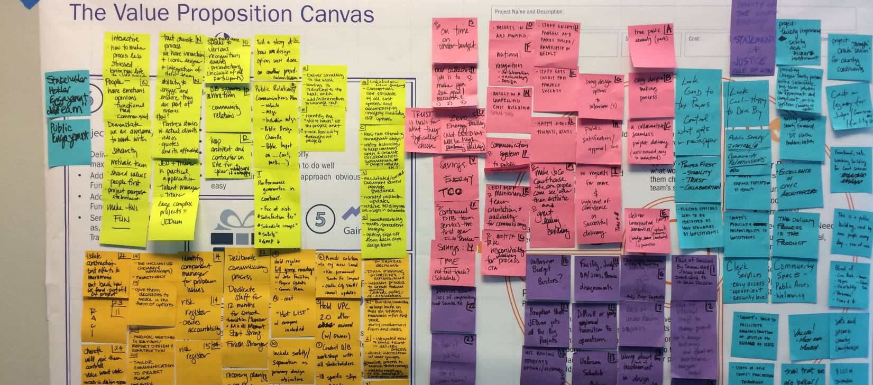
The Value Proposition Canvas

Slide 13
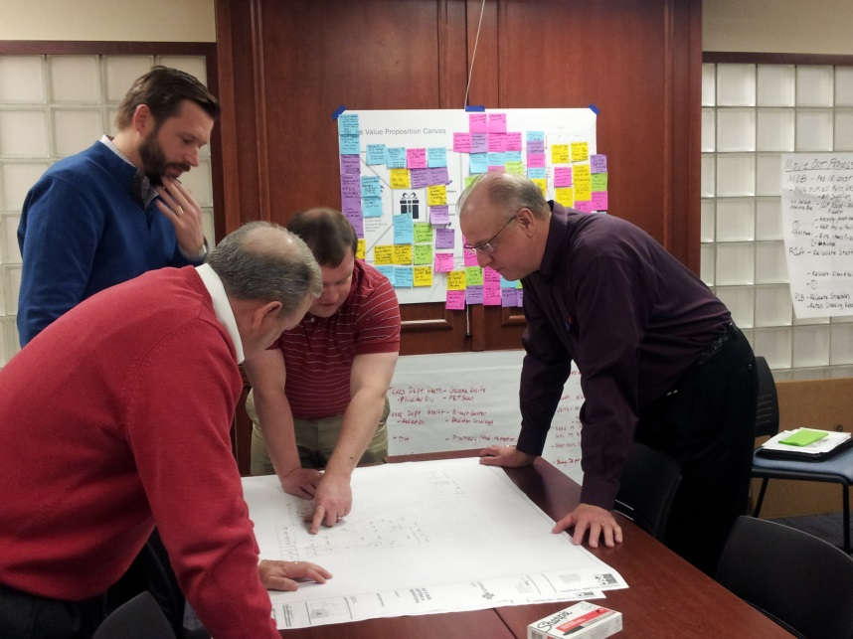
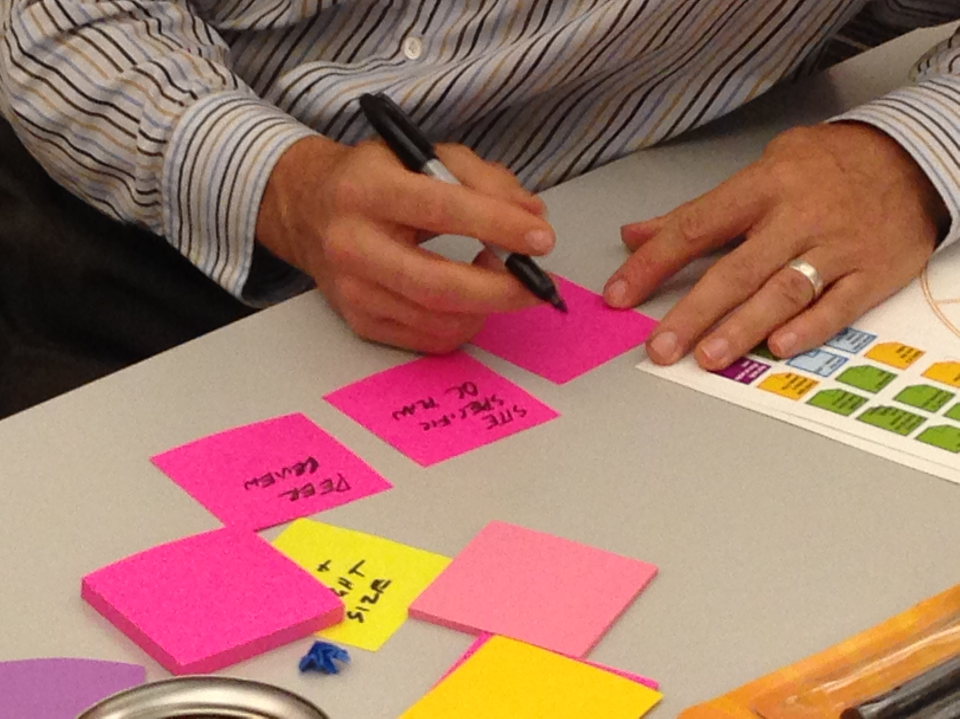
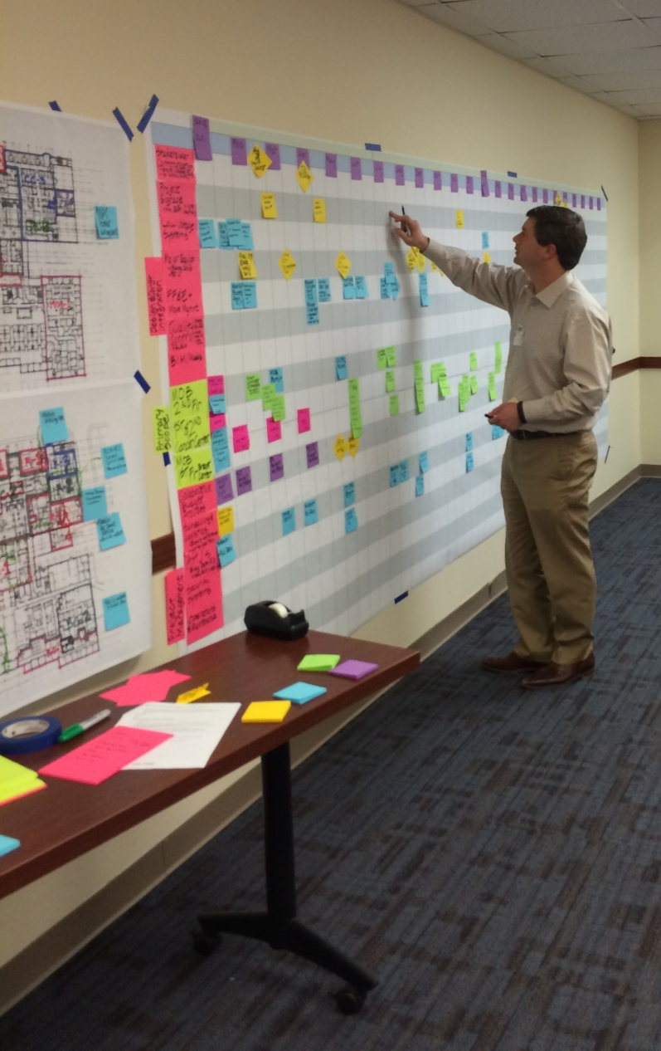
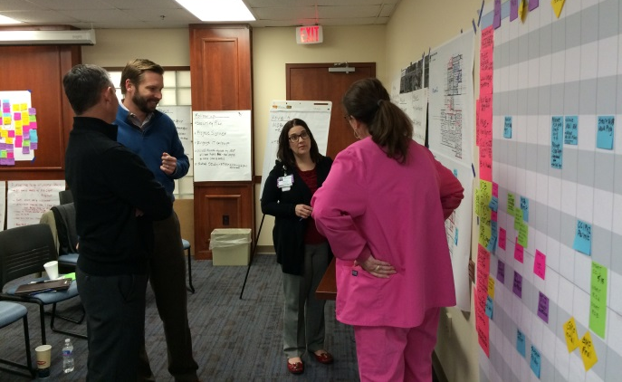
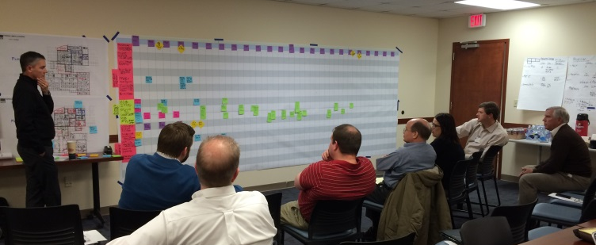
Graphic Master Schedule

Slide 15
Collaborative Process
Shared Vision of Success
Trade Partners
*Onboarding Pkg. – COS, Mission, Org. Chart, Docs
Design Partner Team
Client Team
Client Team
VPC | GMS
Project Design ‘prototyping’
Project Delivery
VPC/GMS 1.0
VPC*/GMS 2.0
VPC* /GMS 3.0
VPC* /GMS 4.0
Pursuit
Team
Pre-Con Team
Construction Team
Concept / SD
DD
CD
CA
Pursuit
Delivery
Award
Focus on integration
Knowledge Capture

Slide 16
Transition to Full Operations
The integration of completion of construction with the initiation of our Owners Operations
Plan for the Operationalization of the new facility
Focus: Bring the facility into full use and performance
First 12 Months – Moving to Full Operations
Full Operations
Final 20% of Construction
Smart Start

Slide 17
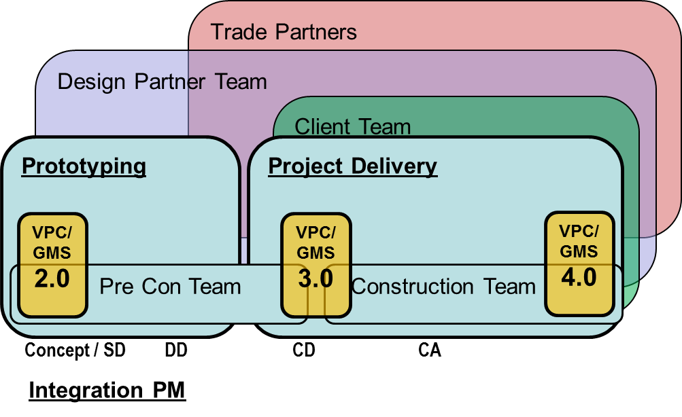
Collaboration into Operations
Client Team
Transition to Full Ops
Project Design ‘prototyping’
4.1
4.2
4.3
Client + JED/DP/Trades
……………..

