Slide 1
Changing behavior and engaging scientists at cu boulder using community-based social marketing* strategies
Christina Greever, B.A.
Program Assistant and Outreach Coordinator for CU Green Labs
* CBSM is a system of promoting behavior change developed by Dr. Doug McKenzie-Mohr

Slide 2
Learning objectives
Understand what community-based social marketing is and how it can help encourage behavior-change in the laboratory sustainability field
Identify how the CU Green Labs Program has utilized community-based social marketing strategies to promote more sustainable behaviors at the University of Colorado Boulder
Learn how to foster sustainable behavior at your own institution using a community-based social marketing approach
Be able to name several community-based social marketing strategies

Slide 3
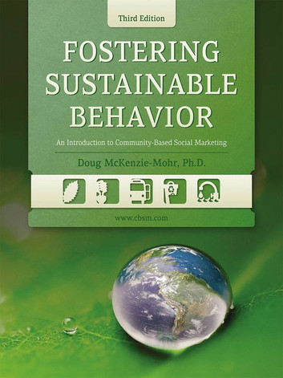
background
Dr. Doug McKenzie-Mohr
www.cbsm.com
Notes:
Draws heavily on research in social psychology
Behavior change is best promoted at the community level and involving direct contact with people

Slide 4
What is cbsm?
An approach to promoting behavior change based on research in social psychology. Can be effectively used for behaviors related to:
Sustainability
Health
Safety & Injury Prevention
Identifies barriers to behavior change before applying strategies to promote lasting change

Slide 5
What cbsm is not
It’s not
a social media campaign
Information-Based Campaigns (Attitude-Behavior Approach)
Economic Self-Interest Approaches
Studies indicate that these strategies are not enough to change behavior
Virtually no link between attitudes/knowledge and behavior
Why doesn’t this work?
BARRIERS TO CHANGE AREN’T CONSIDERED

Slide 6
Community based social marketing
Select Behaviors
Uncover Barriers & Benefits
Develop Strategies
Pilot Strategies
Implement Broadly & Evaluate
1
2
3
4
5
Notes:
Selecting Behaviors
What sector of society should you focus on?
What categories within your sector will have most impact?
Create a list of non-divisible, end-state behaviors
Determine impact, probability, and penetration levels for those behaviors
Select the behavior that has the best combo of impact, probability, and penetration
This process helps to eliminate the situation of a sustainability program being proposed just because someone thought it was a good idea.
Uncover Barriers & Benefits
It’s easy to skip this step.
Essential though, to developing a successful program
Reasons this gets skipped:
Belief that barriers are already known
Time constraints
Financial constraints
Managerial staff who do not support conducting preliminary research
Develop Strategies (what I’m going to spend time focusing on here)
Pilot Strategies
Many suggestions here
Use minimum of two groups
Calculate return on investment
If something doesn’t work, change strategy and then PILOT AGAIN

Slide 7
Strategy: prompts
Sometimes people don’t do sustainable behaviors not because they don’t care or lack motivation, it is that they forget.
General prompts rarely have impact – the suggested behavior must be specific!
Must be delivered in close proximity of time and space with the behavior in order to be effective.
Particularly useful for repetitive behaviors because more impact

Slide 8
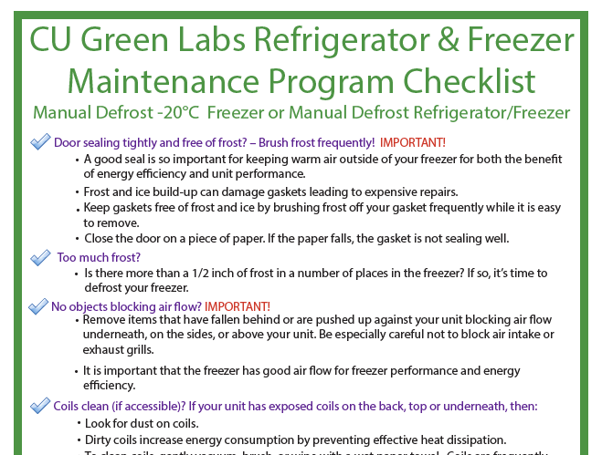
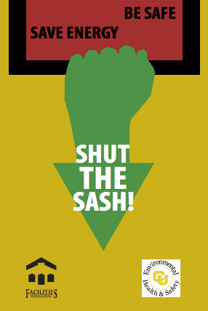
Strategy: prompts
*shut the sash signage modified from ones in use at UC Davis, developed by Allen Doyle
Notes:
Prompts should be noticeable
Self explanatory
Presented close in time and space as possible to the targeted behavior
Use prompts to encourage positive behaviors rather than avoiding unsustainable behaviors

Slide 9
Strategy: Commitment
Individuals that agree to a small, innocuous request are more likely to agree to a much larger request later
Why is this? Making a commitment changes the way we perceive ourselves. As humans, we want to behave consistently. Consistency is a highly valued character trait in society.
Substantial time can pass between the first and second request to make a commitment, and the second request can be made by a different person.
This means that the first request changes how we perceive ourselves in a lasting, durable way.

Slide 10
Strategy: Commitment
Ask labs to make a written commitment (more effective than verbal)
Make the commitment public & durable
Advertised on doors of participating labs
On Green Labs outreach posters
On Green Labs website
Building TV displays
Commitments must be voluntary
Easily combined with other behavior change techniques
Notes:
Future program goal to get labs to take the Green Labs Culture Pledge as part of an enhancement of our Eco Leader Program we are currently working on. The idea is that labs might be more willing to engage in further sustainable actions if they have already committed to this easier action of signing the culture pledge.
RECYCLING

Slide 11
Strategy: social norming
(Building community support)
Normalizing sustainable behaviors in society
Other people have an important role and influence on our own behavior
Make the norm noticeable.
Present norms at the time a targeted behavior should occur.
Use norms to encourage positive behavior
But be careful!
Don’t publicize that an undesirable behavior is common!
Notes:
Injunctive norms: providing information on what behaviors are approved or disapproved of
Descriptive norms: which behaviors are normally engaged in

Slide 12
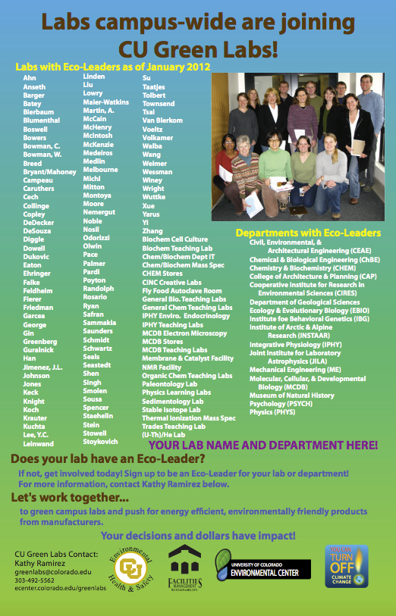
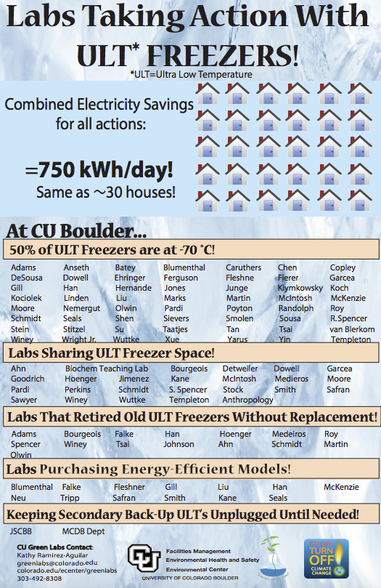
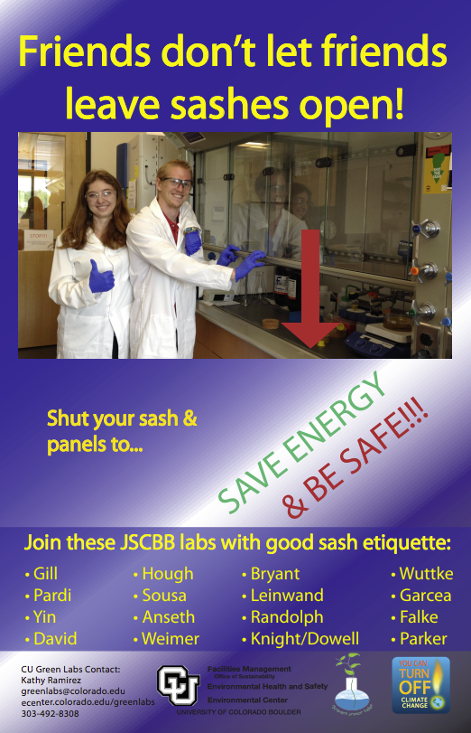
Strategy: social norming

Slide 13
Strategy: social diffusion
(Speeding adoption of positive behaviors)
We are heavily influenced by our social networks: family, friends, coworkers, neighbors
Get help from those that have already adopted sustainable behaviors to influence those around them (social diffusion)
Works two ways:
More people are asked to change behavior
The one doing the asking is more likely to stick with the behavior because they are now asking their social networks to do it too
Make sure the behavior is Observable
Use in conjunction with other strategies such as commitment
Notes:
Have people committed to a new behavior talk to others in their social network about doing the same!

Slide 14
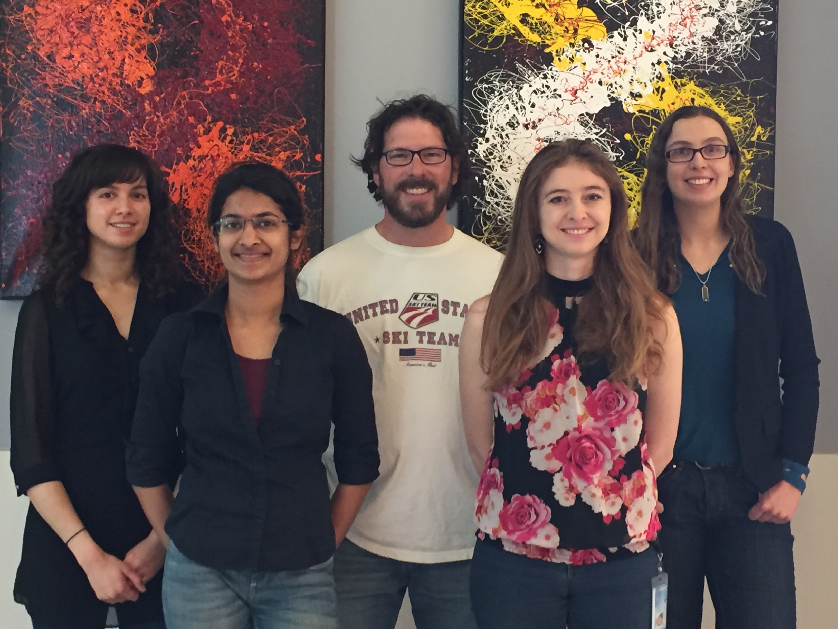
Strategy: social diffusion
Team Lead Role at CU Boulder
Notes:
Getting autoclaves on Eco Mode – we had several lab member champions of this project who learned to reprogram the autoclaves, spoke with neighboring labs about whether they wanted Eco Mode
Future Goal: incorporating an element into the Eco Leader Enhancement where you advance in the program by talking with other labs about lab sustainability initiatives

Slide 15
Strategy: incentives
Useful when an individual’s motivation to engage in a particular behavior is low or when cost to do something sustainable is a significant barrier
From Gardner & Stern’s* reference on using incentives to improve engagement in sustainable actions:
Consider incentive size carefully
Pair the incentive & behavior, ideally present at same time
Incentive should be visible
Reward positive behavior
Be cautious about removing an incentive that is already in place
* Gardner, G.T. & Stern, P.C. (1996). “Environmental Problems and Human Behavior.” Boston: Allyn and Bacon.

Slide 16
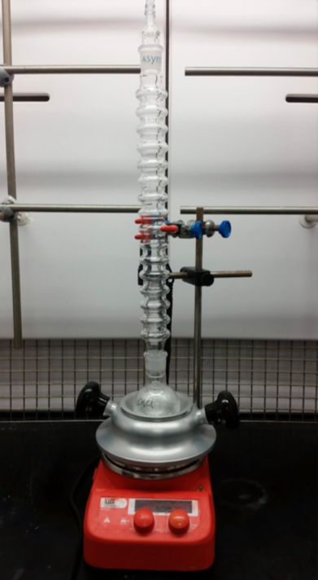
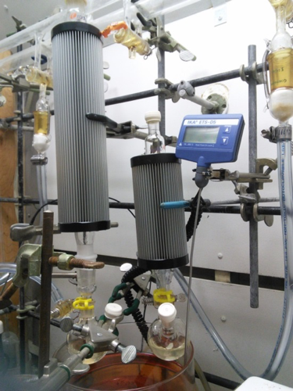
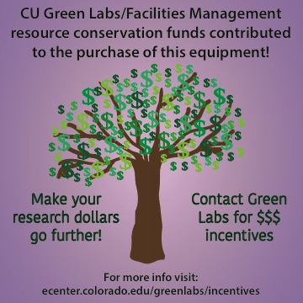
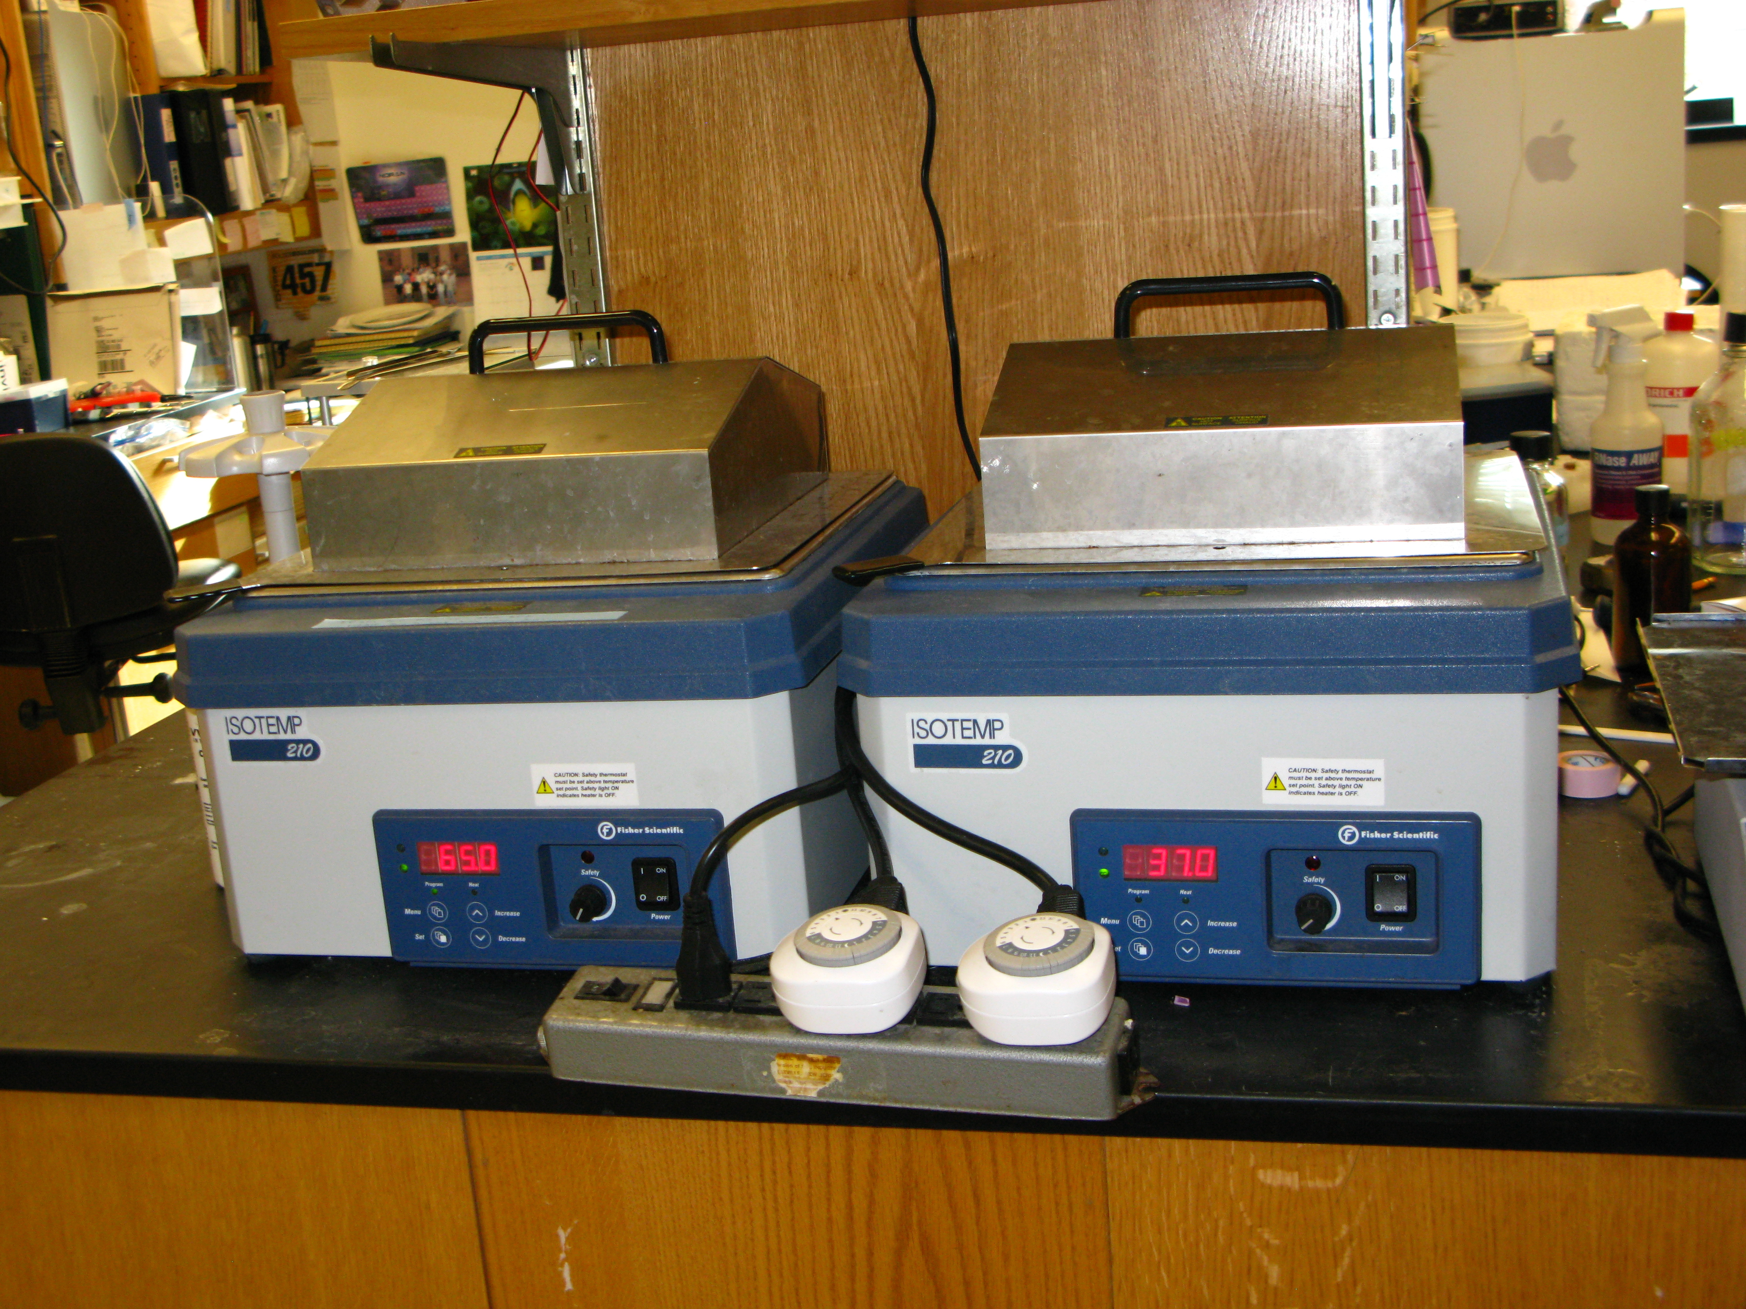
Strategy: incentives
Waterless condensers
Free equipment timers
Stickers on equipment purchased with financial incentives from our Facilities Management group
Notes:
We’re removing the barrier to make these financial investments, with a large payback.
½ energy consumed, or no water used for synthesis.

Slide 17
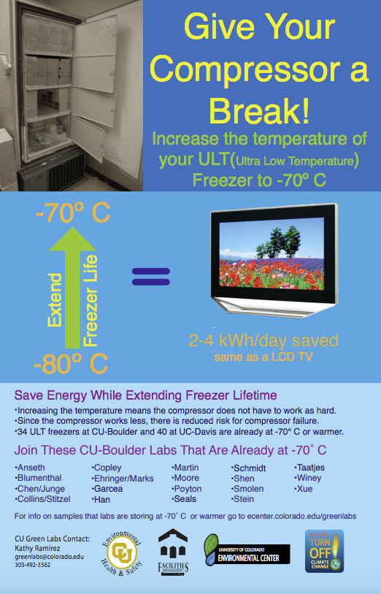
Strategy: incentives
Vivid communication strategy; easy to remember
“Increasing the temperature means the compressor does not have to work as hard. Since the compressor works less, there is reduce risk for compressor failure.”
Social Norming!
Notes:
Save Energy while extending freezer lifetime
This poster highlighted early adopters of -70 C, but now 50% of labs on our campus are at -70 C. use of sticker (to make behavior more visible) also helped

Slide 18
Strategy: high quality communication & effective persuasion
VIVID
CONCRETE
PERSONAL
Know your audience
Reference credible sources and work with credible groups
Make message easy to remember
Provide personal or community goals
Notes:
EH&S
Don’t want to do actions that EH&S isn’t ok with ; don’t want to change what they are doing later on

Slide 19
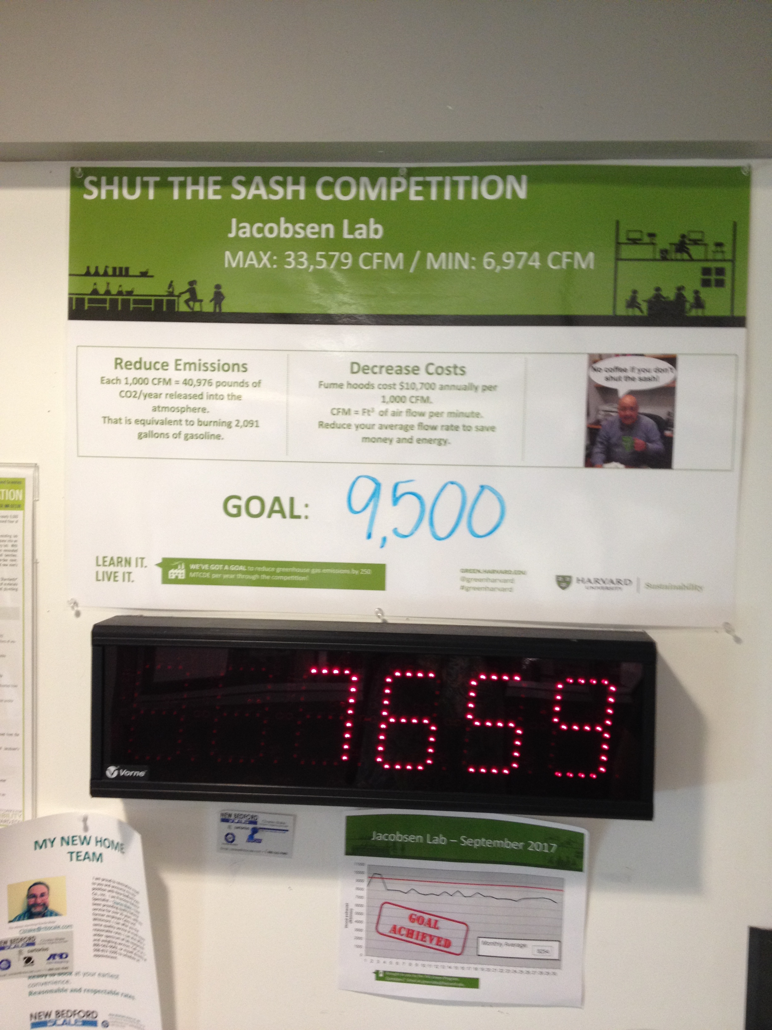
Effective communication
CBSM at Harvard University

Slide 20
Combining strategies
Make it convenient to adopt sustainable behaviors

Slide 21
In summary
I am not an expert on applying CBSM to sustainability
CBSM is a great framework to use to promote more sustainable behaviors at your campus or institution
Also gives interesting insight into human behavior/psychology
Lots more information available online and through the free 3rd edition of Fostering Sustainable Behavior by Doug McKenzie-Mohr

Slide 22
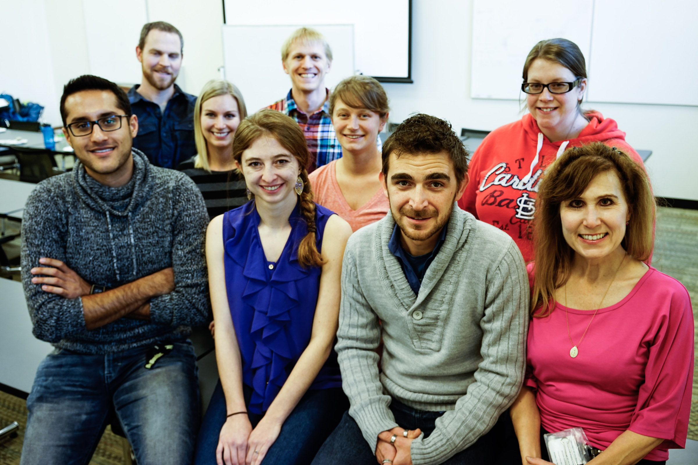
Next steps
Enhancement of Eco Leader Program

Slide 23
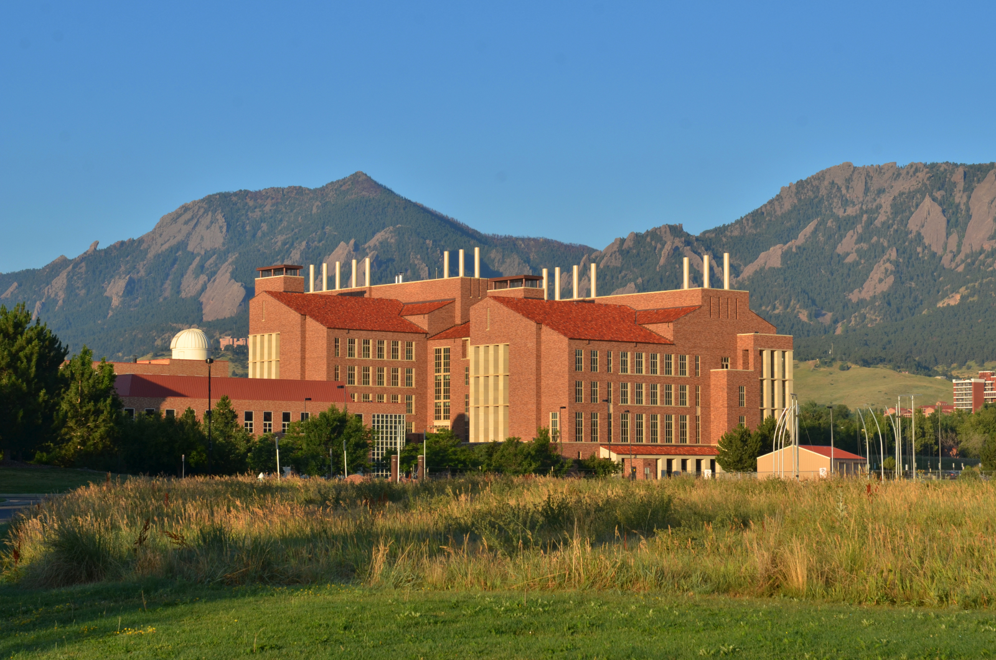
acknowledgments
Kathy Ramirez-Aguilar, PhD - CU Green Labs Program Manager

Slide 24
Questions?
christina.greever@colorado.edu
(303) 735-5612

