Slide 1


Achieving Energy Savings and Awareness with an Intelligent Campus Program
August 29, 2017
Anna Hoenmans, P.E.
www.nrel.gov
Celeste Cizik, P.E.
www.group14eng.com

Slide 2
Learning Objectives
Identify strategies to manage energy at the campus level
Assist with selection of hardware and software for energy monitoring and analytics
Utilize data to benchmark and assess changes in energy use
Drive change in operations and maintenance practices

Slide 3
NREL Intelligent Campus Overview
Notes:
History – How did NREL get to an Intelligent Campus?
Driver – from the top, Executive Orders, federal regulations, DOE’s mission goals and NREL’s own mission statement: NREL advances the science and engineering of energy efficiency, sustainable transportation, and renewable power technologies and provides the knowledge to integrate and optimize energy systems.
In the commercial world it would the owner. The owner would want to have an intelligent system to help optimize energy savings within their facility.
What does it take to have an intelligent campus?
It takes a village in this case a campus…
NREL’s Intelligent Campus program is to support the laboratory’s success by engaging staff in applying what is learned through research and development in facilities and infrastructure systems that serve its campuses.
For the math and science folks in the audience… a simple equation that NREL follows…a more holistic equation:
Energy intelligence System = Data Collection + Data Analysis + Data Application, slide 5

Slide 4
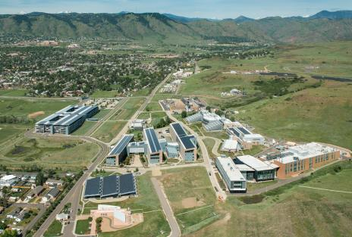
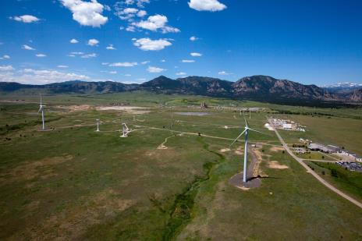
NREL Overview
South Table Mountain (STM) Campus
National Wind Technology Center (NWTC) Campus
DOE/EERE Laboratory in Golden, Colorado
Two Campuses (STM and NWTC)
  63 buildings
  DOE Owned Facilities = 1,080,591 sq ft
STM Campus = 999,256 sq ft
NWTC Campus = 81,335 sq ft

Slide 5
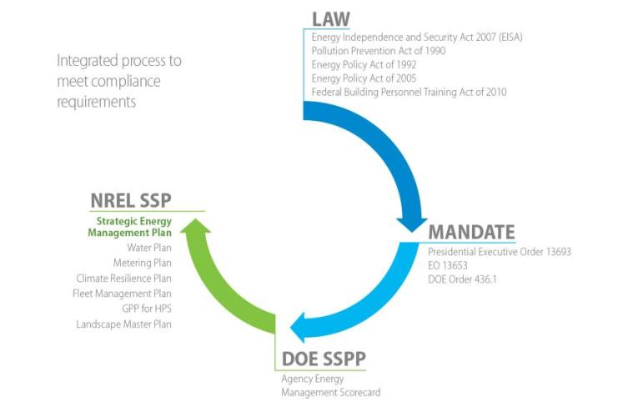
Executive Orders/ Guiding Principles/
NREL’s Mission Statement
Notes:
At NREL
Driving requirements
1) Executive Order goals for energy intensity that is reported through the Consolidated Energy Data Report (CEDR) and Site Sustainability Plan (SSP) and
2) Guiding Principles for High Performance Buildings
3) NREL’s own mission statement

Slide 6
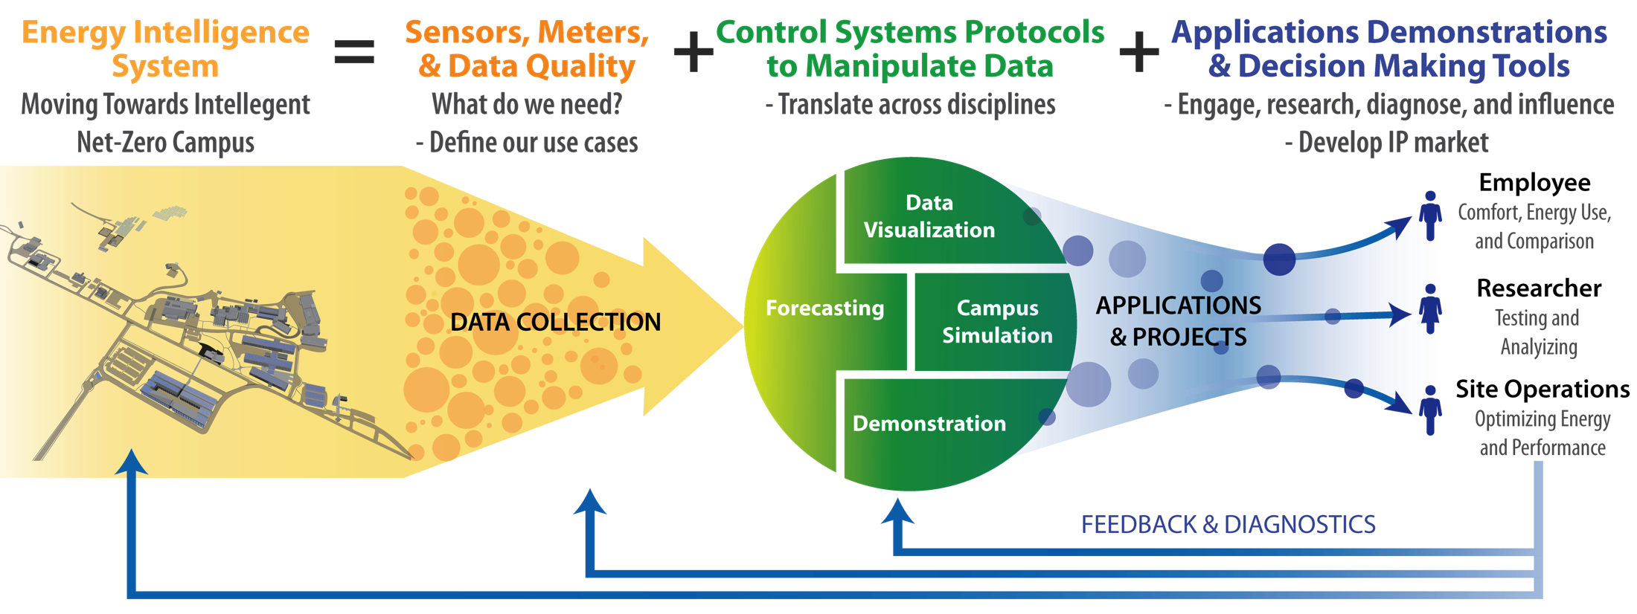
Enabling Holistic System Functionality
As a living laboratory we are utilizing the systems emerging from these projects to optimize energy performance and facilitate business decision making…
Notes:
NREL’s program
both an environment and energy informatics platform,
NREL fosters situational awareness, engagement, and understanding of energy accountability among lab staff and visitors
low carbon economy campus by integrating multiple capabilities including energy and water management, energy data analysis, high performance buildings, and more.
5-10 year plan

Slide 7
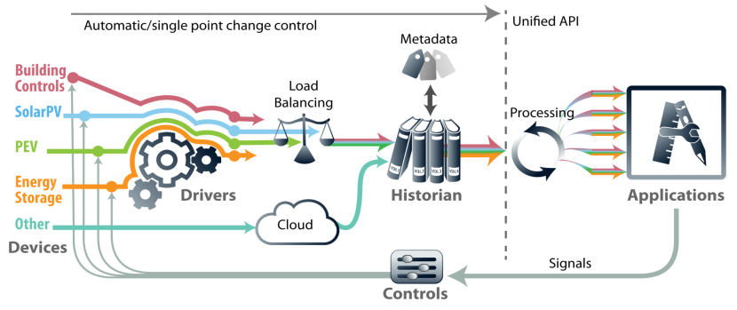
Intelligent Campus – Platform and Environs
Comprehensive energy data for the NREL campus is collected and analyzed in support of a coordinated and comprehensive energy management strategy.
  Purpose
      Deliver data quality & reliability
      Assessment tool for robust energy management performance
      Leverage data resources to support deployment and research activities
  Platform Components
    Utilizes common communication protocols and open standard software for marketplace adoption
    EIC team assessing capabilities that address gaps that generate investment opportunities
Notes:
NREL has a multitudes of platforms that ties into the Mission Research. In our presentation we will be focusing more on the building controls and building energy data at NREL.

Slide 8
Metering Infrastructure and Monitoring

Slide 9
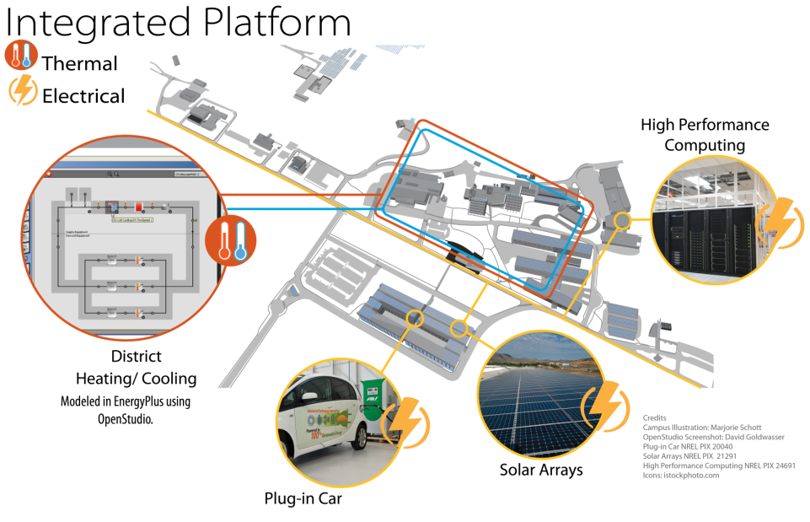
NREL Campus Energy Modeling Vision
Develop an integrated platform for:
Campus-Level Design
Diagnostics and Visualization
Operational Optimization
Hardware-in-Loop (HIL) Testing
Humans-in-the-Loop
Notes:
What does NREL Meter?
Renewable energy
Solar (NWTC and STM)
Wind (NWTC)
Biomass (STM)
Electricity (utility and submeters)
Gas (utility)
Thermal (heating and cooling)

Slide 10

Meters – Implementation Process
Utility meters
  Natural gas meter for each building
  (1) electric meter for STM Site campus, (2) for NWTC campus
  PV Meters on both campuses tied into utility
Electric whole building meters added FY2000
  Sub meters during construction - HVAC loads, plug loads, process loads, lighting loads
  Main building meters upgraded in FY2017 for improved reliability
BTU meters added FY2000
  Upgraded FY2017 for improved reliability and reduction of maintenance
Notes:
In FY2000 started and identified with major energy users of facilities. A good part of NREL building portfolio are small buildings that are not heavy energy users and out of the 63 buildings there are appox. 18 buildings that participate and are assessed in the Guiding Principle of High Performance of Sustainable Buildings.
Each building electrical sub meters to capture as best as possible HVAC loads, plug loads, process loads and lighting loads.

Slide 11
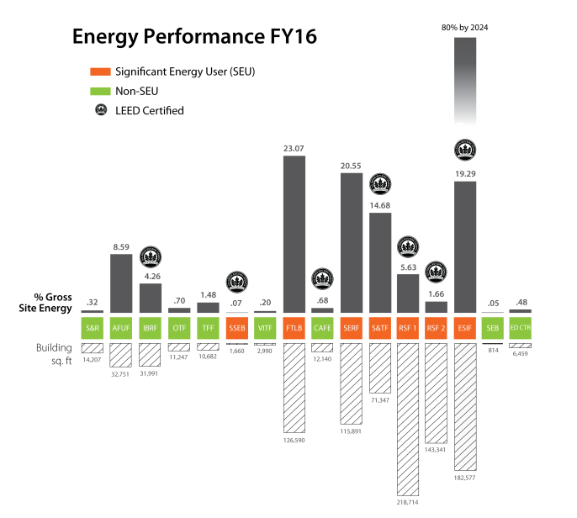
Campus Energy Opportunities and Challenges
Notes:
Graph shows 16 buildings that are on STM campus and illustrates the total energy performance for FY16 which includes the gas and electrical energy for the these buildings. Not shown is NWTC energy performance for the other two buildings.
Graph also illustrates which buildings are the significant energy user, in orange. These facilities are highly targeted to review any energy opportunities. To review the energy consumption of each facility will require monitoring and data analytics. Celeste will now review NREL’s monitoring and data analytics

Slide 12
Monitoring and Data Analytics

Slide 13
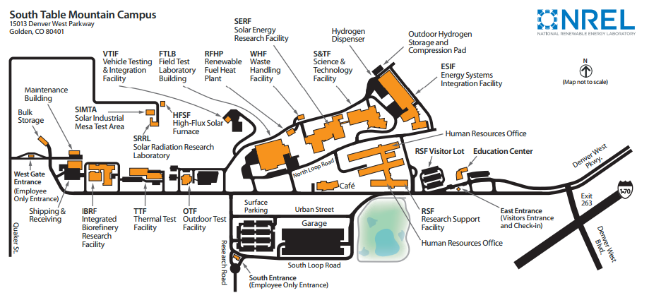
Fault Detection and Diagnostics Deployment

Slide 14
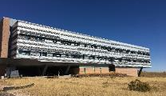
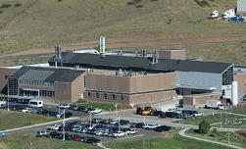
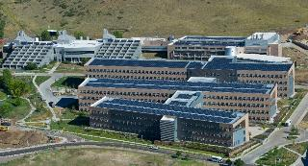
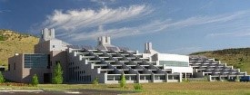
Fault Detection and Diagnostics Deployment
Facility | Space Use | Square Footage
Energy System Integration Facility (ESIF) | (15) laboratories, support offices, data center | 182,500
Field Testing Laboratory Building (FTLB) & Central Plant | Laboratories and offices | 126,590
Research Support Facility (RSF) I & II | Office Space | 362,055
Solar Energy Research Facility (SERF) | (42) laboratories | 115,000
Science and Technology Facility (S&TF) | 3-story office and laboratory facility | 71,347
Analyzing KPIs on metered energy use data for an additional 15 facilities
1.5 million square feet

Slide 15




System Configuration
VMWare for Remote Access
Locally Installed Analytics
Meters
  Energy Information
  System (EIS)
BACnet/ModBus connectors
  +
  Fault Detection &
  Diagnostics (FDD)
BAS
Notes:
FDD - Detailed analytics down to the equipment level. Dashboard can provide info, but often need to dig deeper to solve the problem.
We have data from numerous souces – SkySpark pulls it all together (meters, BAS, IP/web systems, etc.)
The Building Automation System is the computer based system that runs the electronic controls in the building, everything from start/stop to detailed equipment temperature control based on sensors (zone temp, air handling units, chillers, etc.). All of this data is stored and analyzed to provide actionable information.
Data points constantly monitored and stored. Programmed “rules” detect “faults” or issues.
One way communication – provides information that requires human action

Slide 16
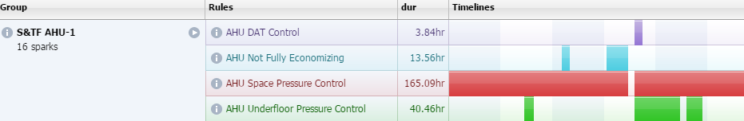
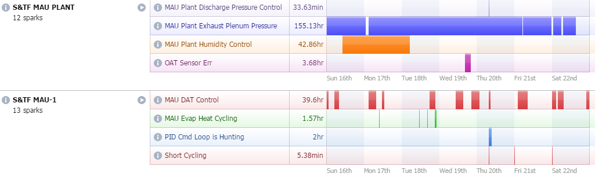
FDD Monitoring
Faults or “Sparks” – auto detect issues
Notes:
Evaluate issues across the portfolio – automated information
ADD IN SPARK SCREENSHOTS FROM OTHER BUILDINGS

Slide 17
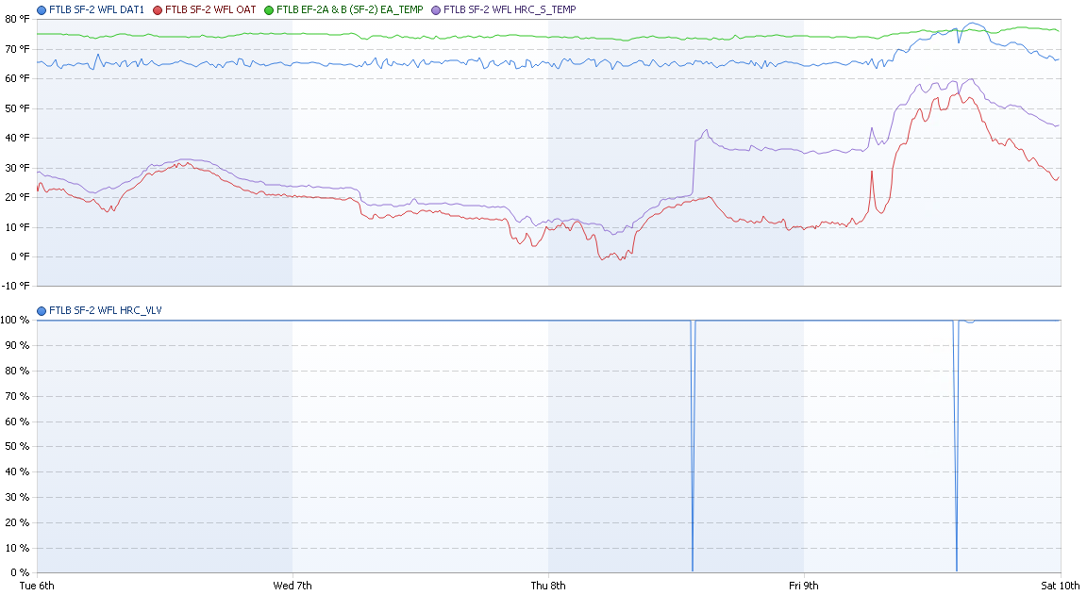
Finding: Failed Heat Recovery
Repaired valve, increased to 20 degree rise across heat recovery coil
Anticipated Savings est. $6,100
Notes:
MAU trend graph for 4 cold days in winter
Top Axis: Temperature points, Bottom Axis: HR valve position
Prior to testing on site, observed HR DAT (purple) closely following OAT (red)
Tested on site, found valve direction was reversed at BAS
20F rise in heat recovery = $6,100 annual savings

Slide 18
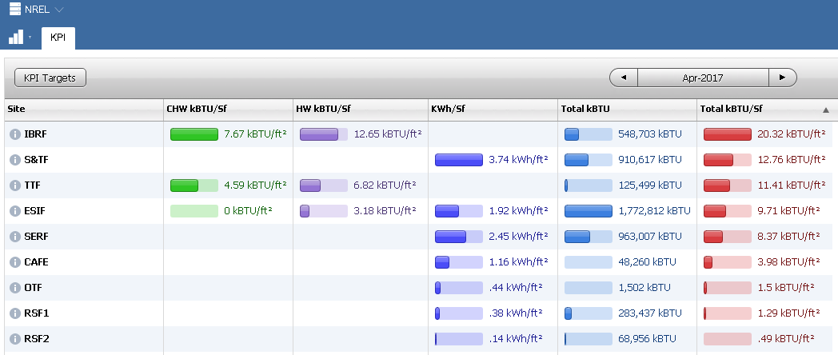
Real Time Key Performance Indicators
Track, compare, identify change
Notes:
EUIs monitored in real time - SkySpark dashboards, KPIs, etc
Real time change in energy, benchmarking, comparisons
testbed for operational and laboratory changes that impact energy use

Slide 19
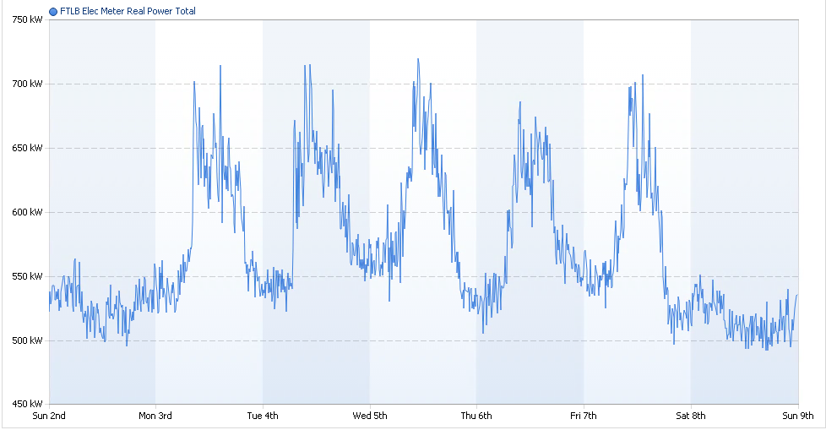
Automated M&V
Demand data in real time, weather normalized baselines, automatic savings calculations

Slide 20
Deployment Process
Plan
Pilot
Implement
Key buildings first
Act!
Plan resources
Refine Process
Phase/Expand
Responsibilities
Utility programs
Notes:
(planning to hire systems engineer – SkySpark and BAS operation)

Slide 21
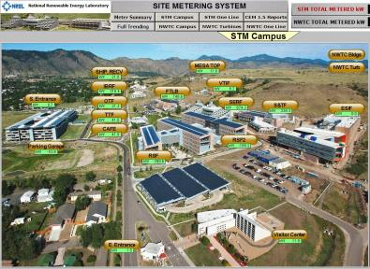
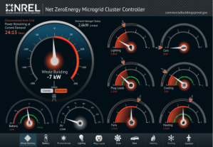
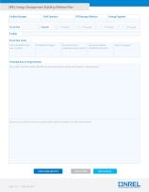
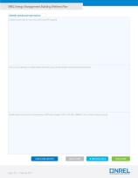
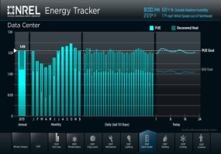
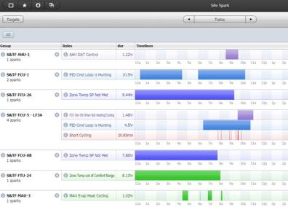
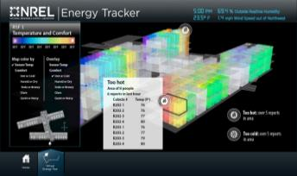
Activities Informing Operations
Campus Dashboard
Facility Dashboard
Building Wellness Checklist
Forecasting and
Demand Management
Fault Detection and Diagnostics
Heat maps of energy loads

Slide 22
Results

Slide 23
Project Savings
FTLB & Central Plant:
  $57,700 annual savings
  9% of utility cost
S&TF:
  $28,100 annual savings
  11% of utility cost
More buildings to come = more savings…

Slide 24
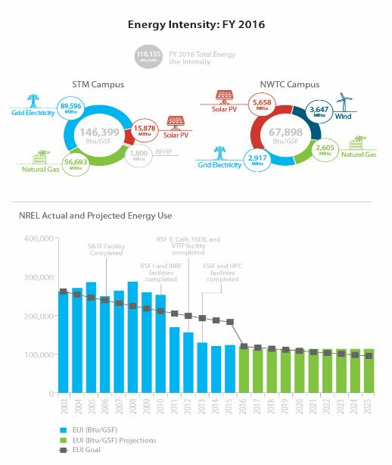
Campus Energy Trends and Savings
Reduced energy use intensity (EUI) by 54% when comparing the NREL campus FY2003 EUI baseline of 258 kBtu/sf to FY2016 EUI of 118 kBtu/sf
Notes:
Graphic? Timeline of savings?

Slide 25
Get Started!
Hardware
Software
Action/ feedback loops
Commitment
= Energy Savings

Slide 26
Questions?
Anna Hoenmans, PE, CEM, PMP
anna.hoenmans@nrel.gov
(303) 384-7432
www.nrel.gov
Celeste Cizik, PE, CEM, LEED AP
ccizik@group14eng.com
(720) 382-1705
www.group14eng.com

