Slide 1

®

Slide 2
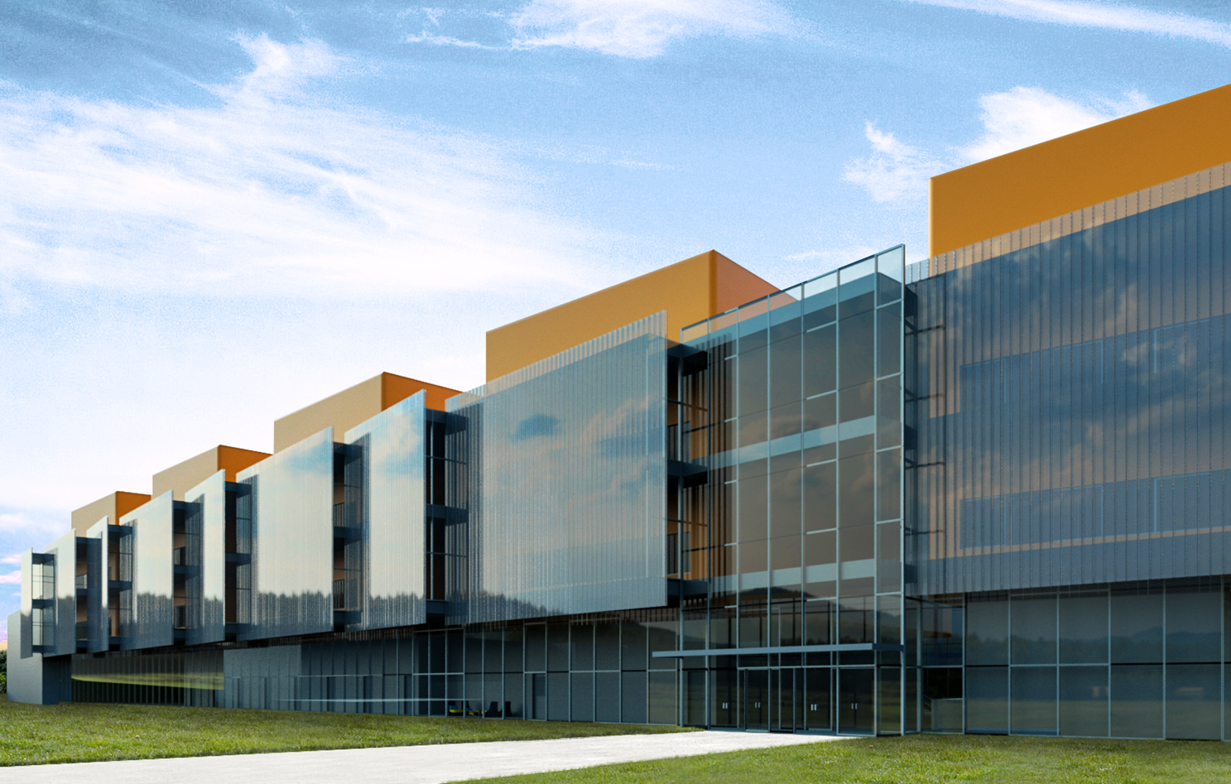
Lab trends
September 21, 2016

Slide 3
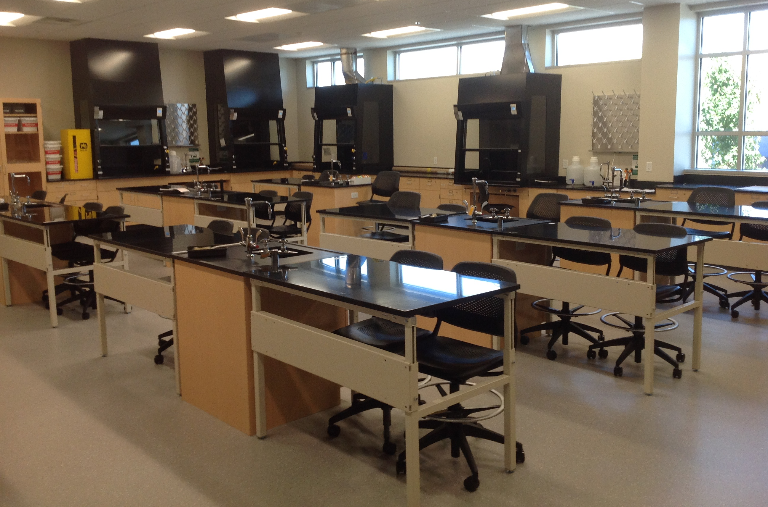
Traditional Planning
Benchmarking
  Historical data and matrices
  Confined to existing data
Use Typical Layouts
  Base layouts on historical lab layouts

Slide 4

Traditional Planning
Benchmarking
  2 Historical data and matrices
  Confined to existing data

Slide 5
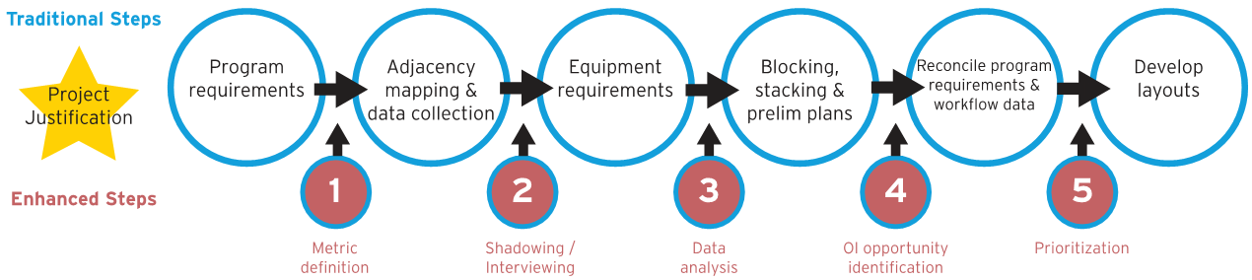
Enhanced Lab Planning
  Looking Forward
  Data driven
  Includes operating constraints and needs

Slide 6
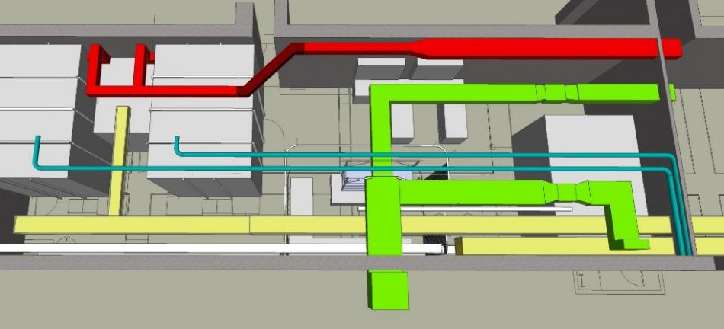
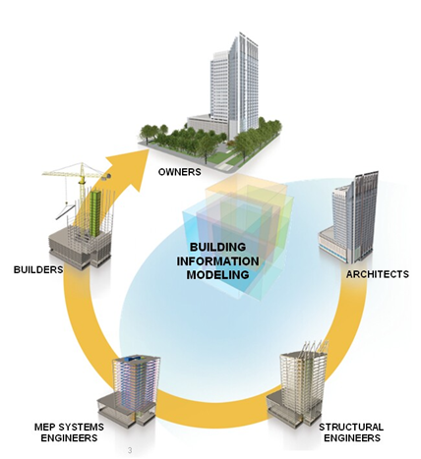
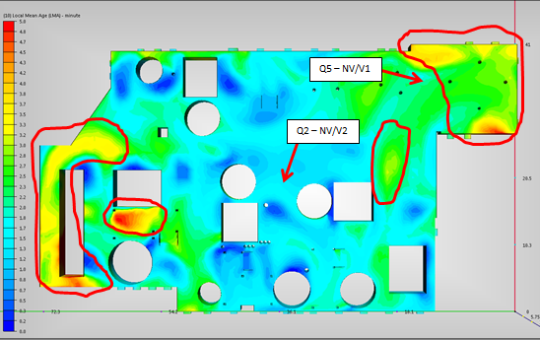
Enhanced Lab Planning
  Components of Enhanced Lab Planning:
    Operations Improvement (OI)
    Interactive Project Delivery (IPD) for increased project efficiency
    Engineering Modeling
    Efficiency through equipment planning
    Dashboarding and real-time survey

Slide 7
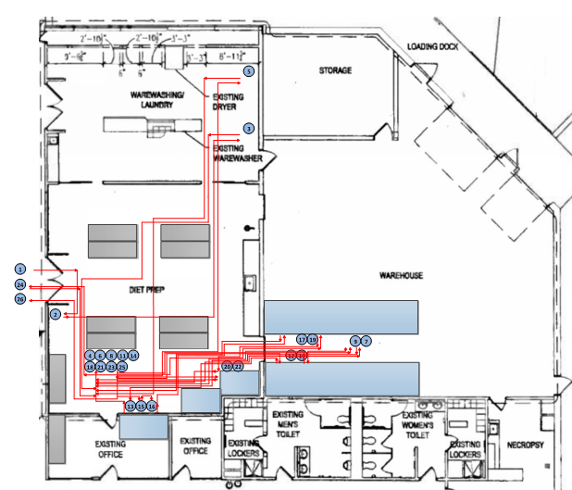
Operations Improvement (OI)
Breakdown your operations
  Do more with same
  Identify NVA opportunities
  Influence utility consumption
  Significant impact on footprint
  Design lean operations

Slide 8
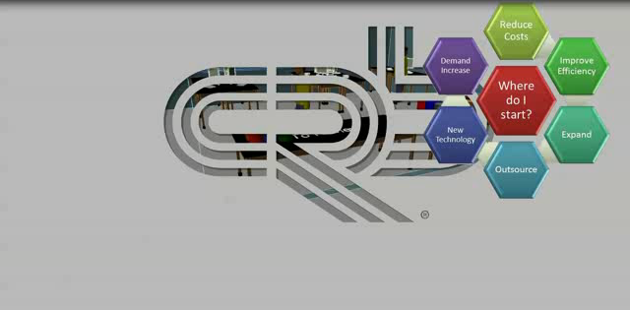
Operations Improvement (OI)
Simulate before you implement

Slide 9
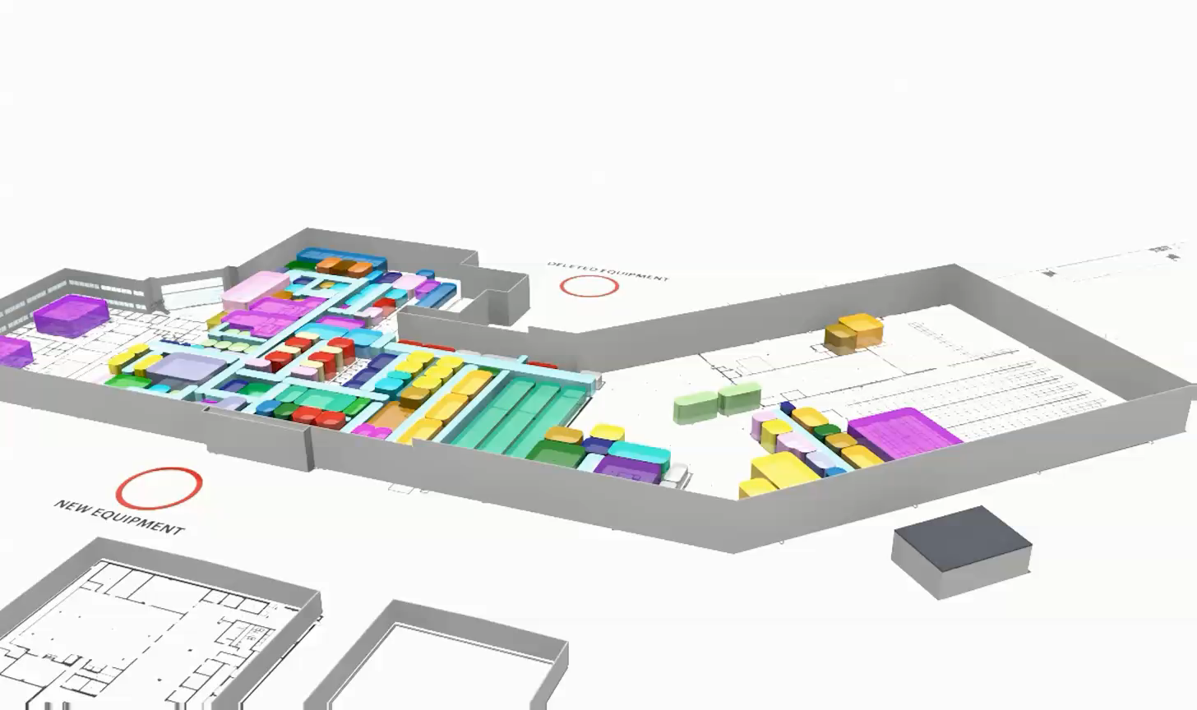
Operations Improvement (OI)

Slide 10
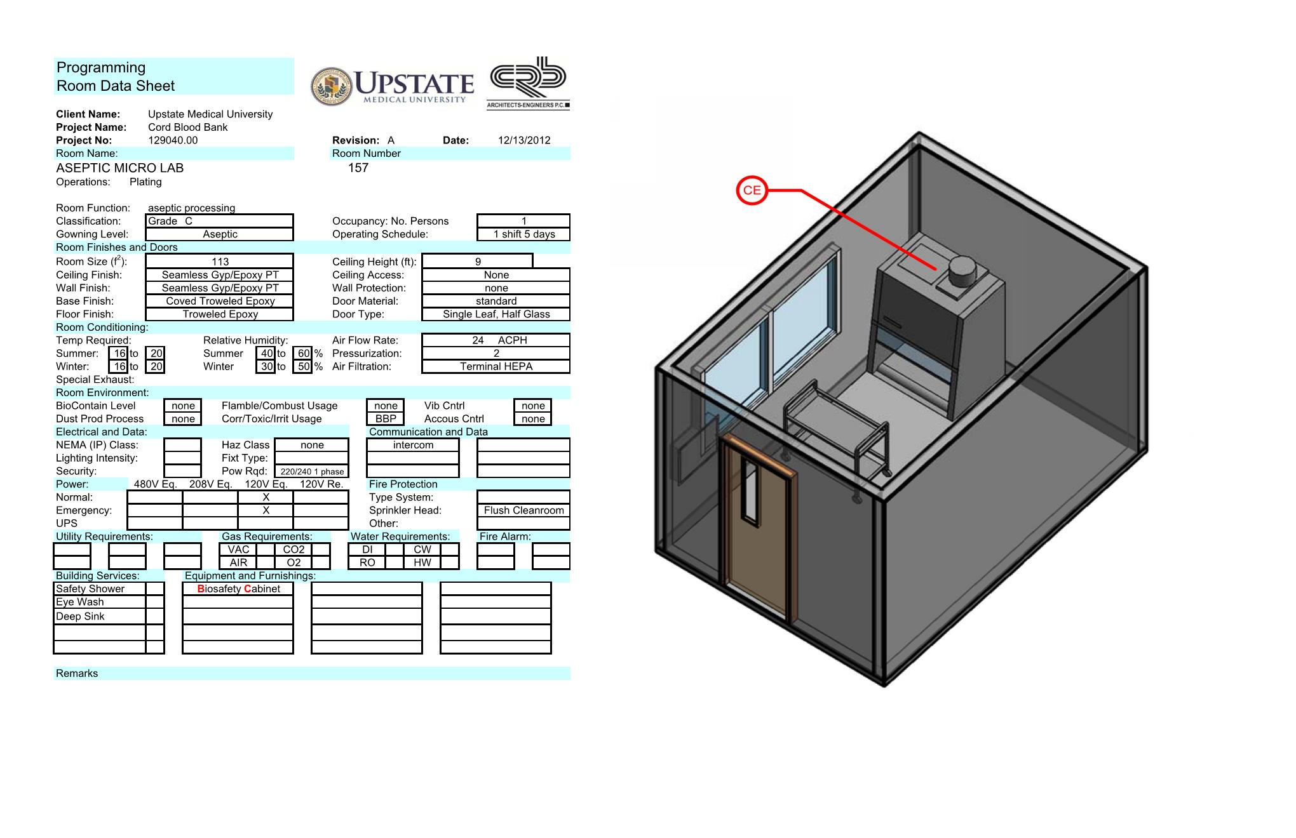
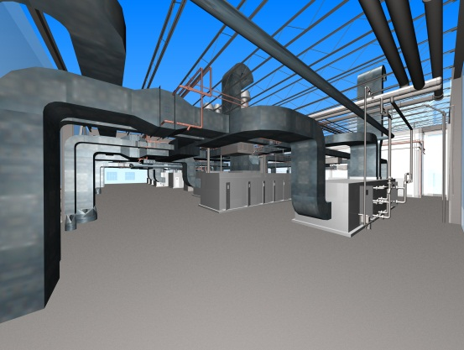
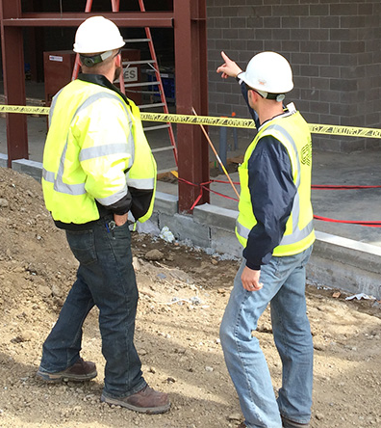
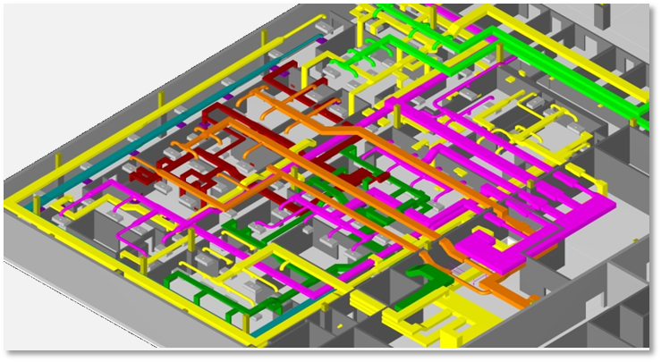
Interactive Project Delivery (IPD)
IDP
  Initial 3D Visualization
  Improved Coordination
  Lean Construction
  Facility Management

Slide 11
Interactive Project Delivery (IPD)
Opportunities for Collaborative Analysis Lead Design
Lighting Selection
Electrical Systems
Energy Model
Lighting Strategies
Building Envelope
Programming
Integrated Rainwater Harvesting
Site Design
Thermal Comfort
Water Systems
Innovative Heating and Cooling Strategies

Slide 12
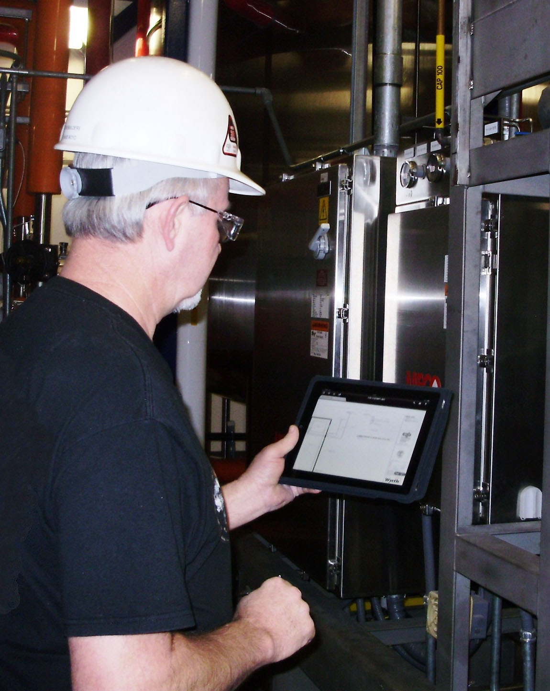
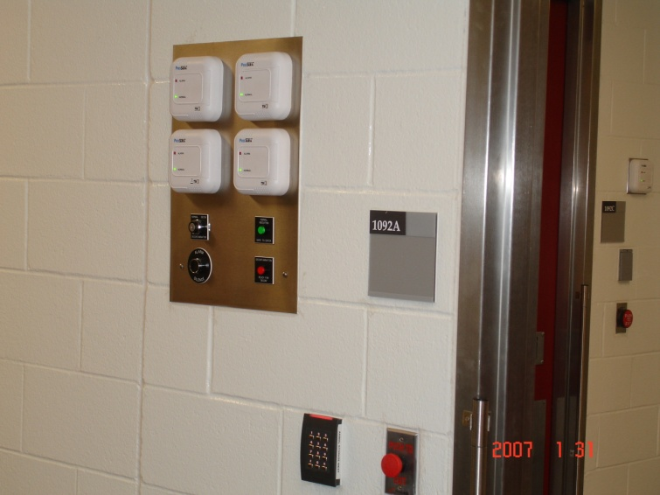
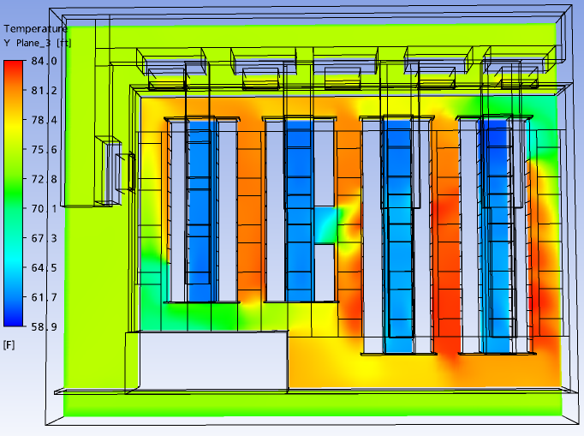
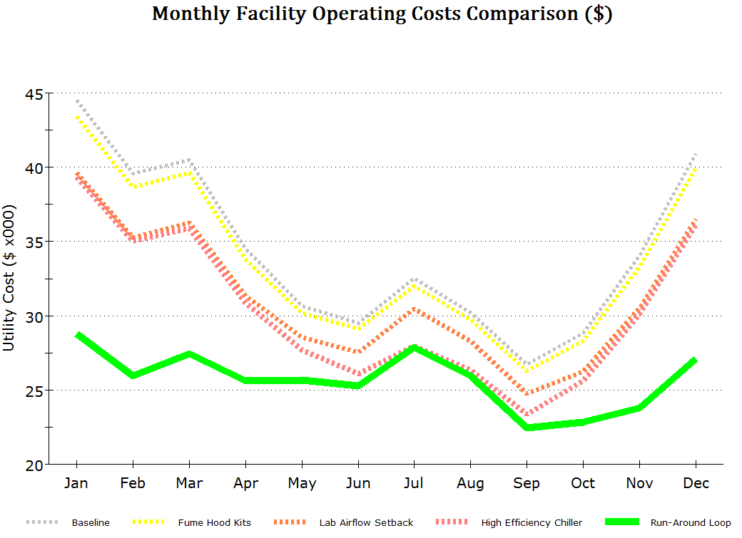
Engineering Modeling
Engineering Modeling
  Monitoring | record keeping
  Animal watering
  Lighting control
  Security
  Controls Automation
  Validation
  CFD analysis

Slide 13
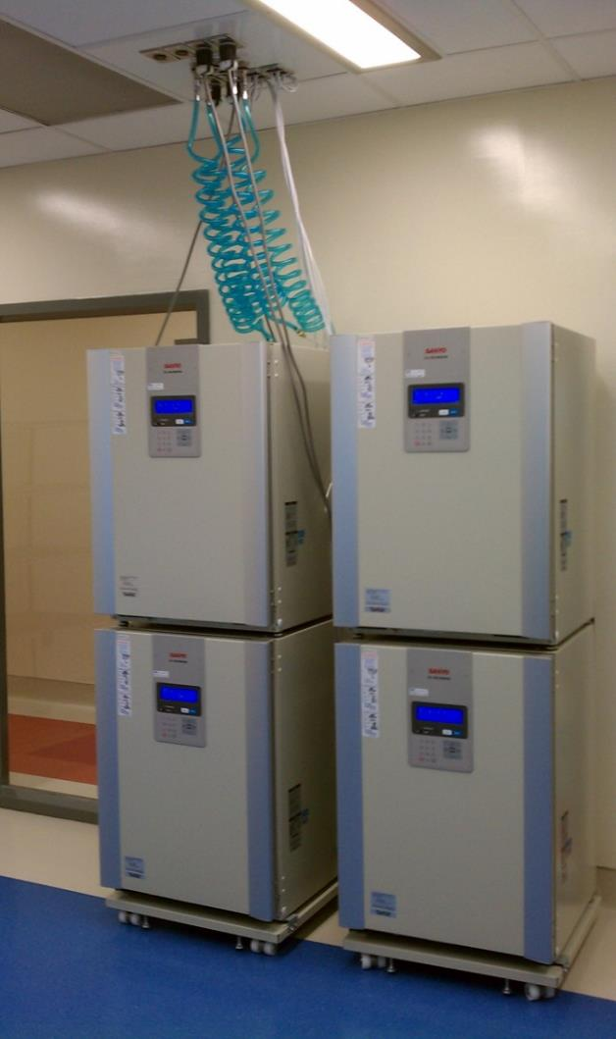
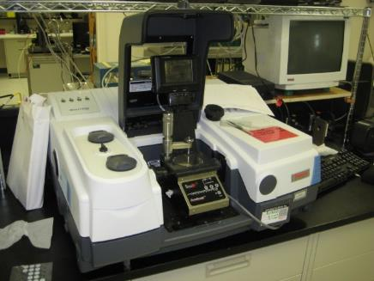
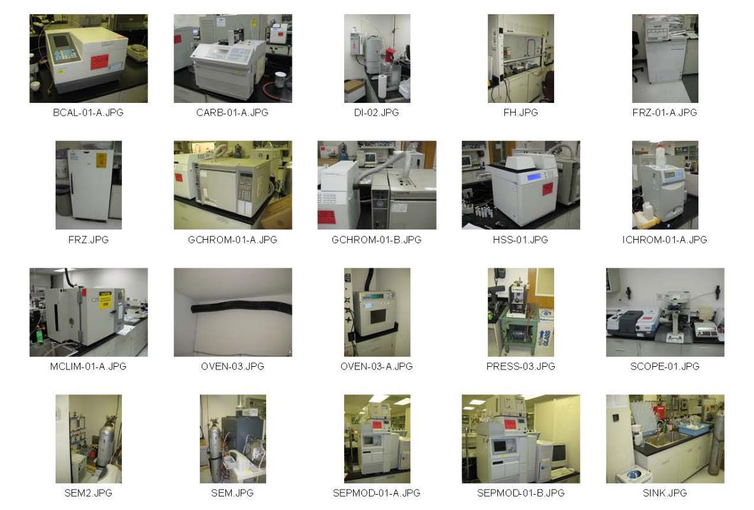
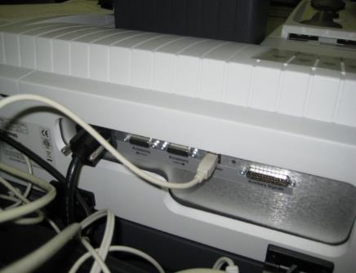
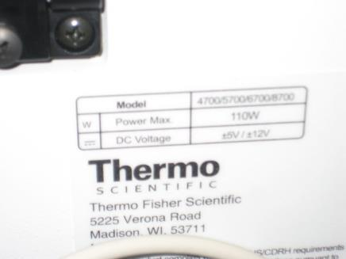
Equipment planning
Field Survey
List
MEP Requirements
Physical
  Access, Operation, Location
front
back
tag

Slide 14
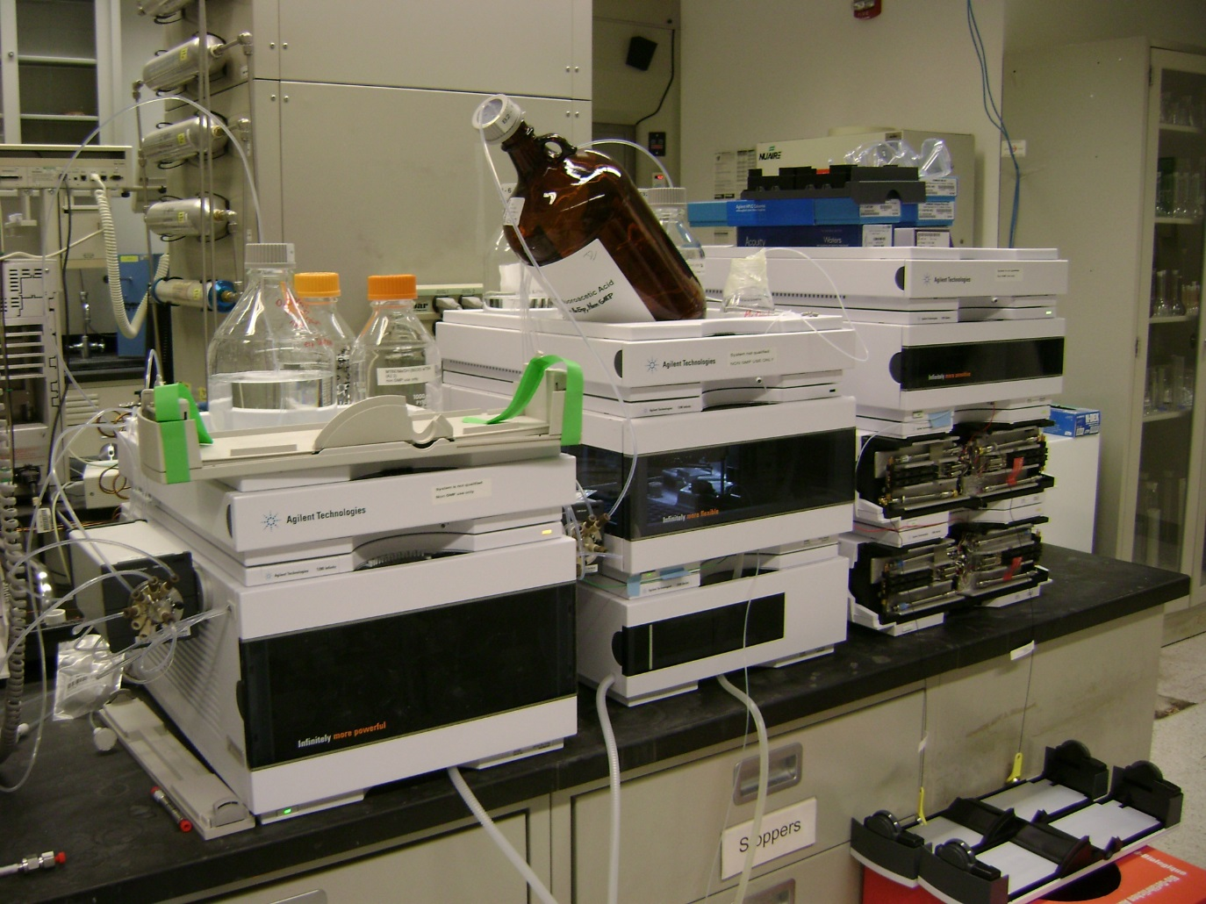
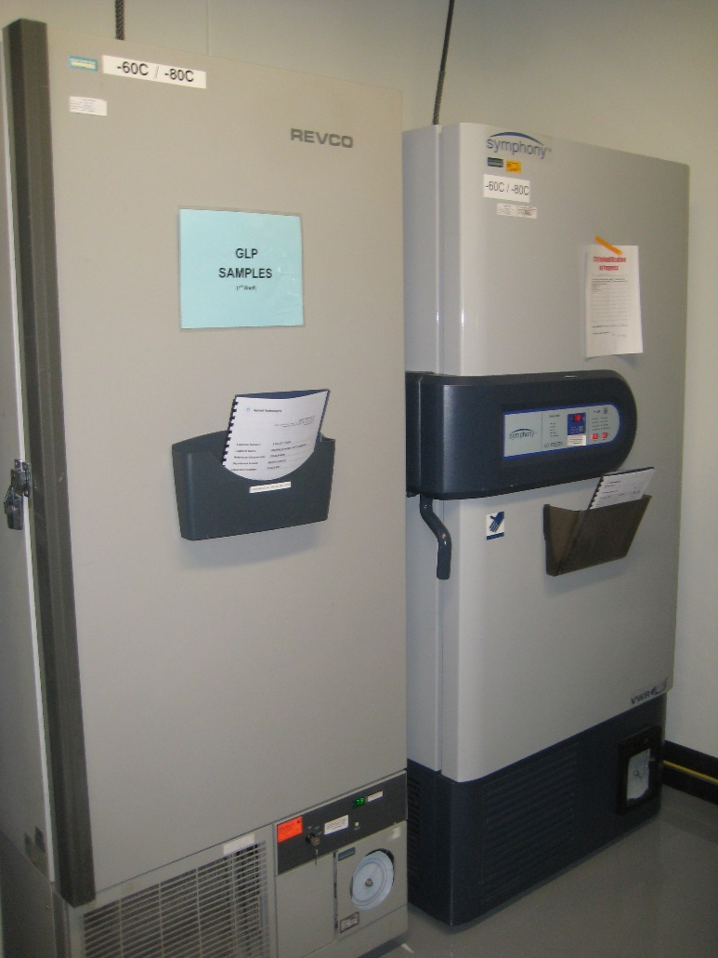

Equipment Planning – efficiency

Slide 15
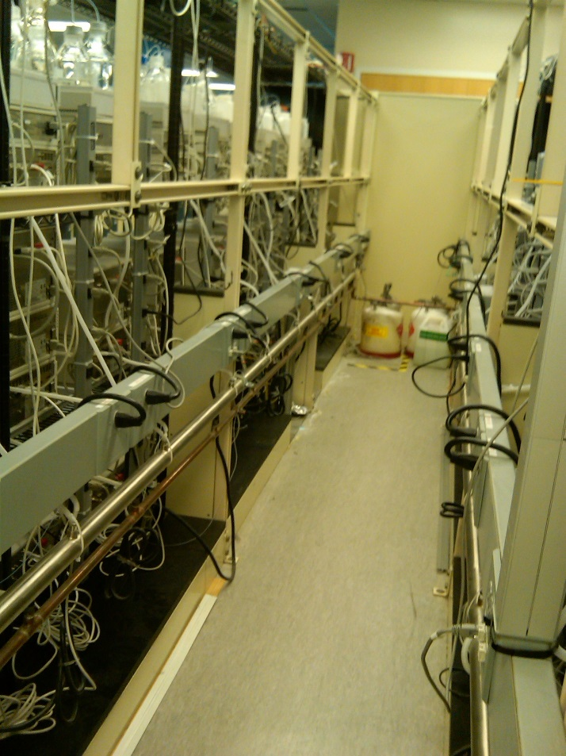
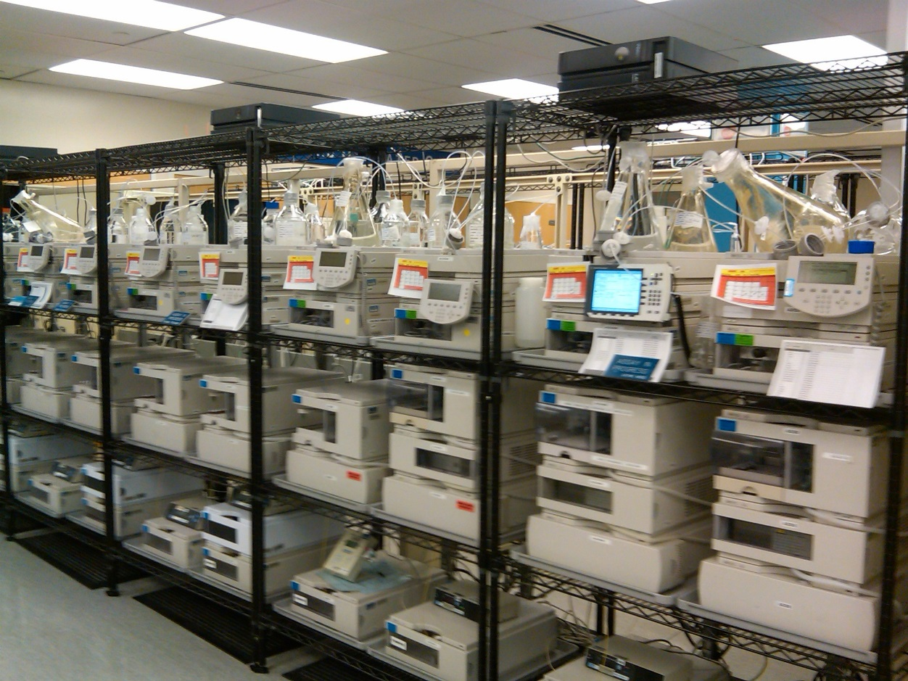
Equipment Planning – efficiency

Slide 16
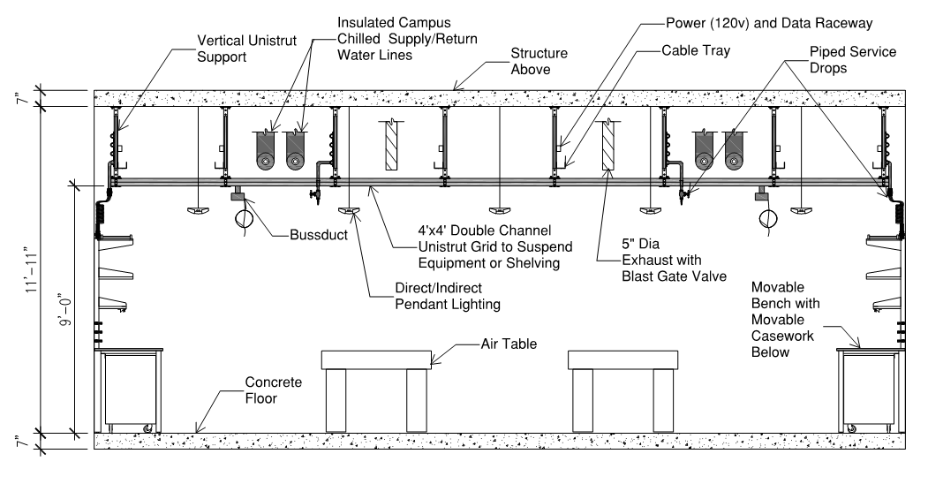
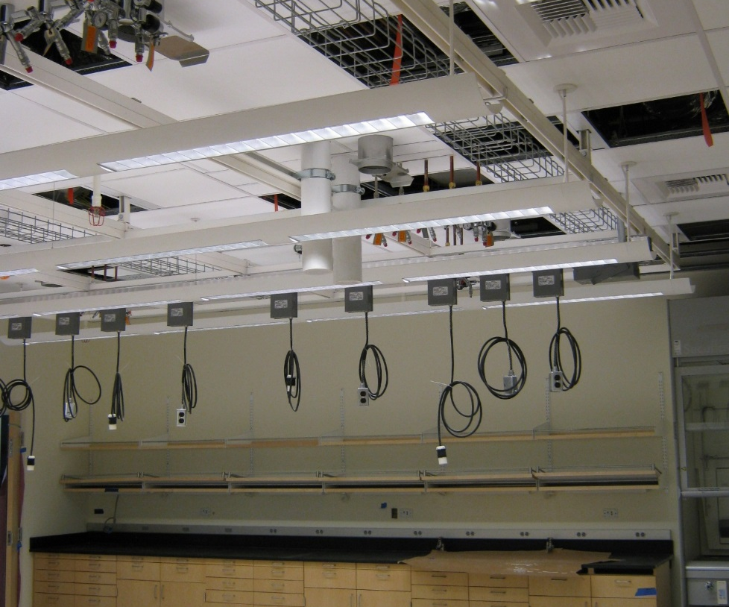
Adaptable Utilities

Slide 17
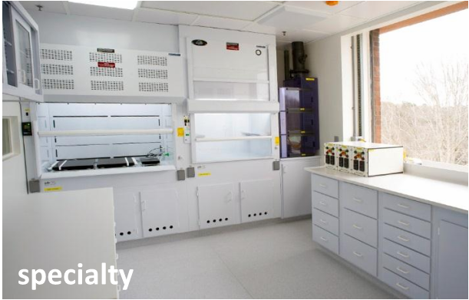
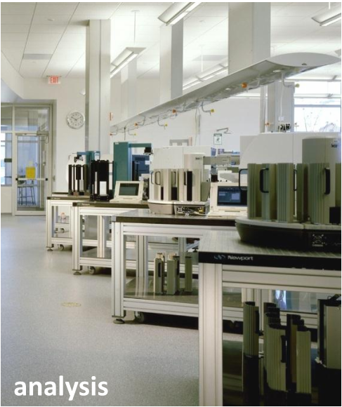

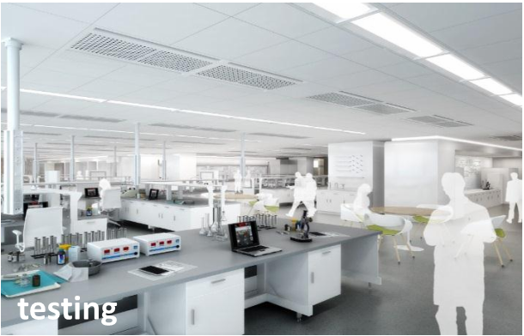
Lab Zones

Slide 18
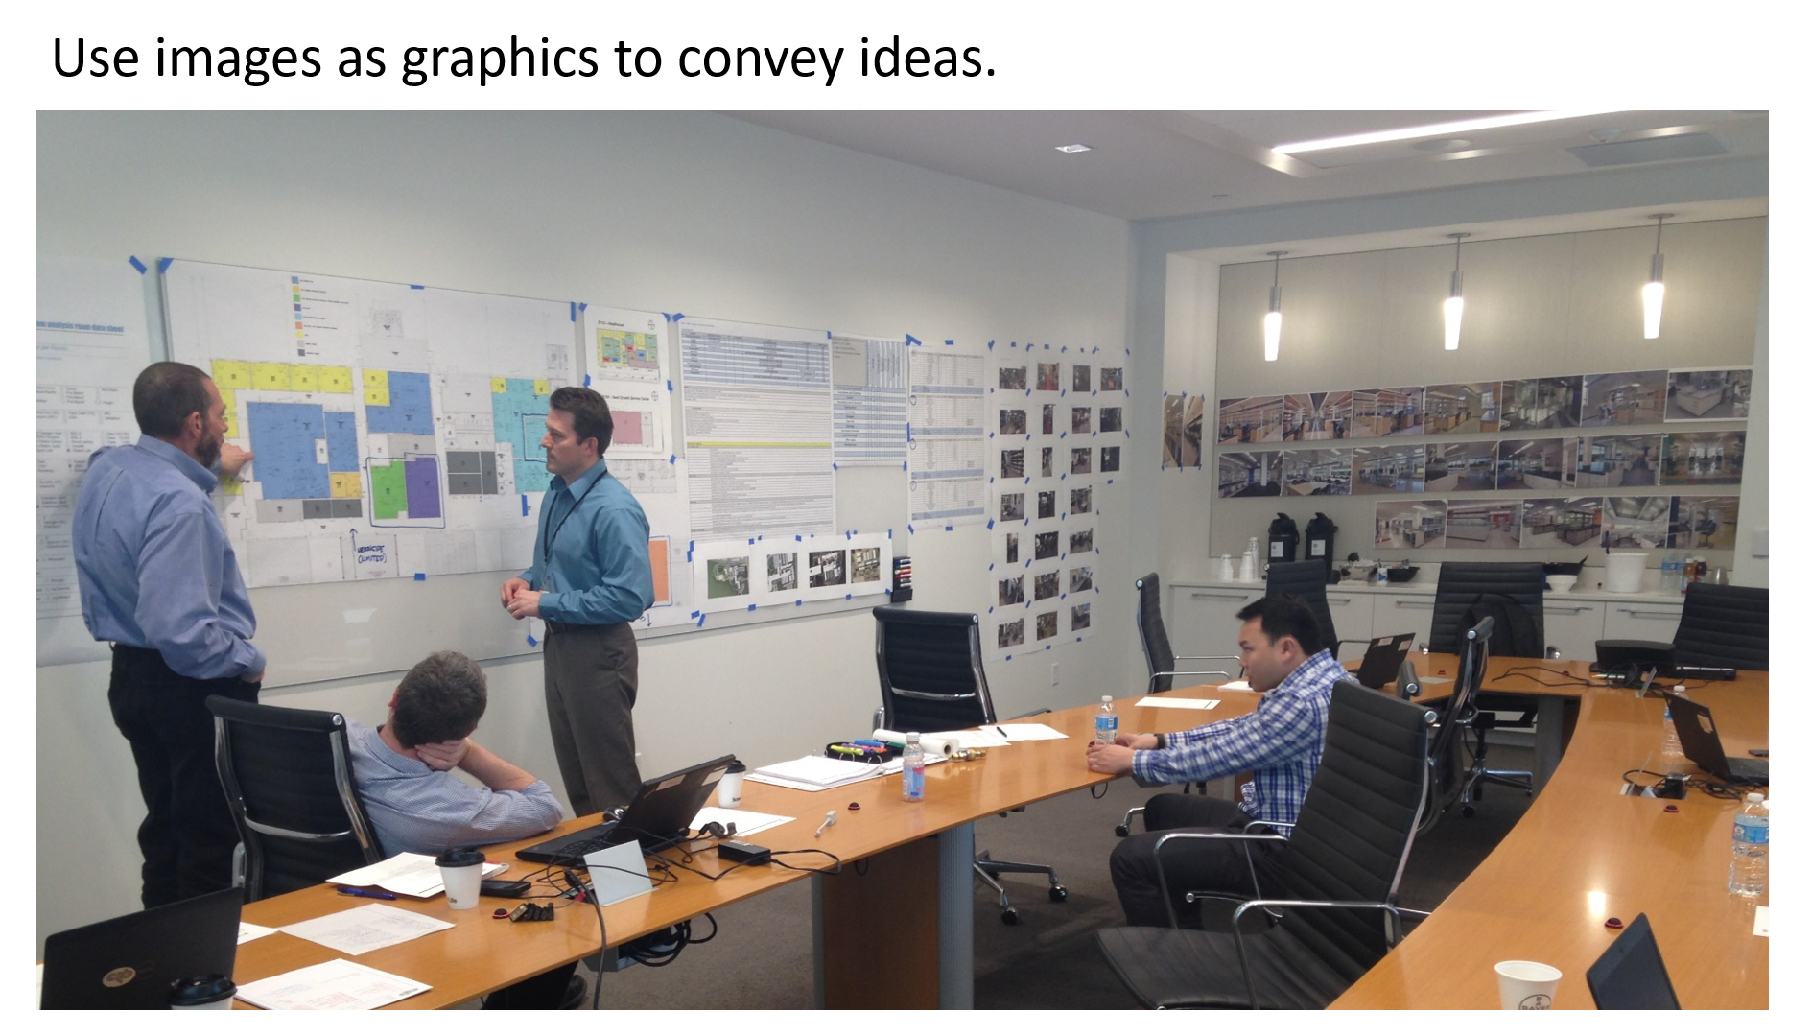
Interactive Planning

Slide 19
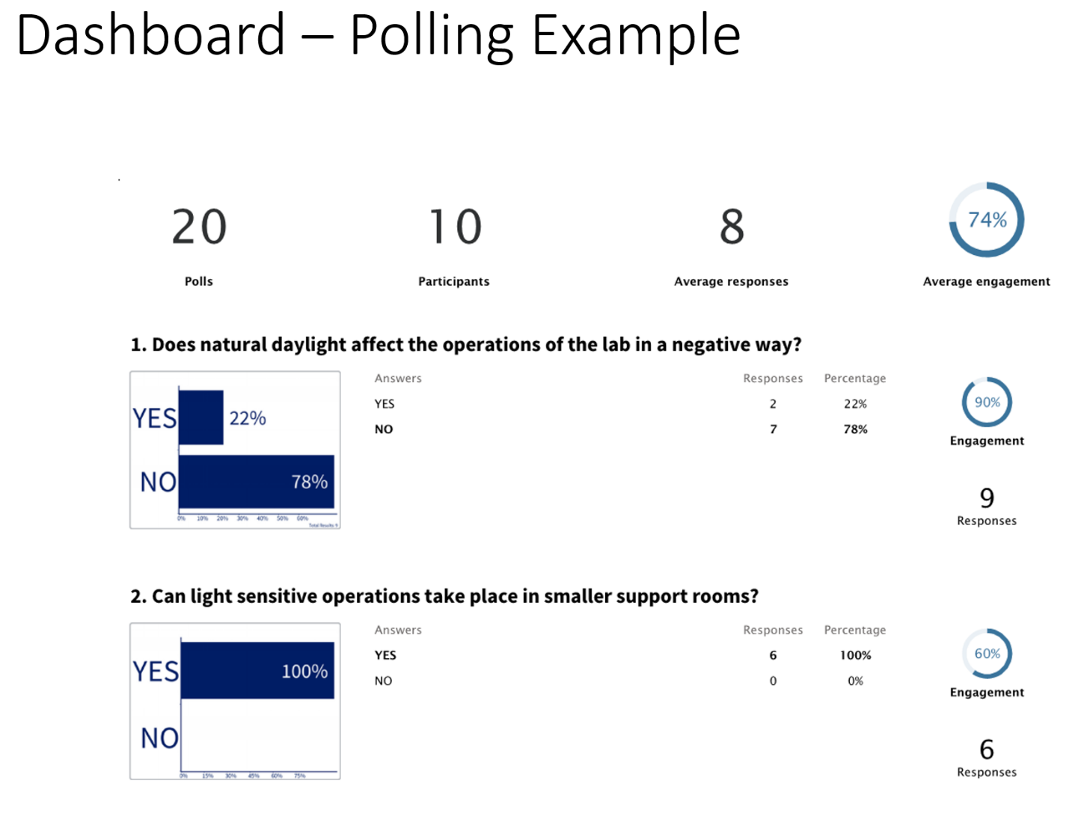
Interactive Planning

Slide 20
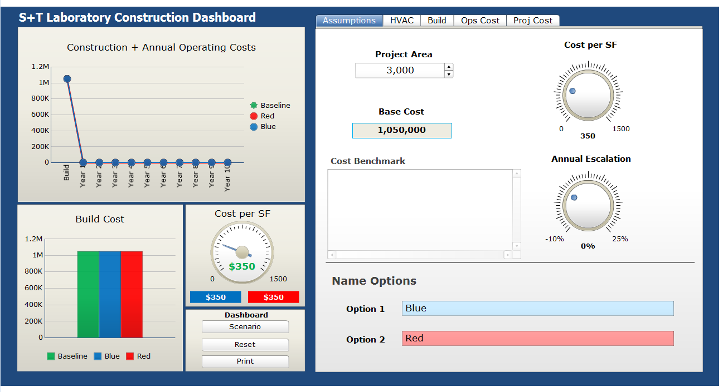
Dashboarding

Slide 21
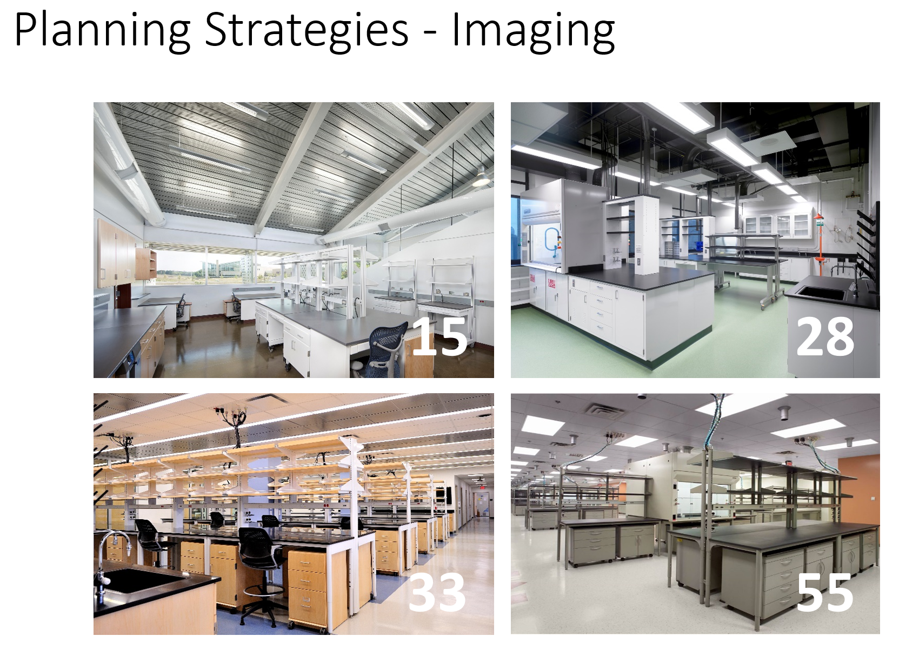
Planning Strategies

Slide 22
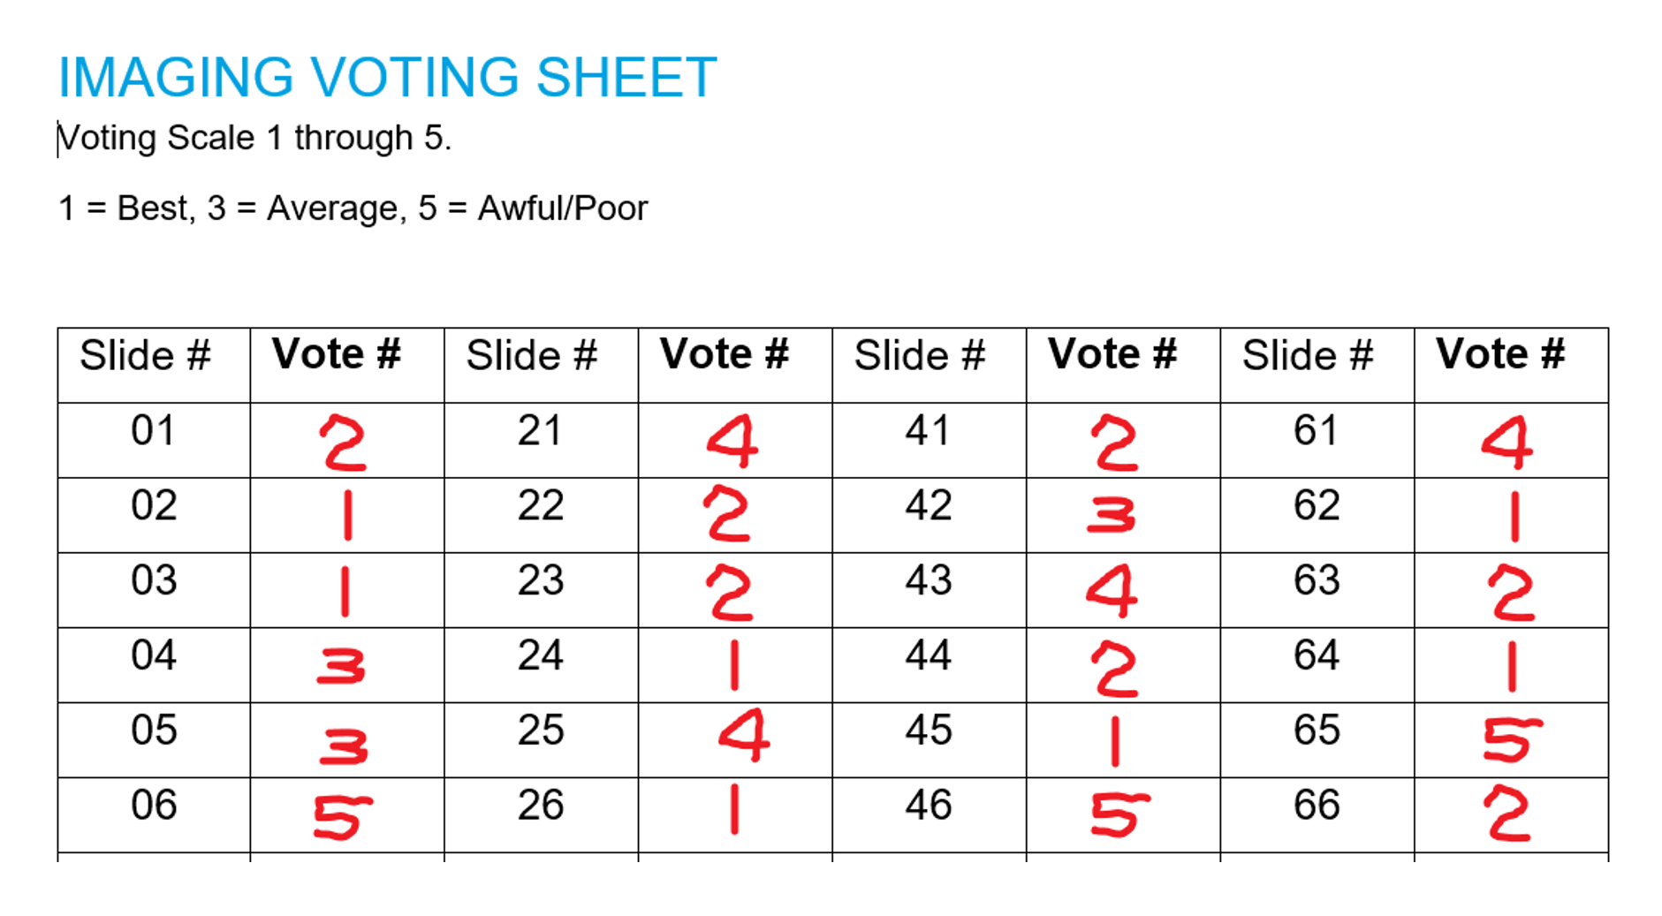
Planning Strategies

Slide 23
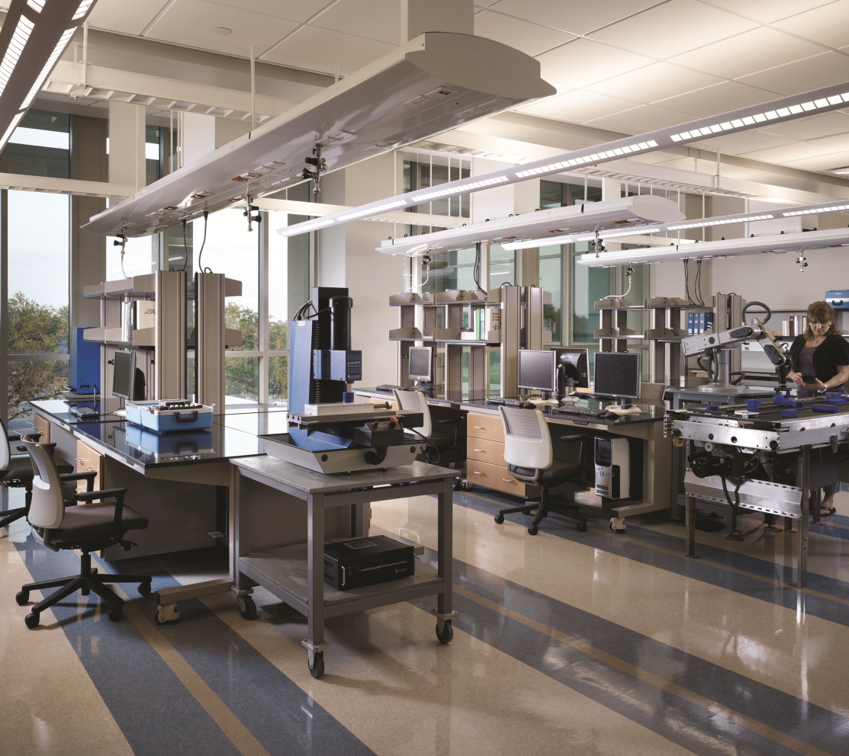

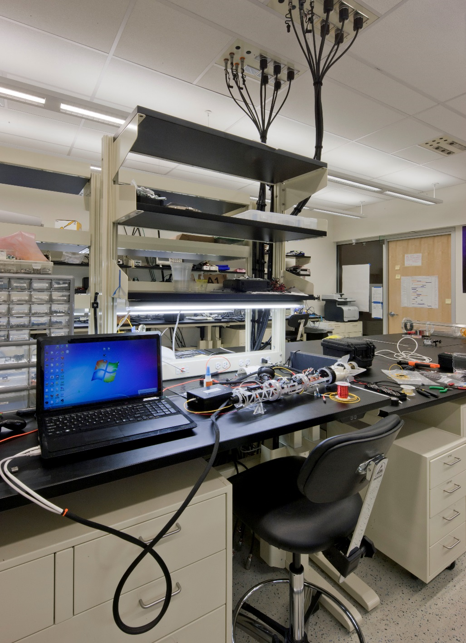
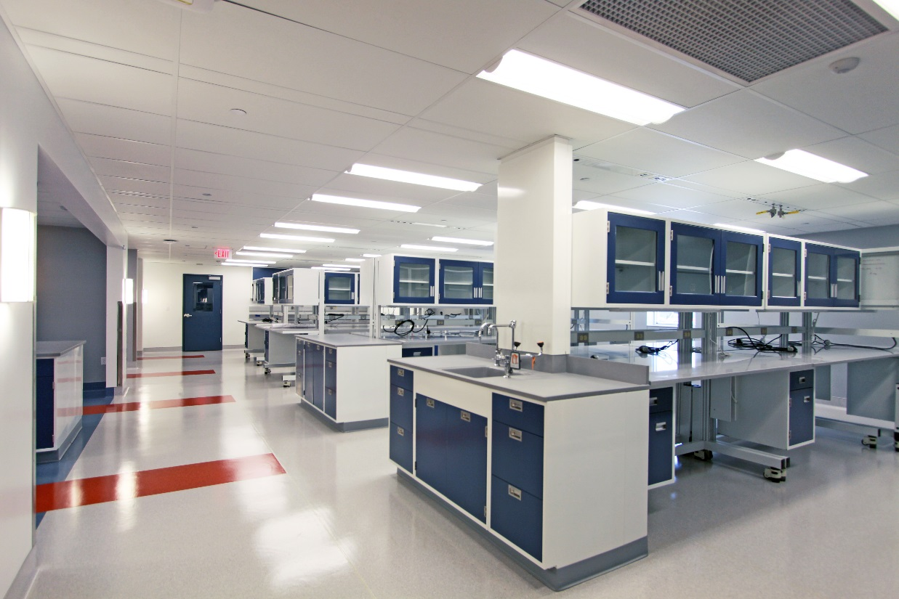
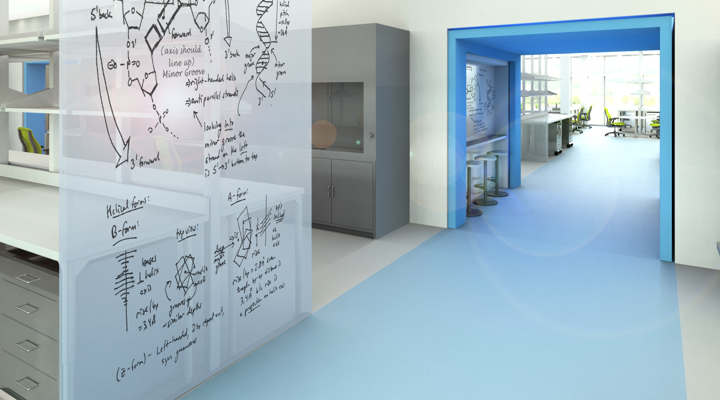
Additional Trends

Slide 24
Questions?

