Slide 1


Designing for Efficient Water Use in Lab Buildings
Why Design Teams Miss This Boat
Lyle Keck, PE, LEED AP BD+C
2017 Colorado I2SL Chapter Education Day

Slide 2
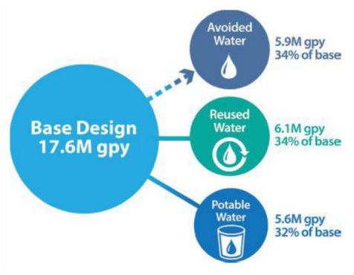
AGENDA
Drivers for Rapid Water Cost Increase
Understanding the Energy:Water Nexus
Water Use in Laboratory and Research Facilities
Total Accounting: Energy + Water
Water Modeling Tools and LEED ACP
Notes:
Miss the boat: design opportunities, total accounting of energy & water, water models to get the most out of LEED certification

Slide 3
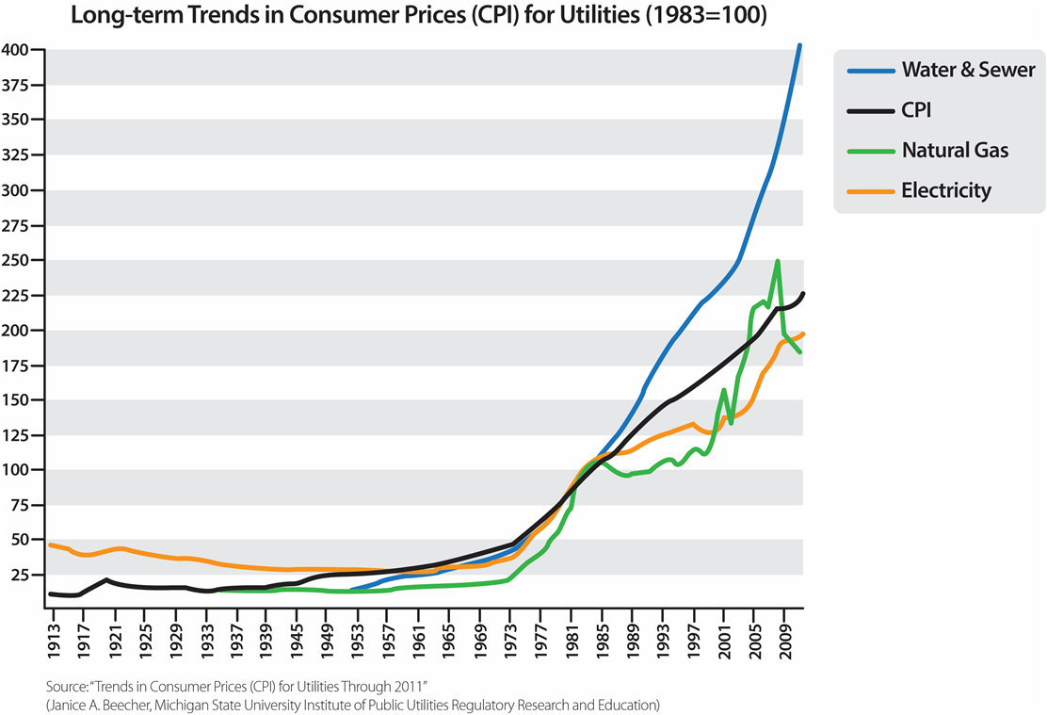
Rising cost of water & sewer
Recent national surveys show average increases in water/sewer rates in the US range between 7% and 9% per annum
Notes:
Gas & electricity in the 2%-4% range, maybe lower

Slide 4
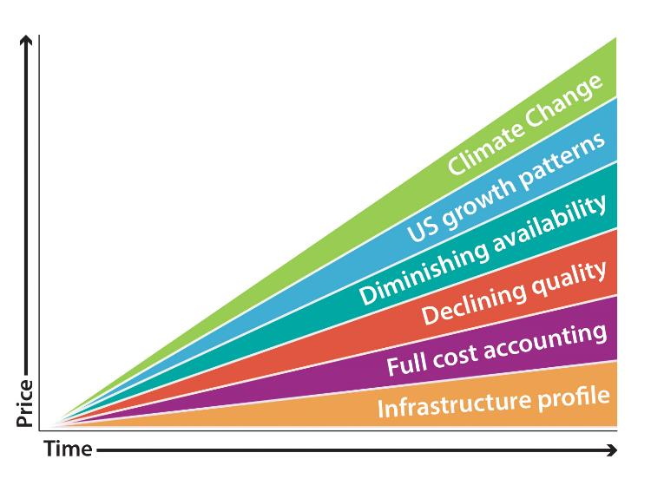
Drivers for rapid increase in water cost
Notes:
Aging and crumbling infrastructure, declining quality (FLINT), increased demand, full cost accounting to make up for lack of investment over the past years & decades

Slide 5
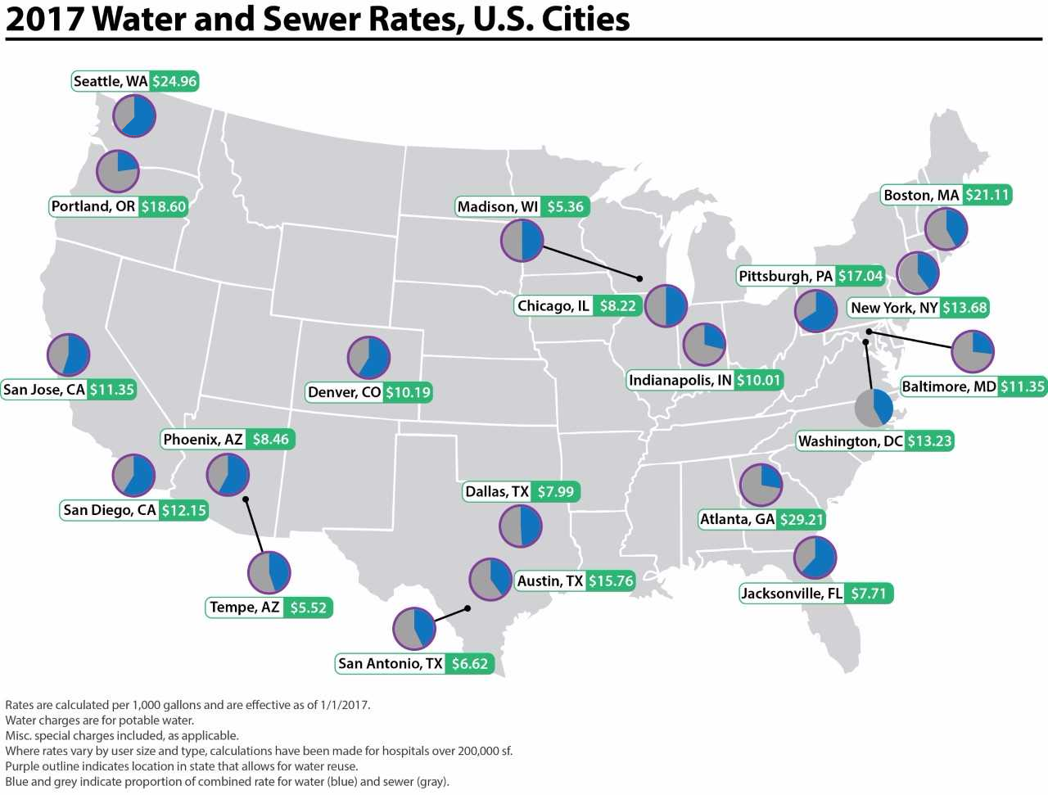
LOCAL UNDERSTANDING - Results may vary
Notes:
Water issues & correlation to cost are extremely local issue.
Climate, geography, policy, infrastructure all have different impacts on availability & cost of water/sewer

Slide 6
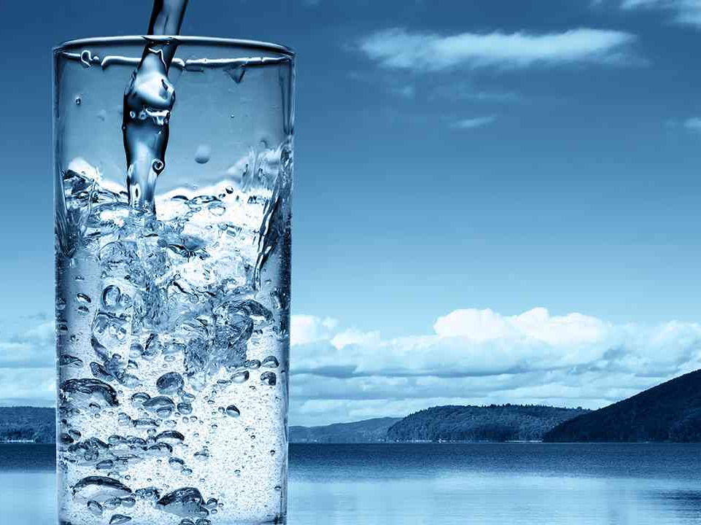

Notes:
Energy and water are intrinsically tied together

Slide 7
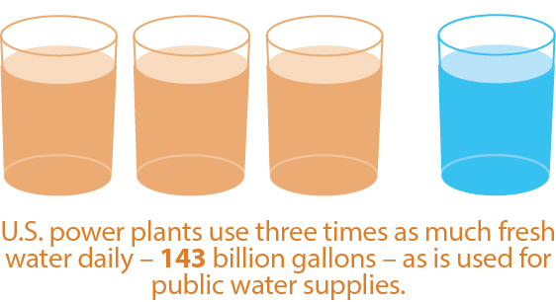
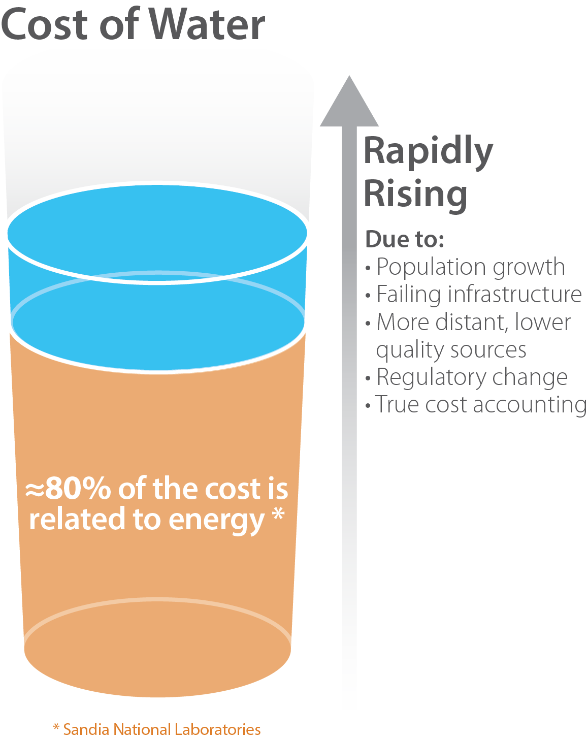
Energy:water NEXUS – utility scale
WATER for ENERGY
Notes:
Use refers to withdrawal, in some cases water is returned to source but may have environmental impacts.
Figure slightly outdated (2011) – current ratio is closer to 4:1

Slide 8
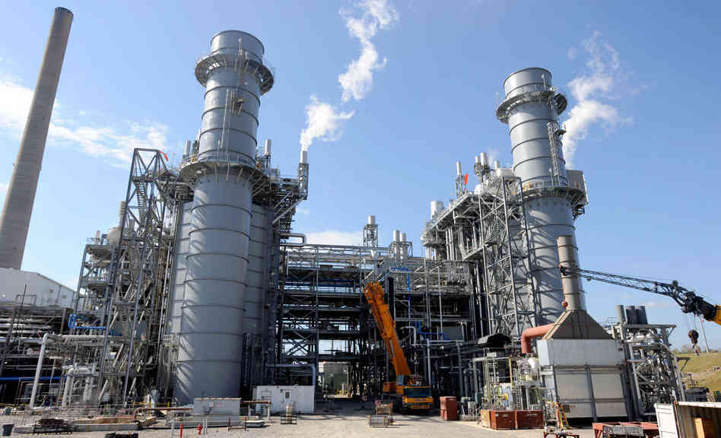
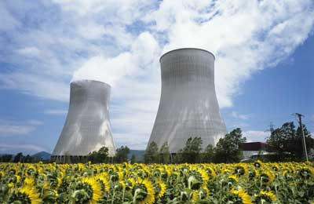
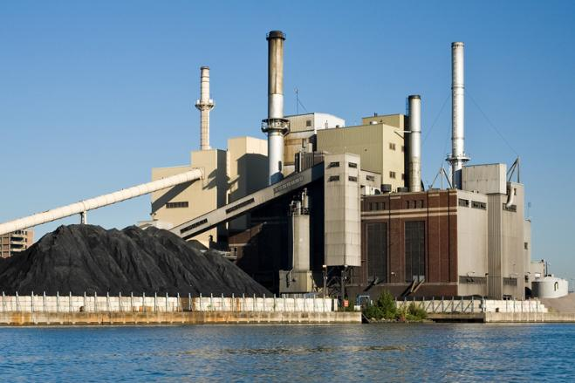
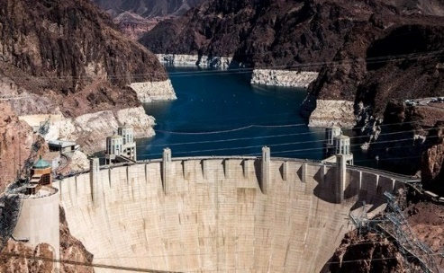
Energy:water NEXUS – utility scale
35 gal/kWh¹
44 gal/kWh¹
Natural Gas
Nuclear
Coal
Hydroelectric
36 gal/kWh¹
65 gal/kWh²
¹ Macknick et al. 2011
² UNESCO-IHE 2011
Notes:
Numbers vary by technology and location but hydro is by far the worst offender.
A tremendous amount of water is also ‘consumed’ meaning evaporated into the atmosphere for heat rejection. It may be part of the natural water cycle but it is not available for use when needed, droughts.

Slide 9
Energy:water NEXUS – utility scale
ENERGY for WATER
Notes:
Large costs associated with conveyance and treatment of water.
Longer distances, lower quality, increased loss and leakage.
Embodied energy in different sources.

Slide 10
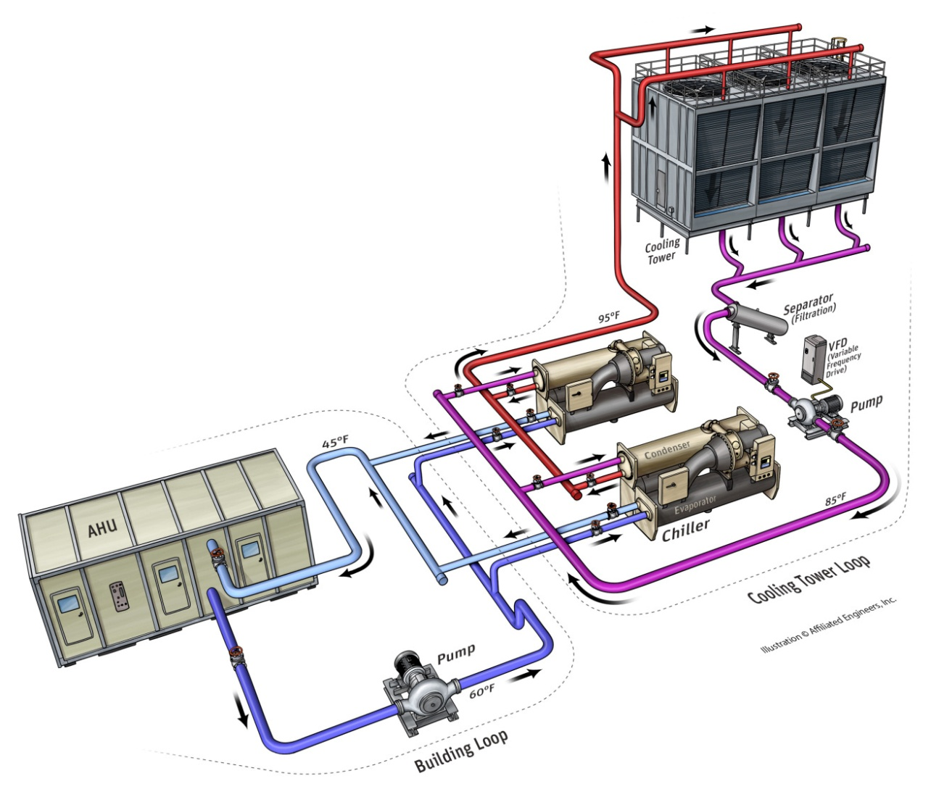
Energy:water NEXUS – Building SCALE
Heat rejection (cooling tower)
Notes:
Transition from utility scale to building scale.
Cooling towers consume water to produce mechanical cooling. Evaporation plus blowdown. 1.8 gal/ton-hr is a good design metric.

Slide 11
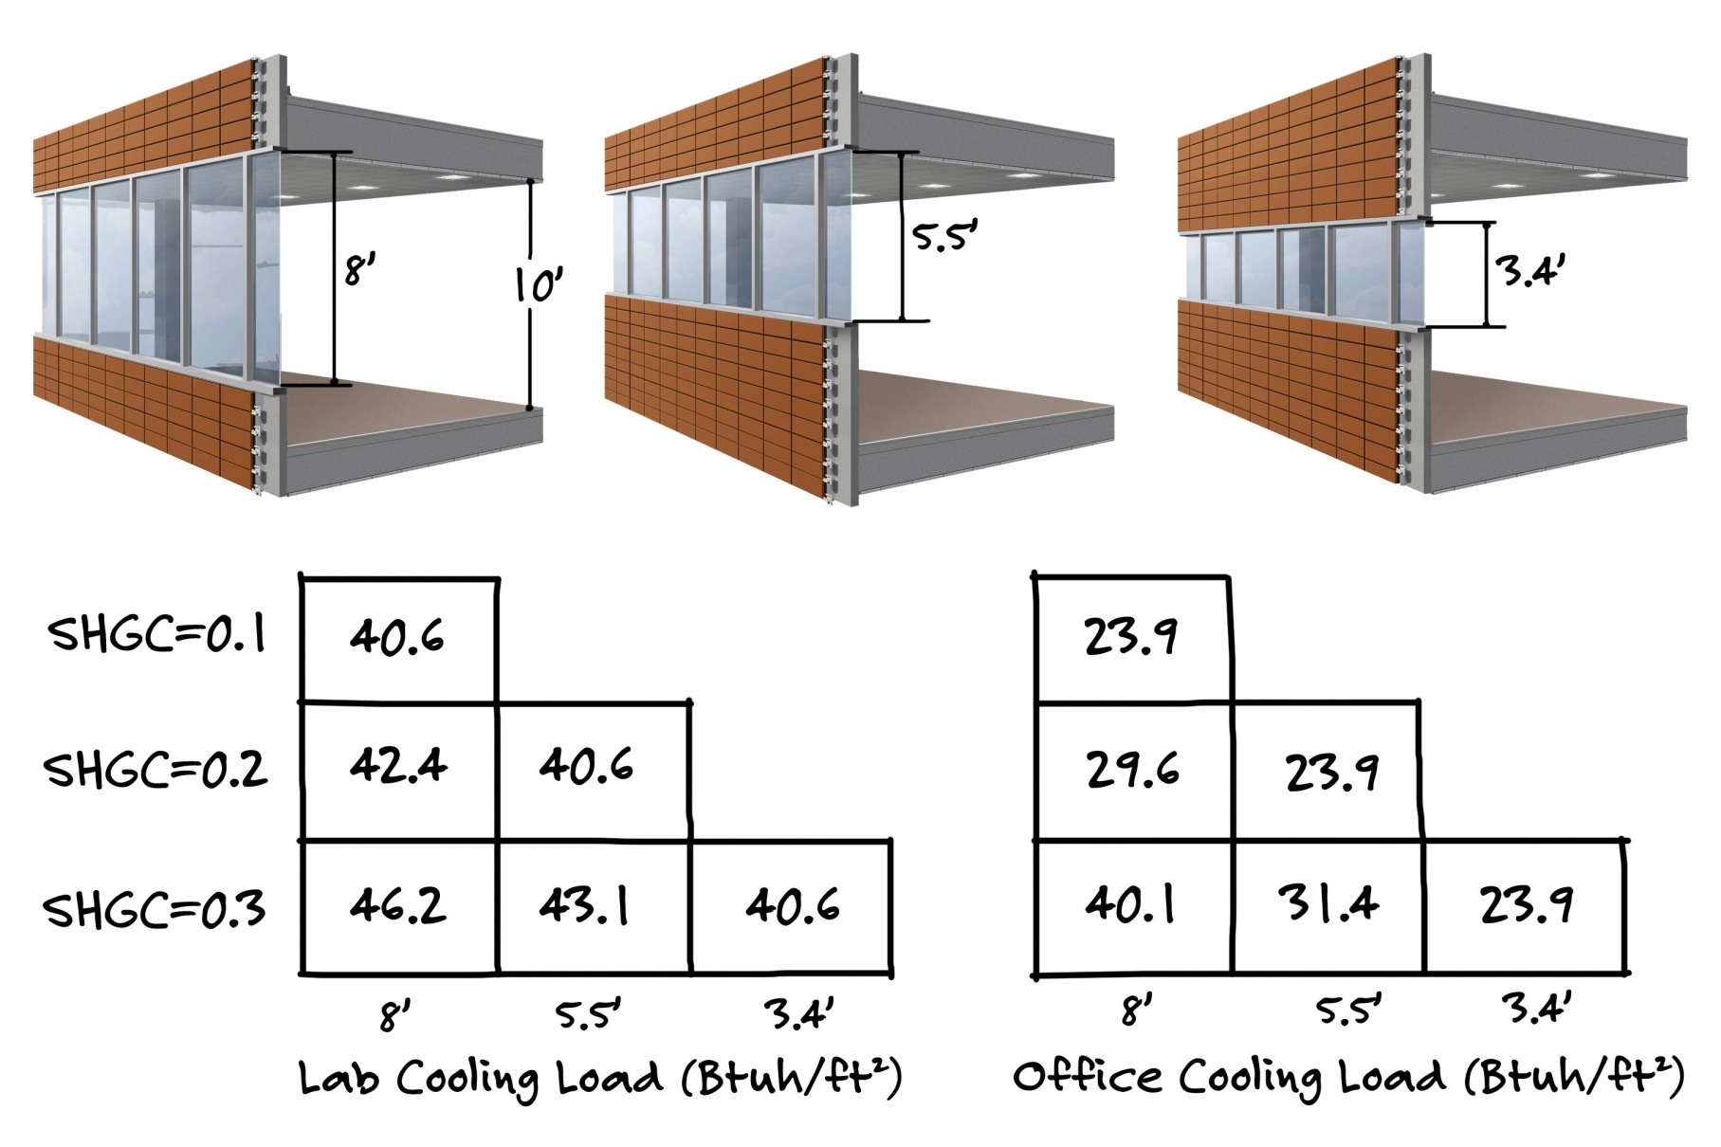
ENERGY:WATER NEXUS – FAÇADE ANALYSIS
Notes:
Matrix of SHGC vs. window area to understand the relationship between cooling load and HVAC energy consumption.
Lab is more internal load driven while office is more envelope driven. Common lab and research facilities have a mix of both programs.

Slide 12
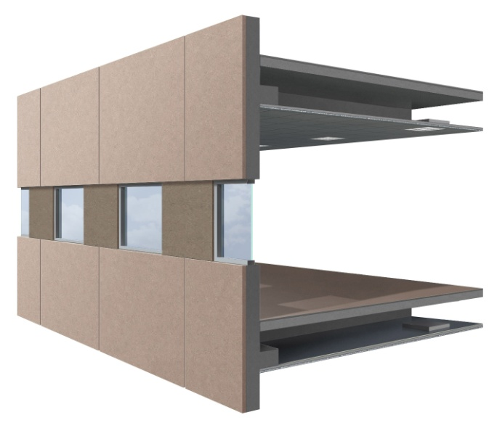
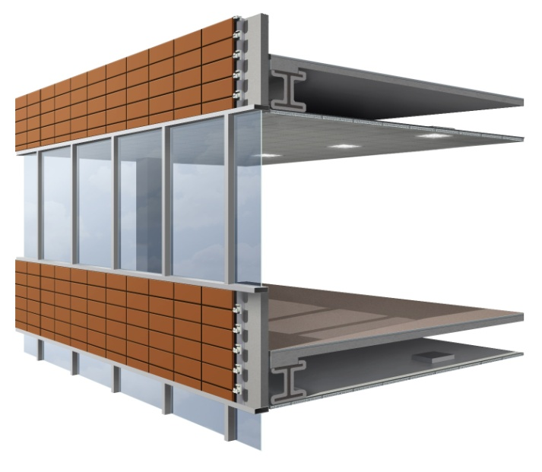
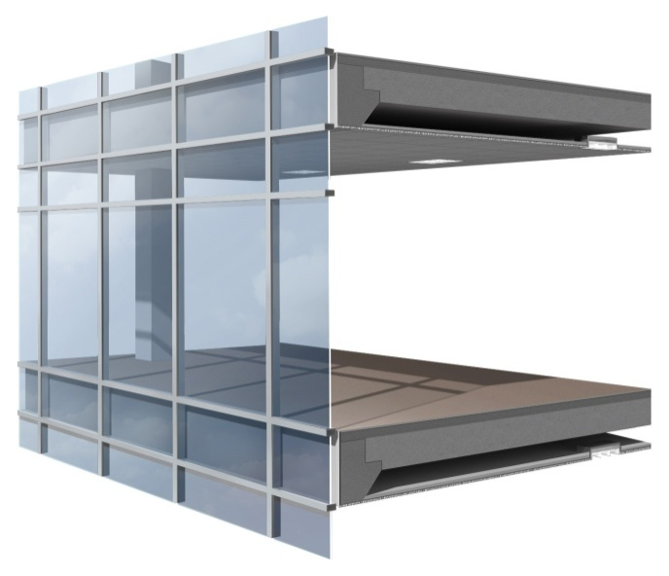
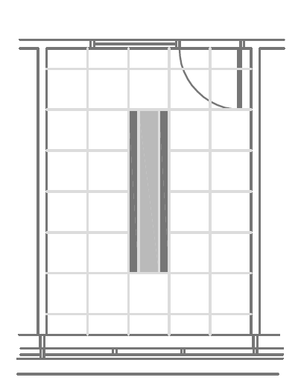
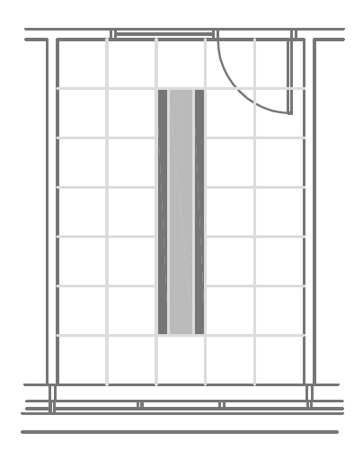
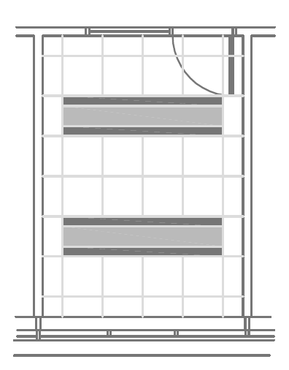
ENERGY:WATER NEXUS – FAÇADE ANALYSIS
Notes:
Engineers may visualize quantatative metrics, architects and other project members may visualize more spatially (area of chilled beam coverage)
Higher peak load means more air, chilled beams, radiant panels, etc. Can easily drive up HVAC system cost when loads go up…at zone level, potentially at AHU and chiller/boiler level…and all of this impacts electrical sizing

Slide 13


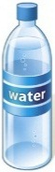
CASE STUDY: GLAZING AREA REDUCTION
For every 10 SF decrease in glass area
Site Water decreases by 3 L/day
Notes:
Water-cooled chiller is typical heat rejection for large commercial buildings across the US.

Slide 14
CASE STUDY: GLAZING AREA REDUCTION
For every 10 SF decrease in glass area
Source Water decreases by 16 L/day
Notes:
When considering inefficient electricity production at the utility, the power plant consumes a tremendous amount of water

Slide 15
ENERGY:WATER NEXUS – INTERNAL LOADS
Plug Loads
(Indirect)
5-35%
Notes:
When designing high performance facilities, internal plug loads start to become a greater piece of the overall energy pie.
In addition to the energy consumed by the equipment itself (direct energy), there is a large portion of (indirect) energy associated with the HVAC space conditioning require (cooling, fans, pumps, etc.)

Slide 16
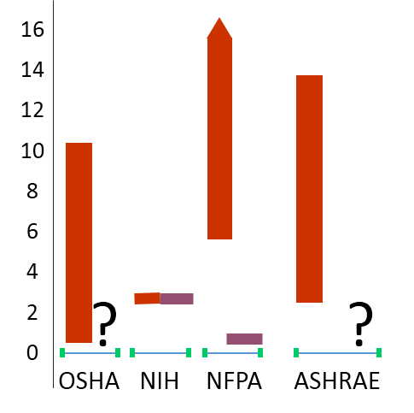
ENERGY:WATER NEXUS – OA CONDITIONING
Ventilation and exhaust requirements
ACH
  Air Quantity Standards
  Exhaust Requirements
  (fume hoods, BSCs)
Notes:
Increased ventilation rates and exhaust requirements drive up the amount of energy and cooling required for OA conditioning.
Establish proper criteria, look for unoccupied setbacks and demand controlled opportunities (occupancy based or contaminant based), many fume hood opportunities (low-flow, auto sash, etc.)

Slide 17
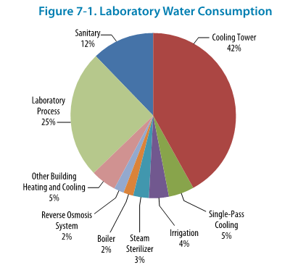
Water use in lab & research facilities
[USEPA]
Notes:
Transition from energy:water nexus to water use in lab & research facilities.
Cooling tower is the largest end-use because of internal load dominated program – opportunities to use heat recovery chillers, air-cooled chillers, fluid coolers, etc.
Beyond that lab equipment and process (also RO, steam sterilizers) is the next largest user – let’s explore a few design opportunities to reduce water consumption here.

Slide 18
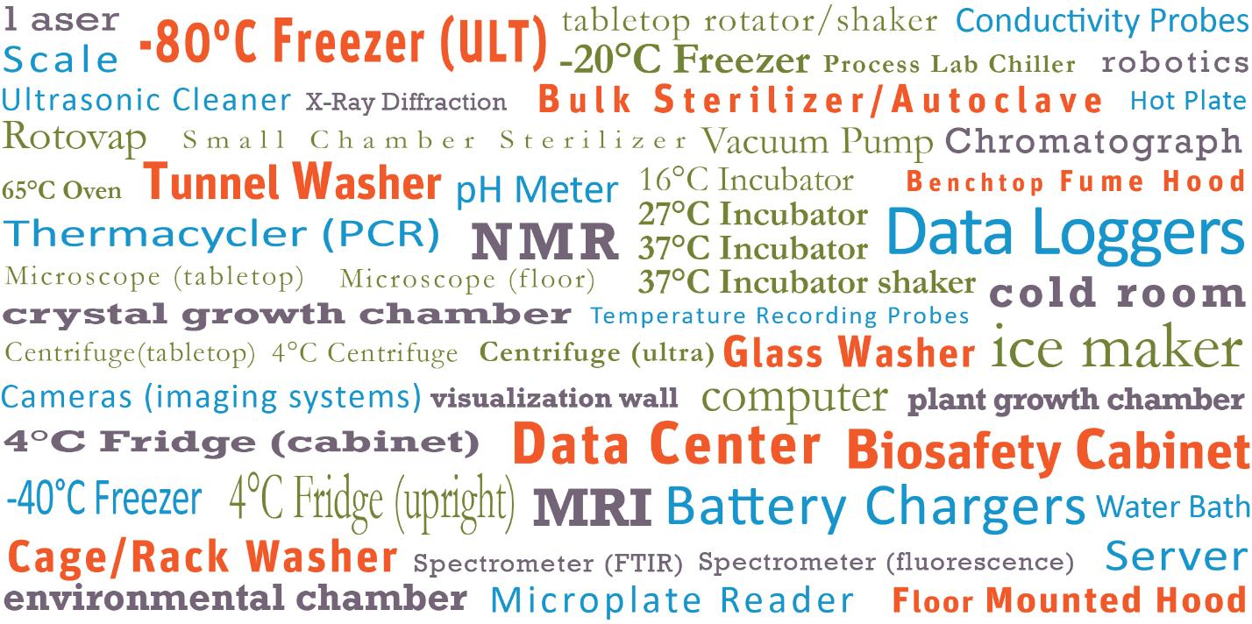
Water use in lab & research facilities
Notes:
Tremendous range of equipment in laboratory environment

Slide 19
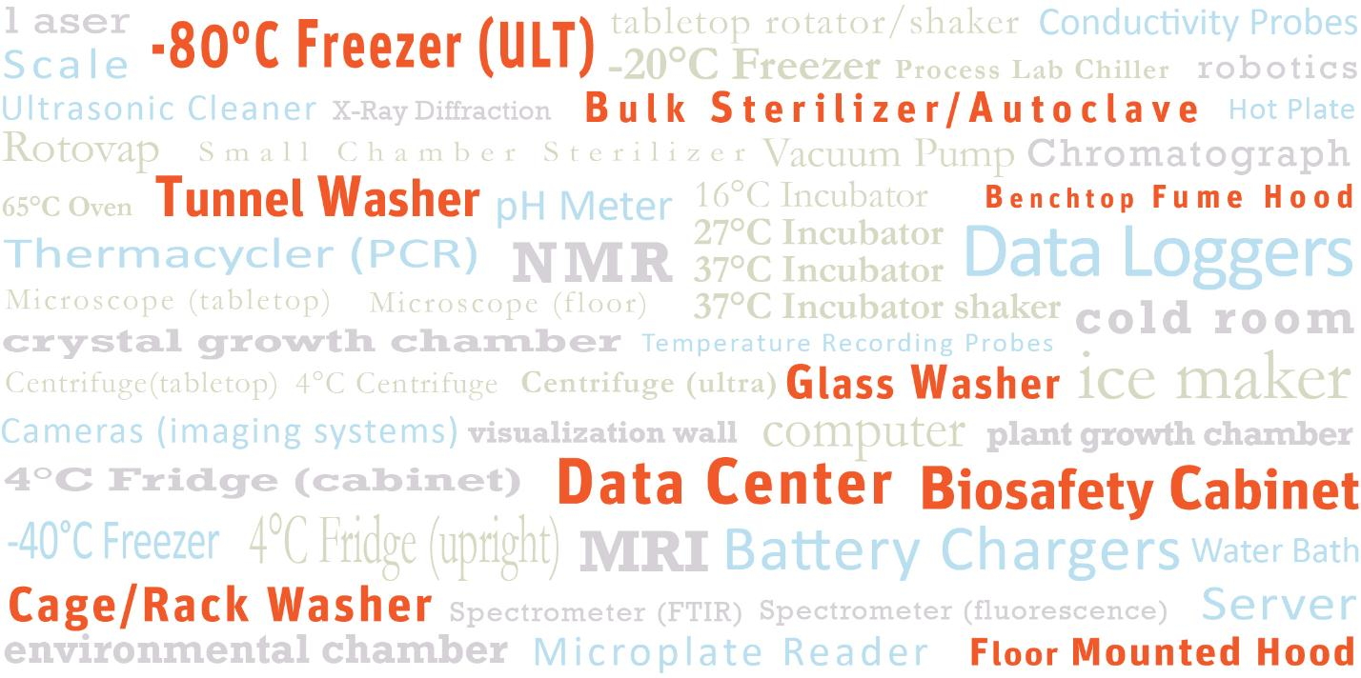
Water use in lab & research facilities
Notes:
Let’s focus on some of the equipment with the largest water (and energy) consumption

Slide 20
Water use in lab & research facilities
Notes:
-80 Ultra Low Temperature freezers are one of the most energy demanding pieces of equipment.

Slide 21
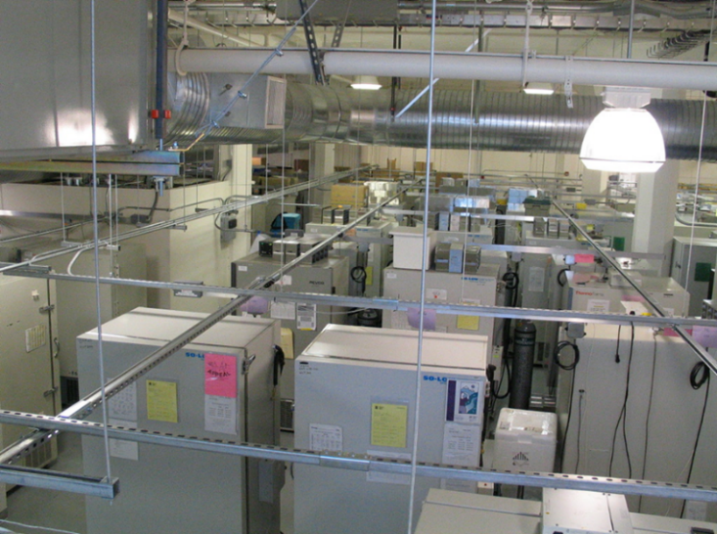
Water use in lab & research facilities
Notes:
Freezer farms & lab equipment corridors.

Slide 22
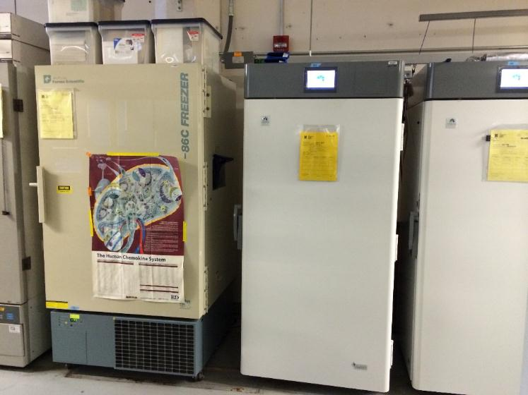
Stirling Engine (ULT) Freezers
Early Adopters
  Fred Hutch
  Roche
  Harvard
  Duke
  UC Davis
Institutional Approach
  New
  Selective Replacement
  Loaners
Notes:
Stirling cycle is a highly efficient thermodynamic cycle that uses a free-piston Stirling cooling engine – helium is cyclically expanded & compressed (not compressor based and does not use liquid nitrogen or conventional cascade refrigeration)

Slide 23
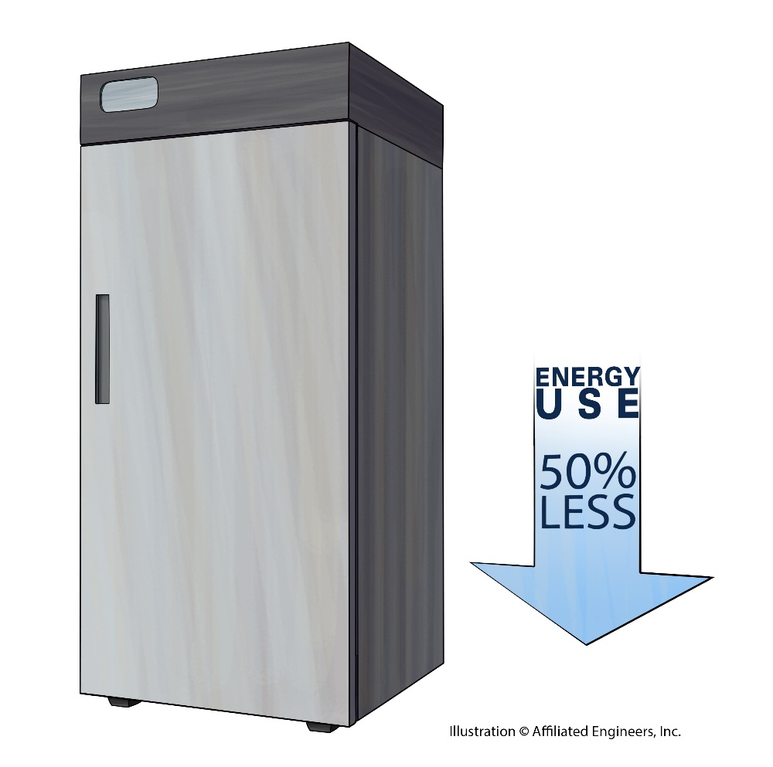
Stirling Engine (ULT) FREEZER Benefits
50-60% energy savings
Water conservation through reduced cooling load
Opportunity to downsize mechanical and electrical systems
Space efficient
Quiet
Range of 120/208V
Wide temperature range:
-20C to -95C (-4F to -139F)
Less refrigerant
Ethane refrigerant
Less standby power
Notes:
Because traditional ULT freezers are some of the worst energy hogs, Stirling ULTs offer significant energy savings and thus give off MUCH lower heat – significantly reducing the internal cooling load of equipment dense spaces.

Slide 24
Water use in lab & research facilities
Notes:
Wash & sterilization equipment

Slide 25
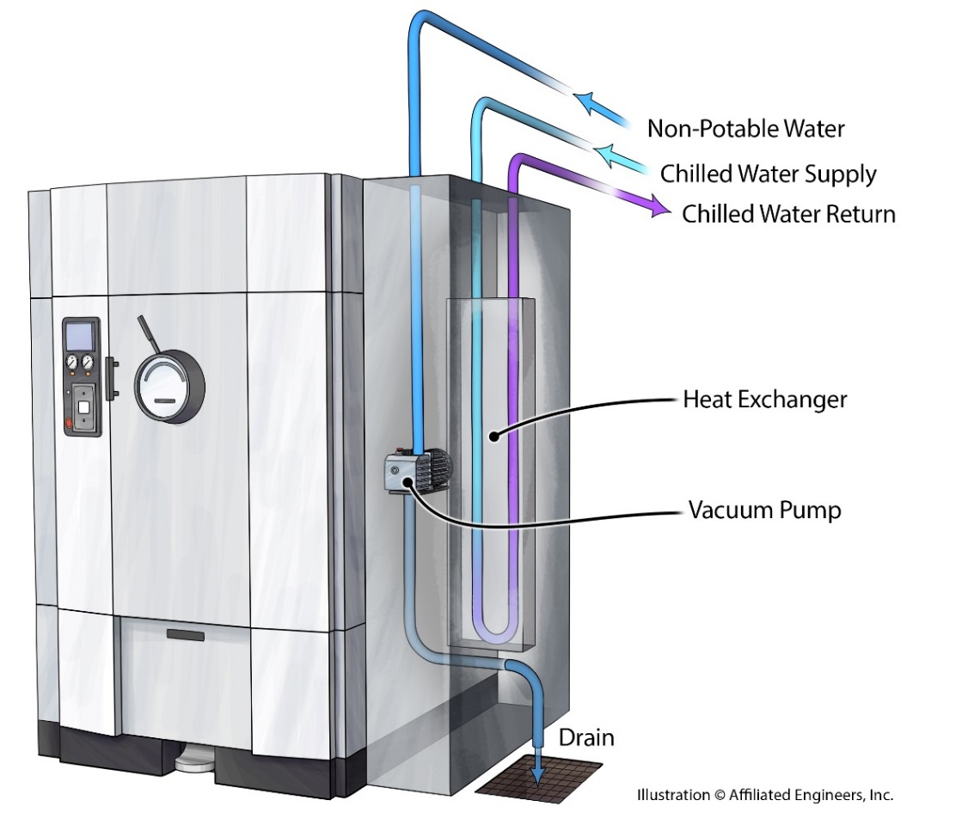
Washers & sterilizers
Chilled water heat exchanger
Rinse cycle reuse tanks
Standby occ. sensors
Water conservation
Energy recovery
  opportunity
Equipment
Water Savings
50-60% (Cage & Tunnel)
80-90% (Autoclaves)

Slide 26

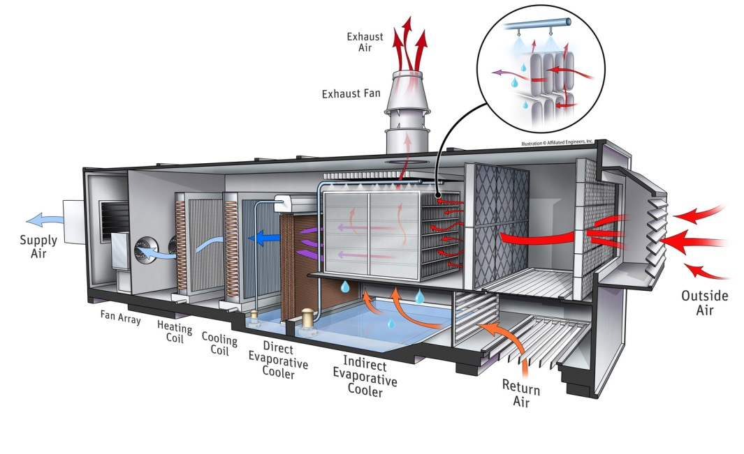
Total accounting: water + energy
Water-cooled chiller vs. Evaporative Cooling
    Consider both site and source water consumption
Notes:
Transition – 2 case study examples for total accounting of energy & water that can be used to support informed design decisions by the project team.
Consider grid scale, campus or district energy scale, and the building scale.
Compare water-cooled chiller plant to evaporative cooling. Indirect/direct evap – 1st stage is indirect where warm air passes through heat exchanger and water is sprayed on the outside (lowers wet bulb & dry bulb). 2nd stage is warm air passing through media saturated with water, humidity is increased and dry-bulb is further reduced.

Slide 27
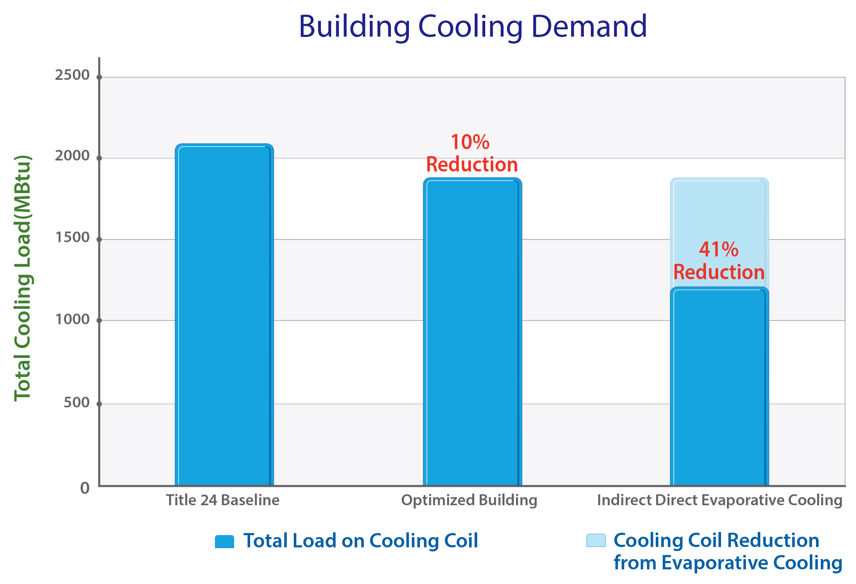
Total accounting: water + energy
Notes:
First, reduce demand for cooling through efficient passive design and load reduction.
Simulation programs used to determine amount of energy & water consumed by both alternatives.

Slide 28

Total accounting: water + energy
Indirect/direct evaporative cooling saves 38,500 kWh/year
SITE
SOURCE
*NREL
218,000 gallons Site Water Increase
178,500 gallons
Source Water Reduction (-)
- 129,500 gallons Site Water Decrease
88,500 gallons
Total Site Water Increase (+)
Net water savings of 90,000 gallons/year
Net electricity savings of 38,500 kWh/year
Notes:
Evap saves electricity which saves water consumption at the power plant (in addition to other environmental impacts).
Evap is less water-efficient as compared to water-cooled chiller (chiller roughly 1.8-2.4 gal/ton-hr…. Direct/indirect evap is roughly 3.5 gal/ton-hr).
Evap saves electricity and actually has a net water savings if source water consumption is considered.

Slide 29

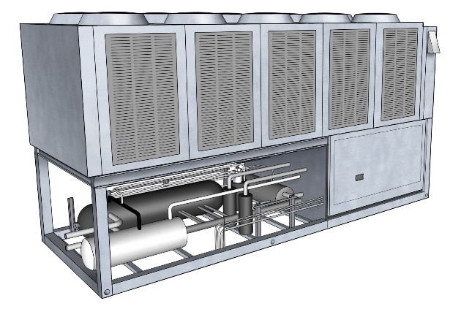
Total accounting: water + energy
Air-cooled chillers plant vs. water-cooled chiller plant
  Consider both electricity and water consumption, and associated utility costs
  2 locations: Nampa, ID and Seattle, WA
Notes:
Economic analysis when considering electricity & water consumption. Should be evaluated as an element of total cost of ownership (including maintenance and other factors).

Slide 30
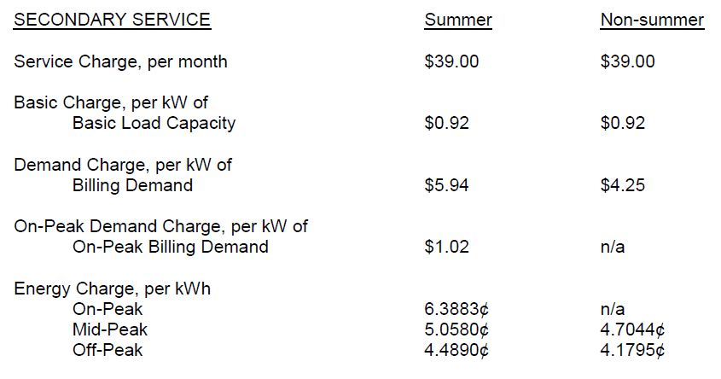
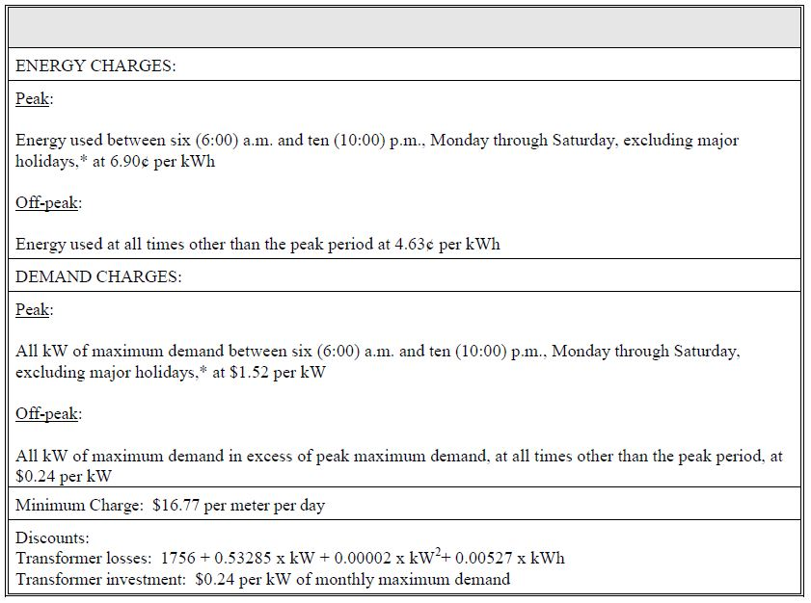
Total accounting: water + energy
Utility Rates - Electricity
Nampa, Idaho →
Virtual Rate = 0.061 [$/kWh]
← Seattle, Washington
Virtual Rate = 0.064 [$/kWh]
Notes:
Similar electricity rates, Nampa slightly cheaper than Seattle

Slide 31
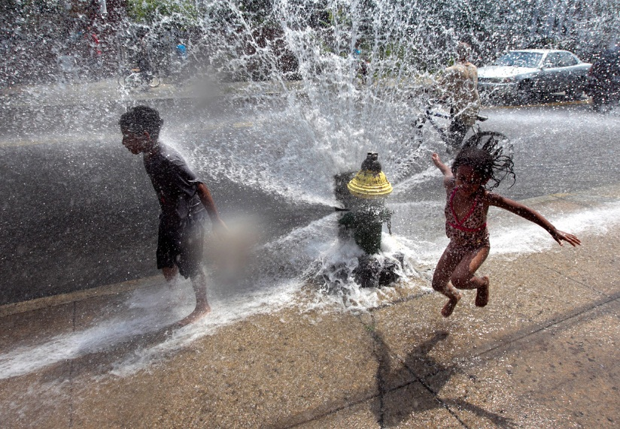
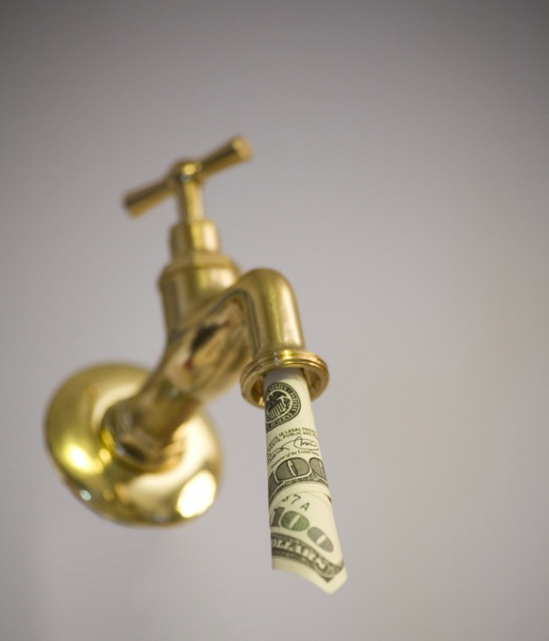
Total accounting: water + energy
Utility Rates – Water
Nampa, Idaho
$0.77/1,000gal [water]
$3.08/1,000gal [sewer]
$3.85/1,000gal [combined]
Seattle, Washington
$7.27/1,000gal [water]
$15.71/1,000gal [sewer]
$22.98/1,000gal [combined]
Notes:
Tale of 2 water rates – cheapest in the country to most expensive in the country

Slide 32
Total accounting: water + energy
Financial Analysis – Year 1
Nampa, Idaho
  Air-cooled: electricity
  778,953 [kWh]
  $47,438 [annual]
  Water-cooled: electricity
  570,238 [kWh]
  $34,727 [annual]
  Water-cooled: water
  2,696,936 [gpy]
  $2,080 [annual]
  Water- Cooled Total Cost:
  36,808 $/year
Seattle, Washington
  Air-cooled: electricity
  689,488 [kWh]
  $44,403 [annual]
  Water-cooled: electricity
  504,745 [kWh]
  $32,506 [annual]
  Water-cooled: water
  2,387,185 gpy]
  $18,943 [annual]
  Water-Cooled Total Cost:
  51,449 $/year
Notes:
When considering electricity alone… water-cooled wins out on utility cost.
When considering electricity & water costs, water-cooled still wins in Idaho but air-cooled is most cost efficient in Seattle

Slide 33
Whole building water modeling
Life-cycle for project water analysis
  Benchmark & goal set
  Preliminary water budget, early water balance
  Refine calculations as information and models become available
  Work design alternatives into BOD and design documentation
  Final models and calculations to support compliance
Notes:
Transition to whole building water modeling – from concept to compliance
Approach water efficient design in the same manner as energy efficient design (first reduce demand for water, look at reuse opportunities and natural resources, minimize potable water required for makeup).
Support early estimates, focus on baking in key concepts with the greatest potential for impact, then transition to detailed calculations and energy/water models to support design and compliance.

Slide 34
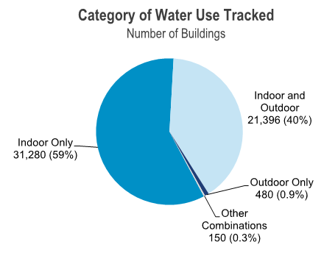
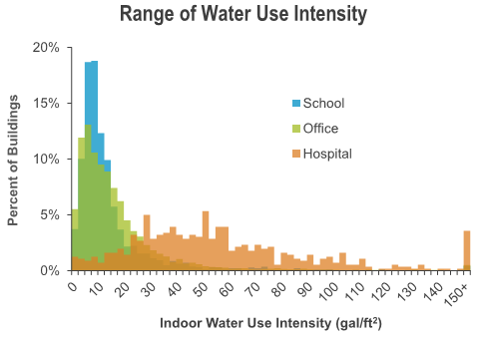
Whole building water modeling
Benchmark & goal set
  Water Use Intensity (WUI) [gallons/sf-yr]
  Industry benchmarks can be inconsistent
  Wide range of laboratory program types & water use intensities
[USEPA]
[USEPA]
Notes:
WUI similar to EUI, metric of water consumed per normalized per unit floor area
Water benchmarks and design criteria much less established as compared to energy. Can be inconsistent and include/exclude different end-uses.
Similar to hospitals or healthcare, wide range of lab/research program types (chem, bio, vivarium, research, teaching, etc.)

Slide 35
Whole building water modeling
Benchmark & goal set
  Building type, size, and location
  Major program elements, water end-uses
  Take current codes into account when comparing to data from older vintage buildings
[USEPA]
Notes:
Begin with an appropriate WUI target for given program mix
Adjust water-end uses as appropriate
Consider current codes vs. vintage codes when using benchmark information

Slide 36
PRELIMINARY WATER BUDGET / early ANALYSIS
Notes:
Begin with square footage and WUI estimate
Allocate end-uses as appropriate and then apply savings estimates to each end-use from benchmarks or analysis results

Slide 37
PRELIMINARY WATER BUDGET / early ANALYSIS
Take annual end-use estimates and distribute monthly to begin water balance
Notes:
Distribute annual estimates to monthly estimates
Some end-uses are more consistent throughout the year while others are more seasonally driven

Slide 38
PRELIMINARY WATER BUDGET / early ANALYSIS
Begin to understand quality requirements
Notes:
In addition quantity and time-of-use considerations, begin to understand quality requirements
What are the actual RO end-uses, which can be served by non-potable water, etc.

Slide 39
PRELIMINARY WATER BUDGET / early ANALYSIS
Work potential reclaimed water resources into water balance

Slide 40
PRELIMINARY WATER BUDGET / early ANALYSIS
Make the case!

Slide 41
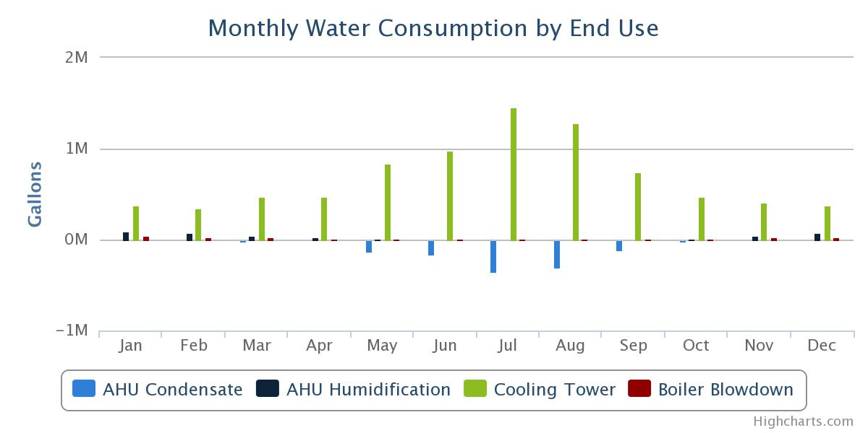
INTERMEDIATE STEPS: SD→DD→CD
Design & refine: expand your preliminary model
Research, model, analyze
Replace design targets with real project calculations as information becomes available and detailed energy/water models are developed
Bake core water conservations strategies into the BOD and early design documentation
[Quench by AEI]

Slide 42

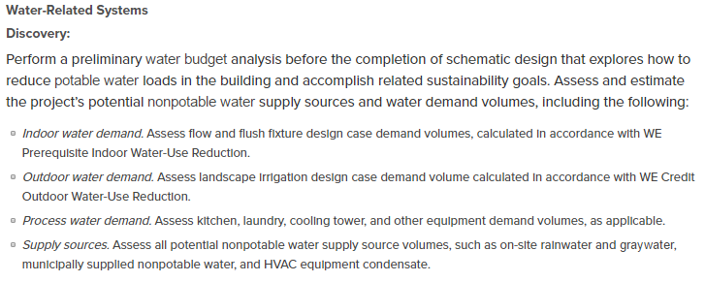
LEED v4 Water credits
Preliminary water balance supports ‘Integrative Process’ credit

Slide 43
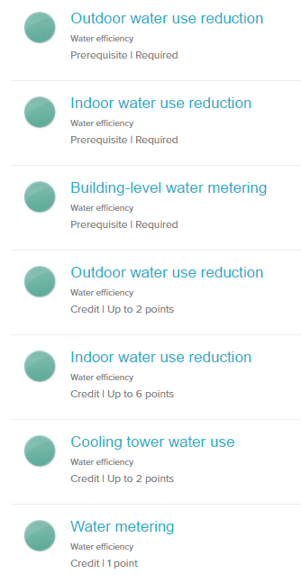
LEED v4 Water credits
Water conservation points are distributed across multiple credits
Savings & LEED points are capped by separate end-use
Many end-uses not accounted for by LEED
Irrigation
Restroom fixtures
LEED Healthcare adds: washing machines, commercial kitchen, select lab/medical equipment – points awarded for compliance NOT % savings over baseline
Cooling tower

Slide 44
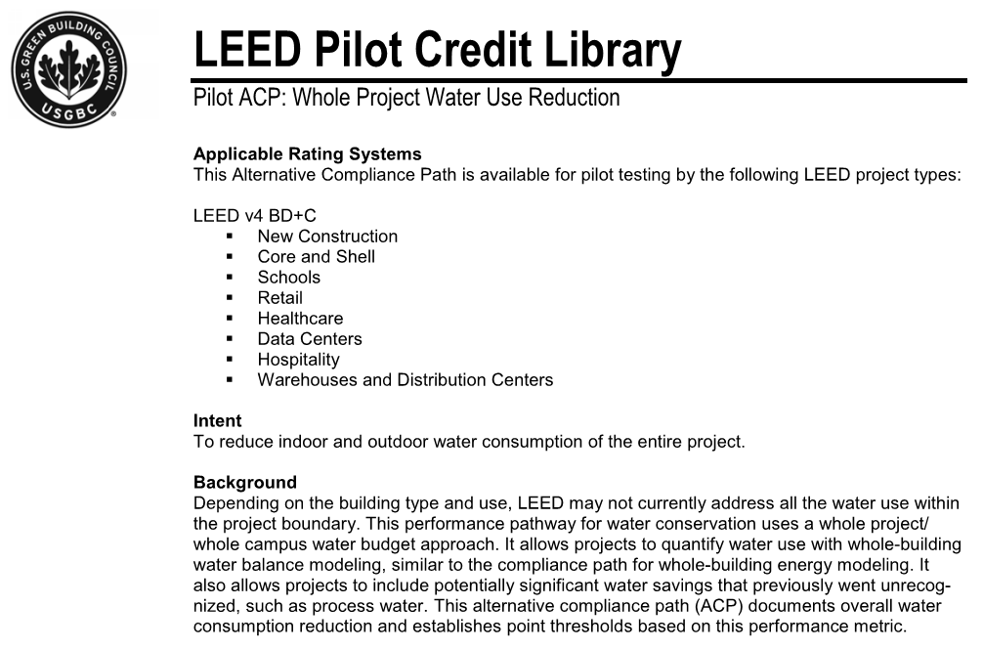
LEED v4 ALTERNATIVE COMPLIANCE PATH
Similar to LEED energy performance credit, points are awarded based on % reduction for whole building/site water use
Merges prescriptive water performance credits into a single credit

Slide 45
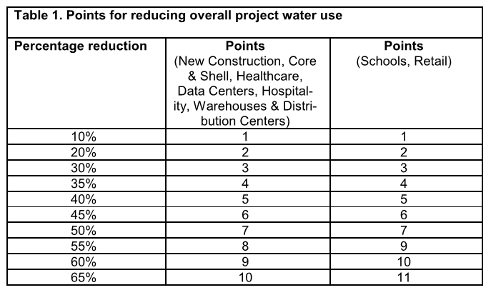
LEED v4 ALTERNATIVE COMPLIANCE PATH
Allows for additional end-uses and tradeoffs between end-uses
  *Effective for projects with significant process water savings and reuse
May be possible for additional points to be achieved (exceed point thresholds for individual credits)

Slide 46
LEED v4 ALTERNATIVE COMPLIANCE PATH
Include at least 90% of water, and break out any end-use that is larger than 5% of total water end-use.
Use existing LEED compliance forms for fixtures and processes where applicable.
Equipment without code minimum flows may be used for savings if a case can be made for the savings
  *(similar to ASHRAE 90.1 exceptional calculations)

Slide 47

LEED v4 ALTERNATIVE COMPLIANCE PATH
ASHRAE SPC 191: water savings calculation methodology
  (similar to ASHRAE 90.1 Appendix G energy savings methodology)

Slide 48
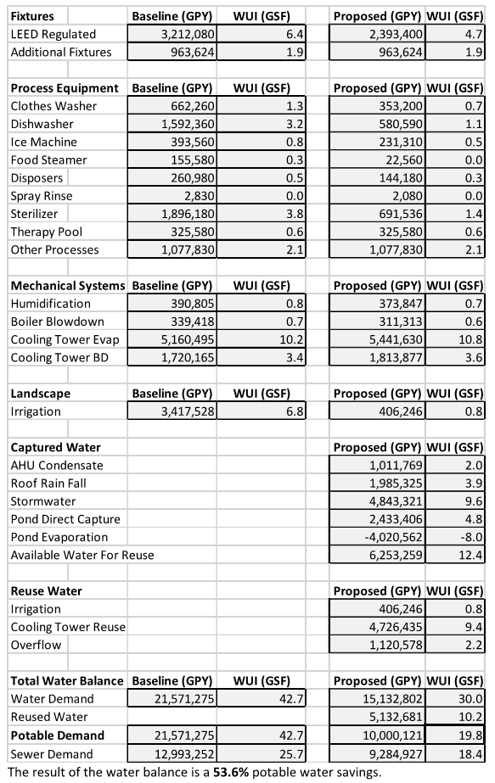
LEED v4 ALTERNATIVE COMPLIANCE PATH
Tools & Approach:
Comprehensive Accounting
Fixtures: LEED + process
Process equipment: component models
HVAC equipment: energy model derived
Landscape: LEED + weather file
Water reuse: energy model + precipitation

Slide 49
Thank You,
Questions?

