Slide 1
Basics of Dispersion Modeling
Anke Beyer-Lout & Jared Ritter
2017 Colorado I²SL Chapter Education Day
Colorado School of Mines
August 29, 2017

Slide 2
Outline
Describe the problem of effluent dispersion within a turbulent flow field
Review the types of dispersion models that are available
Explain the strengths and weaknesses of each simulation technique
Define which is most appropriate for a given application
Notes:
This presentation covers the following:
Also will include occasional discussion on a case study for the recent construction CoorsTek

Slide 3
Effluent Dispersion
Primary Objective: Health/Odor Concerns
  Prevent exhaust re-entrainment within the building and neighboring locations
Additional Considerations
  Cost Savings
    Capital Cost – Stack height, entrained flow vs. conventional fan
    Operational cost - Energy consumption
  Building aesthetic
Notes:
The main concern is to limit exhaust concentration
No hazardous or odorous exhaust is re-entrained or affects neighboring locations
Additional benefits:
Potential cost savings
Day 1 – capital cost
Long term energy use
Architecturally acceptable

Slide 4
Dispersion Modeling Methods
Graphical Methods
Analytical Methods
Numerical Methods (CFD)
Physical Modeling (Wind Tunnel)
Notes:
Sort of ranked in terms of complexity
Could argue that CFD and wind tunnel are most complex, depending on how many cfd simuluations are run
Benefit of better model - most accurate exhaust concentrations – turndown and energy savings

Slide 5
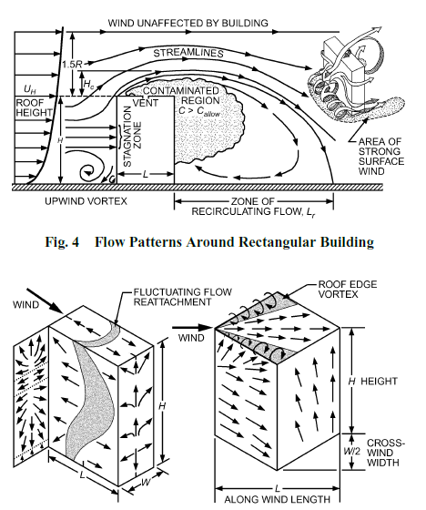
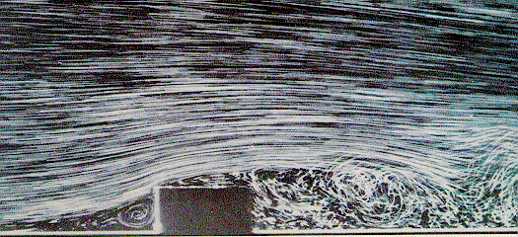
Airflow Around Buildings
Notes:
For all of the dispersion methods, the main driving factor is the complex interaction of the approaching wind and the building
2 main phenomena
Rooftop recirc cavity – wind perpendicular to upwind wall
Corner vortecies – wind approaching corner

Slide 6
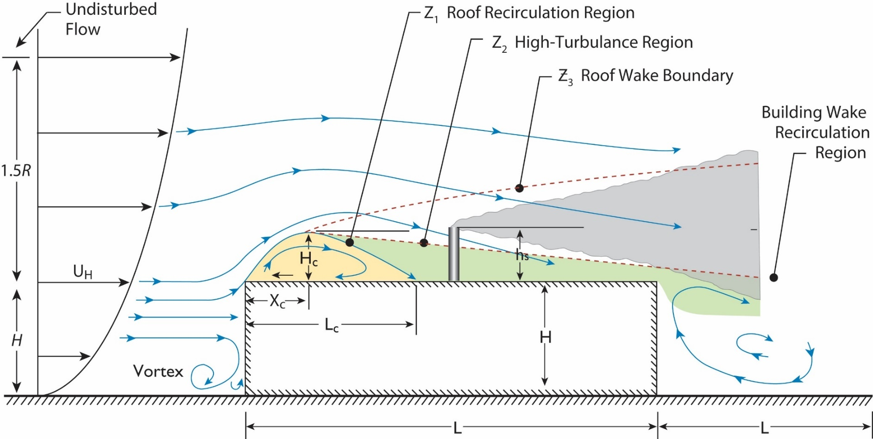
Graphical Method
2015 Handbook – HVAC Applications Chapter 45
Notes:
From the ASHRAE Handbook
Guideline for stack placement
Calculate rooftop wake cavity using building dimensions
From that you can get stack placement and prelim stack ht
ASHRAE also provides preliminary recommendations
stacks on roof, intake on ground to take advantage of stagnation region
Increasing separation distance, or sidewall receptors

Slide 7
Graphical Method
Pros:
Identifies ideal placement of exhaust stacks on the roof
Provides quick indication of possible stack height requirements
Cons:
No actual concentration predictions
Can only be used for isolated building
Can be extremely conservative for large buildings
Notes:
Good starting point to begin to understand how the wind affects the stack design
However, no concentrations are predicted
Not recommended for hazardous stacks

Slide 8
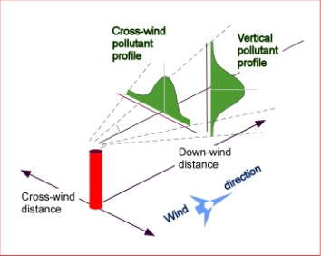
Analytical Dispersion Methods
Gaussian Diffusion Equation
Plume Rise, h_{plume} calculation
Horizontal Dispersion Coefficient, σ_{y}
Vertical Dispersion Coefficient, σ_{z}
Receptor Height, h_{top}
Notes:
More in depth
Exhaust concentration predictions achieved by combining plume rise calculations and gaussian dispersion (horizontal and vertical)
Usually conservative when used properly, but may not be if there are complexities (upwind structures, screenwalls)
Several models fall in this category – including AERMOD

Slide 9
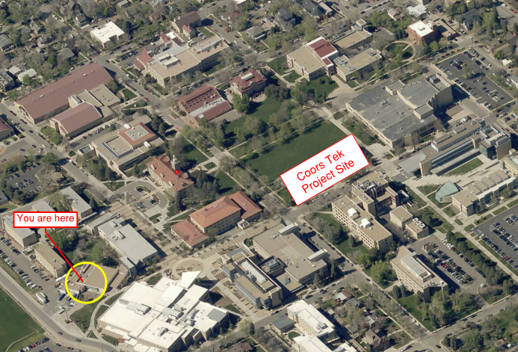
Case Study – CSM CoorsTek
Analytical Dispersion Method
Pros:
Open environment
Surrounding buildings similar in size
Notes:
Case study of nearby recently completed project on CSM
Because the campus is realtively open with all buildings similar size, would think ok for analytical method
If Alderson Hall were 3x size of CoorsTek the approach from the south would be turbulent, which would not be handled well by analytical dispersion

Slide 10
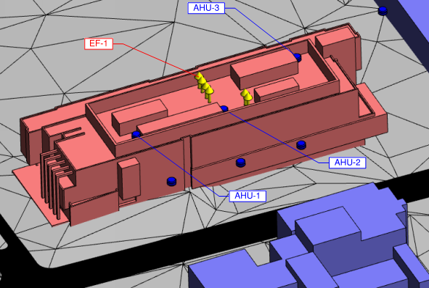
Case Study – CSM CoorsTek
Analytical Dispersion Method
Cons:
Complex rooftop features
Critical locations are expected to be within the rooftop wake cavity
Intake flow from the AHUs may affect results
Notes:
This is a rendering of the CoorsTek building
Relatively complex roof with stacks and intakes within the screenwall
In close proximity (Numerical plume rise could over or under predict)
AHU’s intake suction could affect the shape of the plume within the screen

Slide 11
Analytical Dispersion Methods
Pros:
Relatively easy to use
Based on Gaussian plume dispersion theory
Takes into account building and stack downwash
When properly applied, will generate conservative results
Less expensive than CFD or Wind Tunnel testing
Cons:
Building geometries are generic
Doesn’t properly account for corner vortices or complex rooftops
May be overly conservative for certain situations
Most accurate for isolated buildings
Notes:
So to summarize….
Relatively quick/easy method of obtaining exhaust concentration predictions
Can be used in basic-building applications, but becomes less accurate with complex rooftops or surrounds
In these cases, better predictions can be obtained with CFD or physical wind tunnel modeling - ANKE

Slide 12
Numerical Dispersion Methods - CFD
Computational Fluid Dynamics Models (or CFD) solve the equations of motion on a fixed grid in order to calculate the turbulent motion of the air masses.
Reynolds Number Averaged Navier Stokes (RANS)
Large Eddy Simulation (LES)
Direct Numerical Simulation (DNS)
Notes:
Computational Fluid Dynamics Models (or CFD) solve the equations of motion on a fixed grid in order to calculate the turbulent motion of the air masses.
CFD simulations are extremely computationally intensive and usually only feasible for small scales.
Even then, not all scales of turbulence can be resolved, because the smallest scales of turbulence in the atmosphere are on the millimeter scale (or fraction of an inch scale) and the largest turbulence elements can be on the km scale (i.e. mile).
Therefore some or all turbulence needs to parameterized.
If all turbulence is parameterized, you end up with a Reynolds number averaged Navier Stokes (RANS) CFD model. If only the turbulence that is smaller than your grid is parameterized and the larger turbulence scales are resolved, you have yourself a large eddy simulation (or LES).
If you have the time and money to resolve all turbulence scales, you end up with direct numerical simulation (DNS).

Slide 13
Numerical Dispersion Methods - CFD
Steady State
Reynolds-Average Navier Stokes (RANS)
Does not resolve turbulent fluctuations within the flow field (important for dispersion modeling)

Slide 14
Numerical Dispersion Methods - CFD
Large Eddy Simulation (LES)
Resolves most of the turbulent fluctuations within the flow field.
Notes:
…but can be expensive and time-consuming to run.

Slide 15
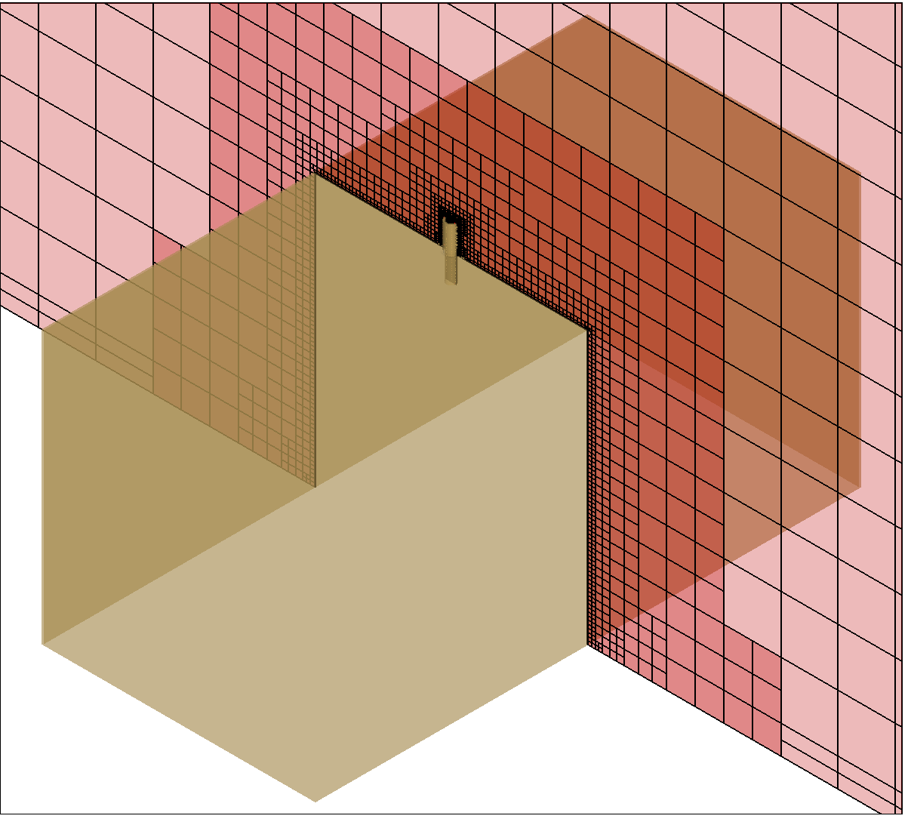
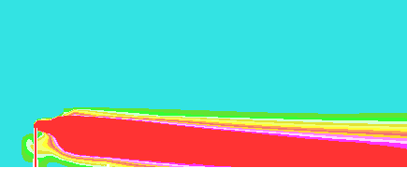
Numerical Dispersion Methods - CFD
Critical Issues:
Mesh Resolution
Turbulence Modeling
Boundary Conditions
Notes:
Numerical diffusion

Slide 16
Numerical Dispersion Methods - CFD
Pros:
Provides a nice visual picture of flow phenomenon
RANS useful for interior and mean flow exterior modeling
Can model complex environments
Can include atmospheric stability and thermal effects
Cons:
Steady-State RANS does not sufficiently resolve turbulence. (not accurate for plume dispersion modeling)
LES shows promise, but the time dependent models are currently too computationally intensive for most applications
Every wind speed and wind direction requires a separate simulation

Slide 17
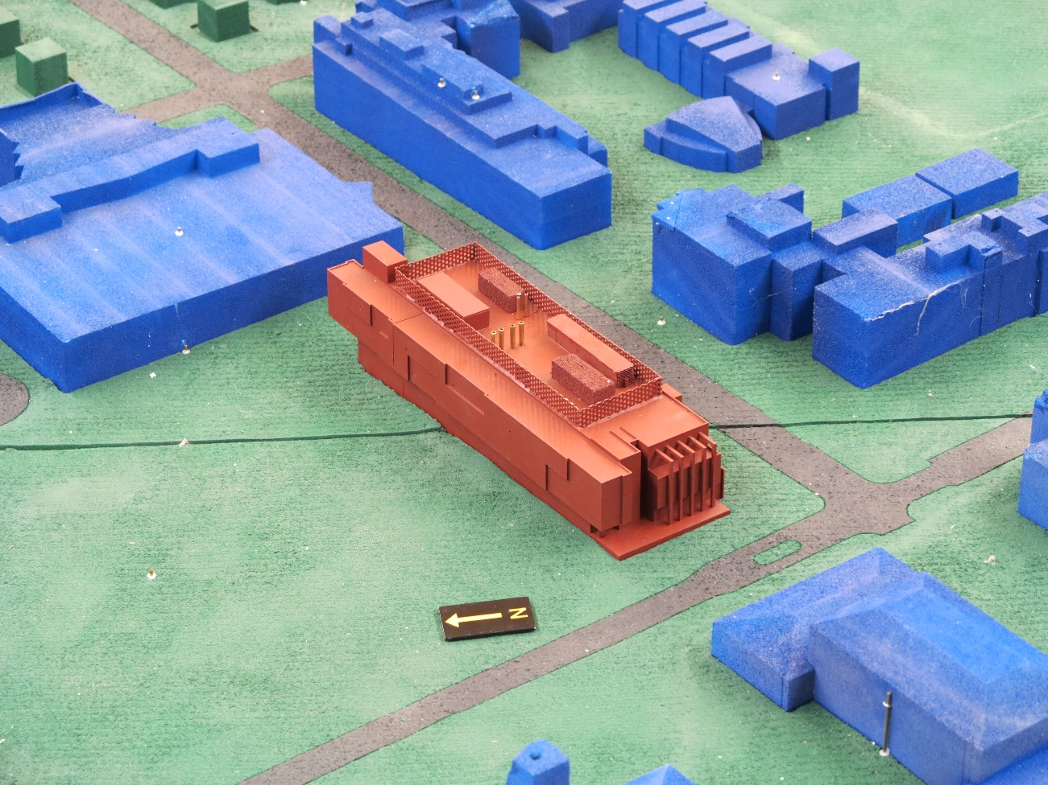
Physical Dispersion Methods
Construct Scale Model of Site Building and Surroundings
Colorado
School of Mines
CoorsTek

Slide 18
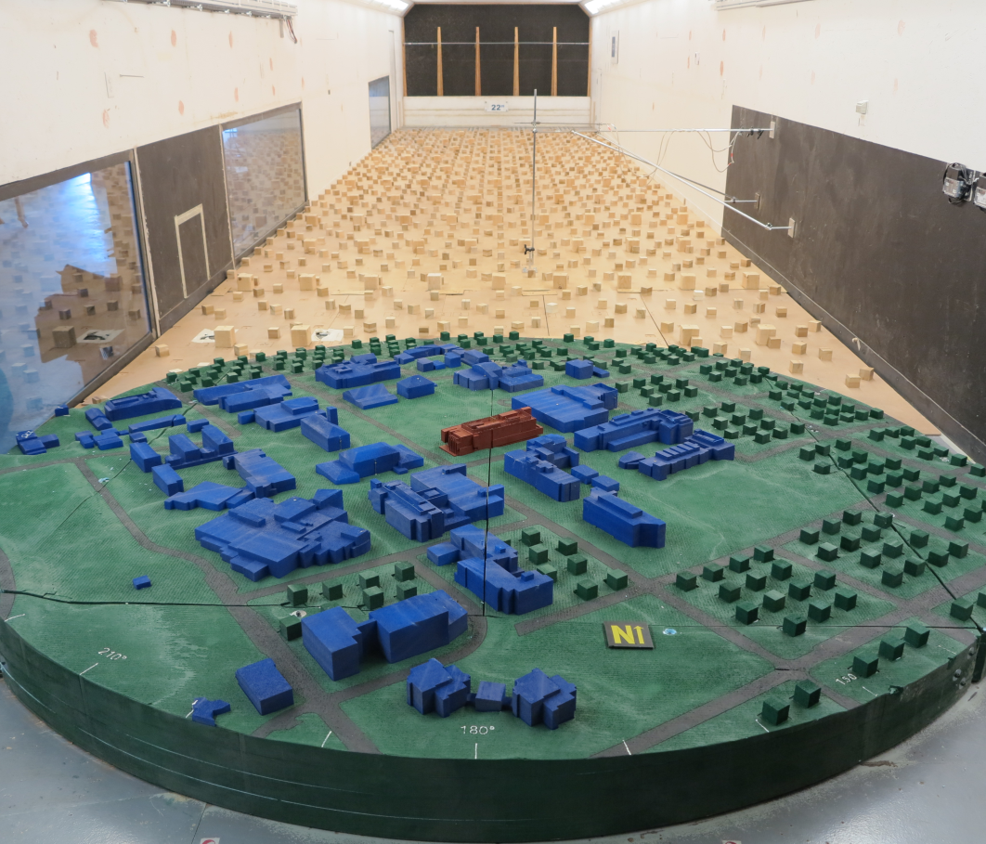
Physical Dispersion Methods
Place in Atmospheric Boundary Layer Wind Tunnel

Slide 19
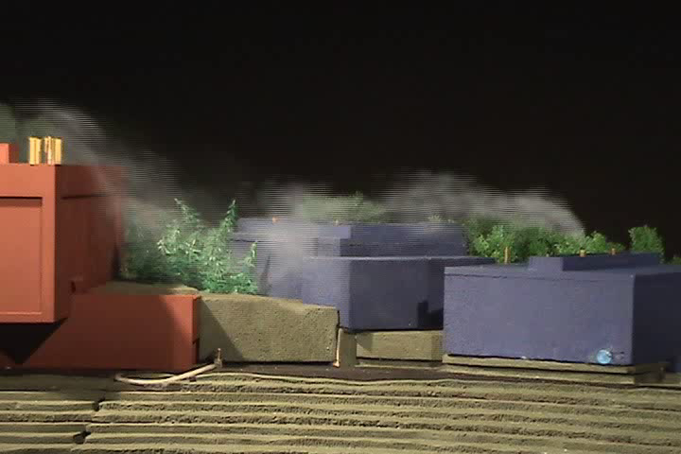
Physical Dispersion Methods
Concentration Measurements in Atmospheric Boundary Layer Wind Tunnel
Tracer gas released from stack
Sample withdrawn from intake

Slide 20
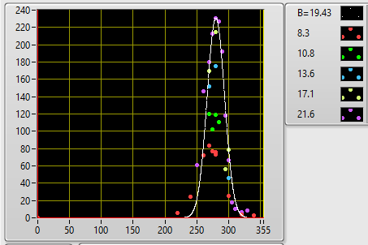
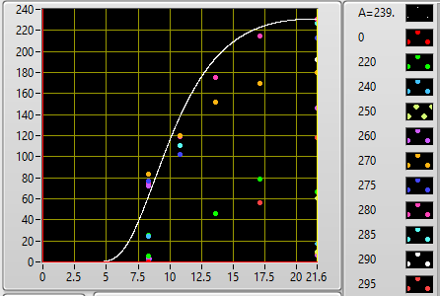
Physical Dispersion Methods
Develop Concentration Profiles of C/m vs. WS and WD
C/m vs. Wind Direction for various Wind Speeds
C/m vs. Wind Speeds for various Wind Directions

Slide 21
Physical Dispersion Methods
Pros:
Accurate simulation of air flow patterns around complex buildings
Can evaluate impact of screens, stack shape, and other reasonably small structures
Multiple wind speeds and wind directions can be readily modeled
Cons:
Size of wind tunnel limits the sizes (scales) of objects
Discrete sampling rather than entire flow field (flow visualization can be misleading)
Atmospheric Stability and thermal impact difficult to model

Slide 22
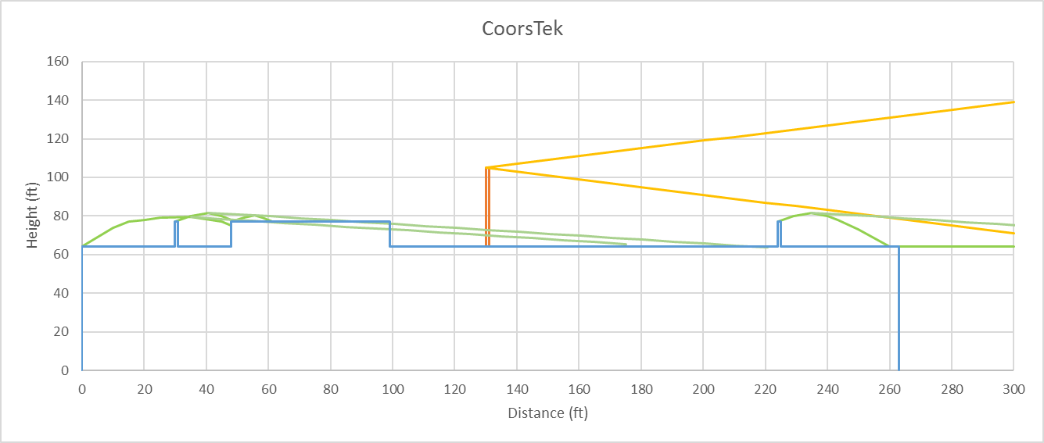

Conclusions
Graphical Method
Use only as a first cut for estimating stack height and location
Do not use for final design if using hazardous chemicals.
Notes:
So, what have we learned? The graphical method is a starting point.
I tried the ASHRAE graphical method on the CoorsTek Building. The building outline is shown in blue (screen walls and a rooftop AHU are included). As a rough estimate, a stack height of 40ft above roof is required so the lower edge of the plume stayed above the recirculation zones.
The graphical method does not prodce concentration estimates and is therefore not recommended for…

Slide 23
Conclusions
Analytical Modeling
Provides plume dispersion estimates and thus can be used for final design
Applicable for simple buildings with no taller surrounding buildings/features and/or when stack height is not a critical issue
Notes:
A gaussian plume model provides concentration estimates and thus can be used for final design.
…
If we look at the CoorsTek Building, we can see rooftop equipment and screen walls that a plume model does not include. To account for the increased plume spread due to the screen wall, ASHRAE recommends screen wall reduction factors.
Overall, analytical models are designed to be conservative. If desirable concentrations are computed using a Gaussian Plume model, the exhaust and intake design can be finalized at that point. However, advanced modeling methods may be able to optimize the design.

Slide 24
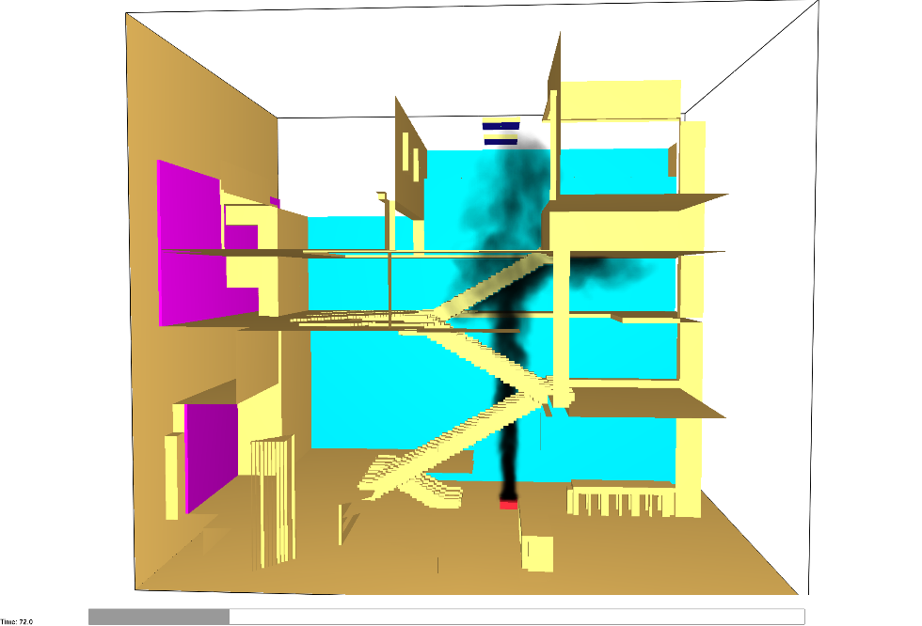
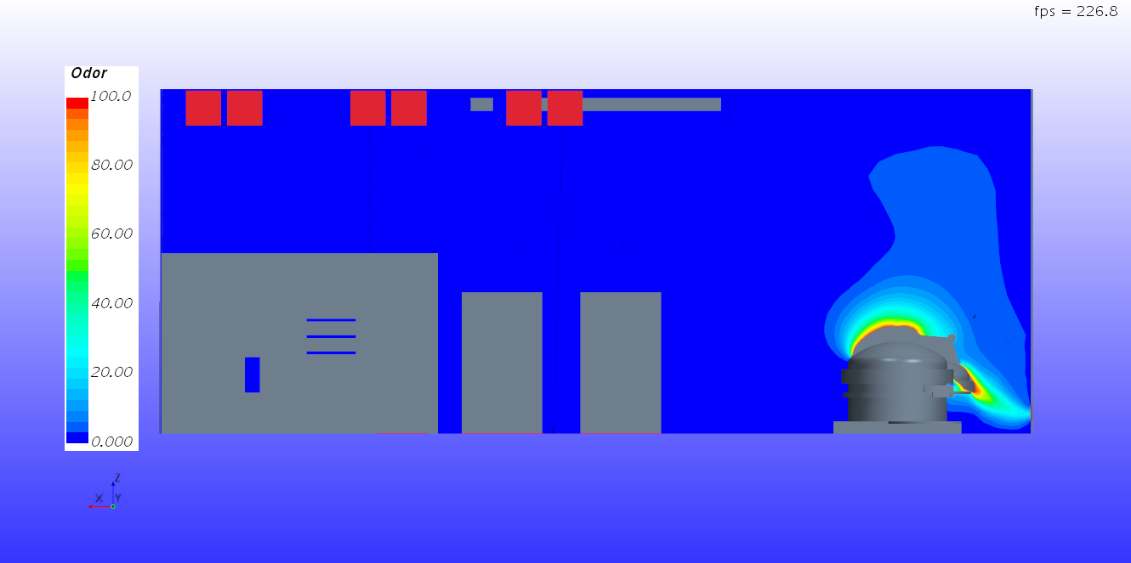
Conclusions
CFD Modeling
Typical RANS method is not appropriate for dispersion modeling. Rather, only LES models should be used for dispersion modeling
Make sure sufficient WS/WD are modeled
Validation of CFD results is still very critical
Notes:
If CFD is desired to be used for exhaust dispersion, sufficient WS/WD need to be modeled. And, sufficient means, at least 16 wind directions and multiple wind speeds for each direction foe each stack. We are talking up to 100 simulations to ensure that absolute worst case concentrations are computed. Considering that each simulation can take days to run, depending on the domain size, that project schedule can get out of hand very quickly.
Interior air flows are much more suitable to be simulated with CFD.
We did not do any CFD simulations for the CoorsTek Building. If we had, it may have looks similar to these two examples here. The top picture shows an LES simulation of atrium smoke.
The second picture shows odor associated with a tissue digester. In this case supply air comes from the vents up top and exhaust is pulled through the vent next to the digester.

Slide 25
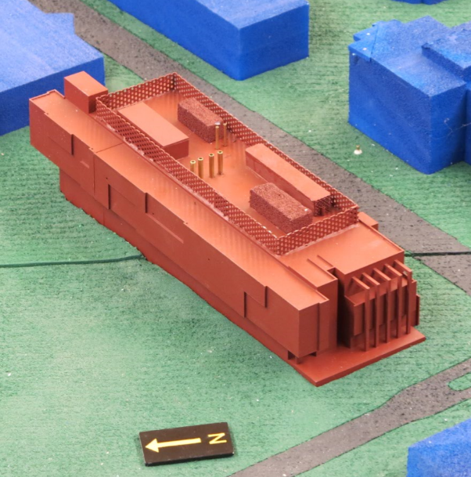
Conclusions
EF-1
Wind Tunnel Modeling
Use for complex geometries and/or when stack height is critical
Can be fully validated using EPA methodology
Use when employing a VAV exhaust strategy
Make sure sufficient WS/WD are modeled
AHU-3
AHU-2
AHU-1
Notes:
Alternate designs, such as different screen walls, stack heights and intake locations are easily evaluated in the wind tunnel.
Use when employing a VAV exhaust strategy, because the exhaust parameters can be fine tuned.
In a project timeline, wind tunnel simulations can be done during initial design, to optimize stack and intake placement, as well as during final design.

Slide 26
Case Study – CSM CoorsTek
Method | Maximum Predicted Concentration (C/m) | Worst- Case Location
Graphical | 40ft stack height
Analytical | 1,655 μg/m³ per g/s (16ft stack height) | AHU-2 Intake
Wind Tunnel | 614 μg/m³ per g/s (16ft stack height) | AHU-2 Intake
Notes:
We can compare the concentration predictions for the Coorstek Building,
That concludes our presentation and we would love to answer your questions.

Slide 27
Questions?
For More Information
Anke Beyer-Lout
Senior Lead Scientist
abeyerlout@cppwind.com
Jared Ritter
Senior Project Engineer
jritter@cppwind.com
CPP, Inc.
2400 Midpoint Drive, Suite 190
Fort Collins, CO 80525
(970) 221-3371

