Slide 1
The Benefit of Including Energy Recovery System Analysis
When Planning Energy Efficiency Upgrades
Heidi Dugan Konvekta USA, Inc.
I2SL Colorado Chapter - Education Day 2018

Slide 2
Learning Objectives
Why Is It Important To Consider Energy Recovery Options Early in the Design Phase
How To Effectively Analyze Energy Recovery Systems
How A High Performance Energy Recovery System Can Help Achieve N+1 Redundancy With Significantly Less Cooling Plant Chiller Capacity
How To Optimize An Energy Recovery System To Maximize CO2 Savings
How A High Performance Energy Recovery System Can Help Achieve N+1 Redundancy With Significantly Less Cooling Plant Chiller Capacity
What Are The Potential Unintended Consequences Of Lighting & Boiler System Upgrades Which Can Undermine Estimated Energy Savings?
I2SL Colorado Chapter - Education Day 2018

Slide 3
University of Denver Seeley Mudd Science Building
The Goal:
Mechanical System Upgrades
Environmentally Responsible Energy Efficient Systems
Carbon Neutrality by 2050
24% Carbon Emissions Reduction by 2020
I2SL Colorado Chapter - Education Day 2018

Slide 4
Upgrades
ER System Analysis
HVAC System
High Efficiency Boilers
High Efficiency Chillers
Energy Efficient Lighting
ER Technology/What Works in Building
Reduced Energy Cost
Peak Demand Reduction
Beneficial Added Features
Redundancy / Reliability
Utility Rebates
Monitoring / Reporting
I2SL Colorado Chapter - Education Day 2018

Slide 5
Why Is It Important To Consider Energy Recovery Options Early in the Design Phase?
Type of ER Technology Selected Affects:
Annual Heating & Cooling Cost Reductions
Carbon Footprint Reduction
LEED Points
Utility Company Rebates
Boiler & Chiller Capacity Requirements
Central Plant Efficiencies
First Cost Savings
Other Resource Demands (water)
Physical Space Needed For Air Handlers
Height Requirements In Mechanical Rooms
Ductwork Requirements
Sizing Fans, Heating Coils & Cooling Coils
Free Cooling Opportunities
Ability To Use Available Waste Heat
I2SL Colorado Chapter - Education Day 2018

Slide 6
Effective ER System Analysis
I2SL Colorado Chapter - Education Day 2018

Slide 7
Effective ER System Analysis
Calculate Both Heating & Cooling Savings For Every Hour
Consider Various Heat Transfer Fluids
Consider Added Features (adiabatic cooling, free cooling, waste heat)
Calculate Net Annual Effectiveness – How Much Energy Will The System Consume?
Calculate Peak Heating & Cooling Reduction
Use Current Utility Cost To Calculate Annual Savings & Payback
I2SL Colorado Chapter - Education Day 2018

Slide 8
Energy Savings Analysis:
Research Lab Building Denver, Colorado 328,000 cfm Supply and 250,000 cfm Exhaust
Denver, CO |  | Without Energy Recovery | Traditional REARS | High Performance REARS PG | High Performance REARS EG
Winter
Heating Energy Requirement | kWh/a | 8,782,300 | 4,551,834 | 1,986,600 | 713,700
Effectiveness Heating |  |  | 48% | 77% | 92%
 |  | Without Energy Recovery | Traditional REARS | High Performance REARS PG | High Performance REARS EG
Summer (with adiabatic cooling in exhaust)
Cooling Energy Requirement | kWh/a | 4,642,327 | 3,172,538 | 2,601,601 | 2,187,561
Effectiveness Cooling |  |  | 32% | 44% | 53%
I2SL Colorado Chapter - Education Day 2018

Slide 9
Energy Savings Analysis:
Research Lab Building Denver, Colorado 328,000 cfm Supply and 250,000 cfm Exhaust
Denver, CO |  | Without Energy Recovery | Traditional REARS | High Performance REARS PG | High Performance REARS EG
Year
Heating Energy | kWh/a | 8,782,300 | 4,551,834 | 1,986,600 | 713,700
Cooling Energy | kWh/a | 4,642,327 | 3,172,538 | 2,601,601 | 2,187,561
Electricity (Fans/Pumps) | kWh/a | 0 | 568,308 | 580,325 | 438,062
Total Energy Consumption | kWh/a | 13,424,627 | 8,292,680 | 5,168,526 | 3,339,323
Effectiveness |  |  | 38% | 61% | 75%
I2SL Colorado Chapter - Education Day 2018

Slide 10
Energy Savings Analysis:
Research Lab Building Denver, Colorado 328,000 cfm Supply and 250,000 cfm Exhaust
Denver, CO |  | Without Energy Recovery | Traditional REARS | High Performance REARS PG | High Performance REARS EG
Year
Heating Energy | kWh/a | 8,782,300 | 4,551,834 | 1,986,600 | 713,700
Cooling Energy | kWh/a | 4,642,327 | 3,172,538 | 2,601,601 | 2,187,561
Electricity (Fans/Pumps) | kWh/a | 0 | 568,308 | 580,325 | 438,062
Total Energy Consumption | kWh/a | 13,424,627 | 8,292,680 | 5,168,526 | 3,339,323
Effectiveness |  |  | 38% | 61% | 75%
Reduce CO2 Emission By Reducing Electrical Consumption of Fans & Pumps
(number of coils, minimize apd, high efficiency pump motors)
I2SL Colorado Chapter - Education Day 2018

Slide 11
Energy Savings Analysis:
Research Lab Building Denver, Colorado 328,000 cfm Supply and 250,000 cfm Exhaust
 |  | Without Energy Recovery | Traditional REARS | High Performance REARS PG | High Performance REARS EG
Peak Demand
Cooling | kW | 3,735 | 2,659 | 2,378 | 2,094
 | tons | 1,067 | 756 | 676 | 595
Heating | kW | 5,585 | 3,692 | 2,746 | 2,492
 | MBTUH | 19,056 | 12,597 | 9,369 | 8,503
45% Reduction
I2SL Colorado Chapter - Education Day 2018

Slide 12
Energy Savings Analysis:
Research Lab Building Denver, Colorado 328,000 cfm Supply and 250,000 cfm Exhaust
 |  | Without Energy Recovery | Traditional REARS | High Performance REARS PG | High Performance REARS EG
Peak Demand
Cooling | kW | 3,735 | 2,659 | 2,378 | 2,094
 | tons | 1,067 | 756 | 676 | 595
Heating | kW | 5,585 | 3,692 | 2,746 | 2,492
 | MBTUH | 19,056 | 12,597 | 9,369 | 8,503
45% Reduction
56% Reduction
I2SL Colorado Chapter - Education Day 2018

Slide 13
Energy Savings Analysis:
Research Lab Building Denver, Colorado 328,000 cfm Supply and 250,000 cfm Exhaust
Denver, CO | Without Energy Recovery | Traditional REARS | High Performance REARS PG | High Performance REARS EG
Annual Energy Cost
Heating Energy | $447,897 | $232,144 | $101,317 | $36,399
Cooling Energy | $162,481 | $111,039 | $91,056 | $76,565
Electricity (Fans/Pumps) | $0 | $42,623 | $43,524 | $32,855
Total Energy Cost | $610,378 | $385,806 | $235,897 | $145,819
Energy Cost Savings |  | $224,573 | $374,482 | $464,561
I2SL Colorado Chapter - Education Day 2018

Slide 14
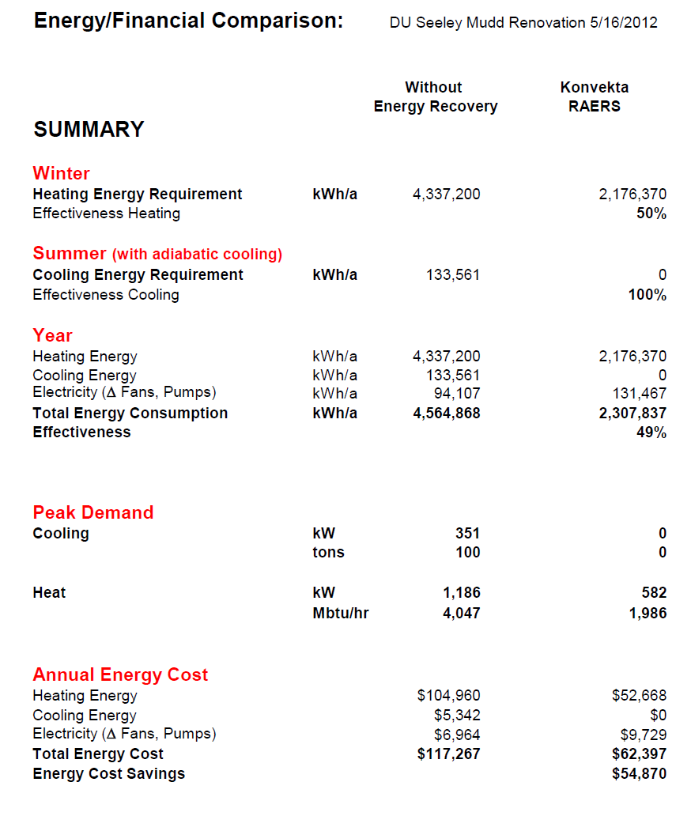
SAT 70F
With Adiabatic Cooling
EAT 52F
100% of Annual Cooling from ER System
Peak Heating Demand Cut By 51%
I2SL Colorado Chapter - Education Day 2018
7 Year Payback (uninstalled)

Slide 15
How A High Performance Energy Recovery System Can Help Achieve N+1 Redundancy
With Significantly Less Heating & Cooling Plant Capacity
I2SL Colorado Chapter - Education Day 2018

Slide 16
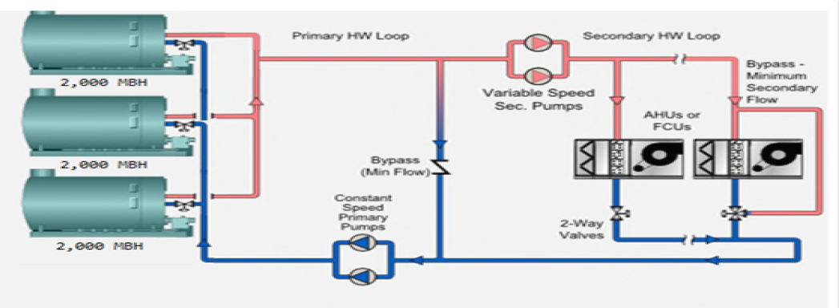
Initial Design Without ER System
92,000 CFM of Make-up Air
Initial Design Boiler Capacity 4,000 MBH + 2,000 MBH
Initial Design Chiller Capacity 750 Tons + 750 Tons
I2SL Colorado Chapter - Education Day 2018

Slide 17
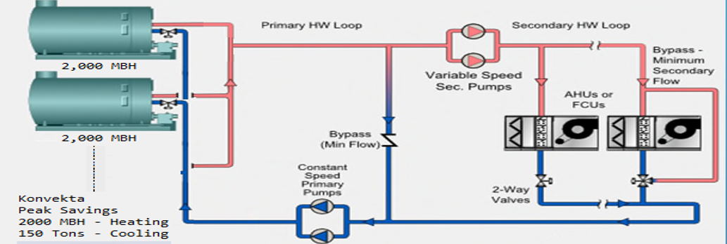
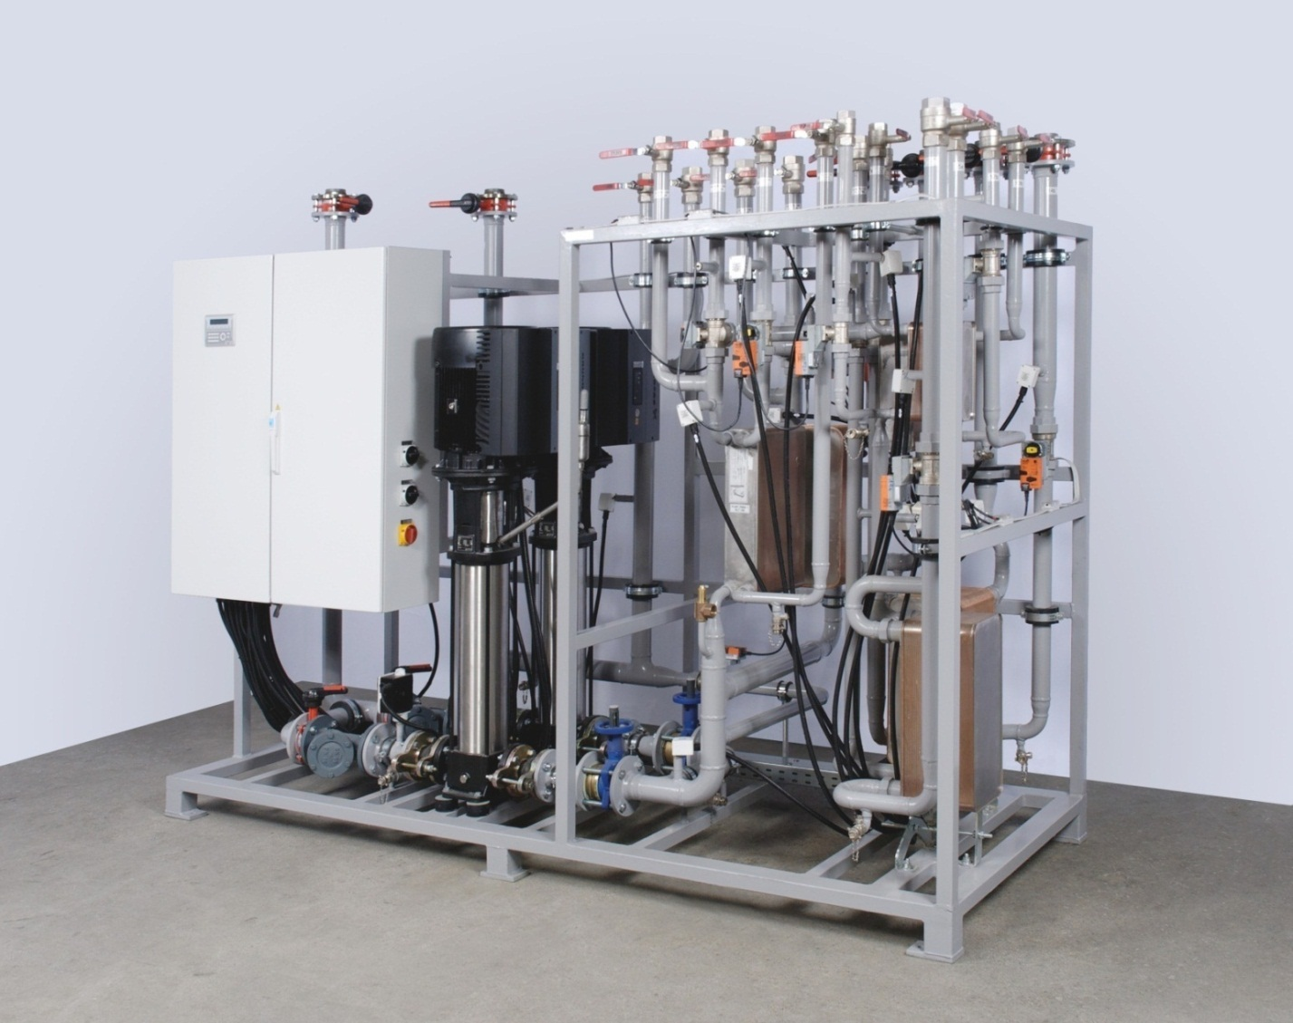
Design With High Performance ER System
Boiler Capacity with high performance ER system:
4,000 MBH - ER System Contributes 2,000 MBH
Chiller Capacity with high performance ER system:
600 Tons + 600 Tons - ER System Contributes150 Tons
I2SL Colorado Chapter - Education Day 2018

Slide 18
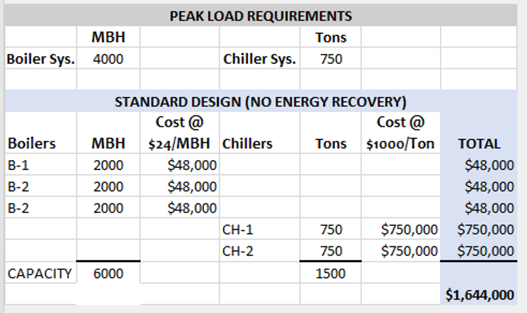
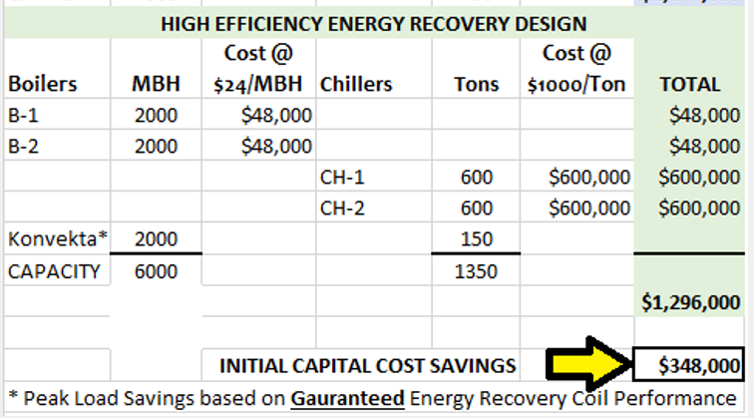
First Cost Savings From ER System
ER System
Capacity
I2SL Colorado Chapter - Education Day 2018
Note: Boiler Capacity Estimated @ $24/MBH
Chiller Capacity Estimated @ $1,000/ton

Slide 19
Lessons Learned
What Are The Potential Unintended Consequences Of Lighting & Boiler System Upgrades
Which Can Undermine Estimated Energy Savings ???
I2SL Colorado Chapter - Education Day 2018

Slide 20
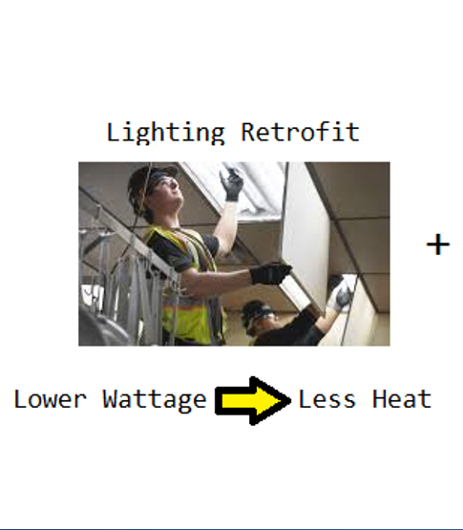
Energy Efficiency Upgrades:
Lighting
I2SL Colorado Chapter - Education Day 2018

Slide 21
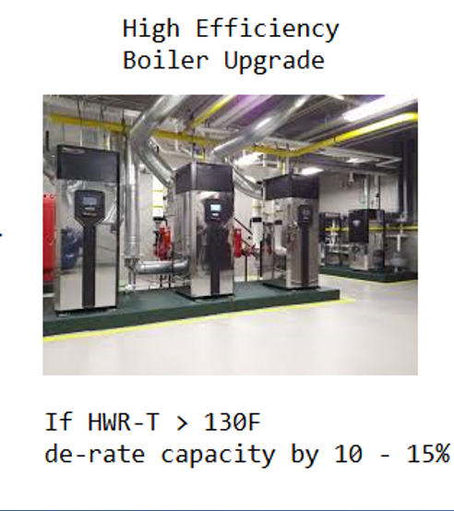
Energy Efficiency Upgrades:
Lighting Condensing Boilers
+
=
I2SL Colorado Chapter - Education Day 2018

Slide 22
Energy Efficiency Upgrades:
Lighting Condensing Boilers
HIGHER ANNUAL
ENERGY
COST !!!!
WHAT????
+
=
I2SL Colorado Chapter - Education Day 2018

Slide 23
Energy Efficiency Upgrades:
Lighting
I2SL Colorado Chapter - Education Day 2018

Slide 24
Energy Efficiency Upgrades:
Lighting Condensing Boilers
Existing heating coils returned HW > 130F so condensing boilers were not condensing!
+
I2SL Colorado Chapter - Education Day 2018

Slide 25
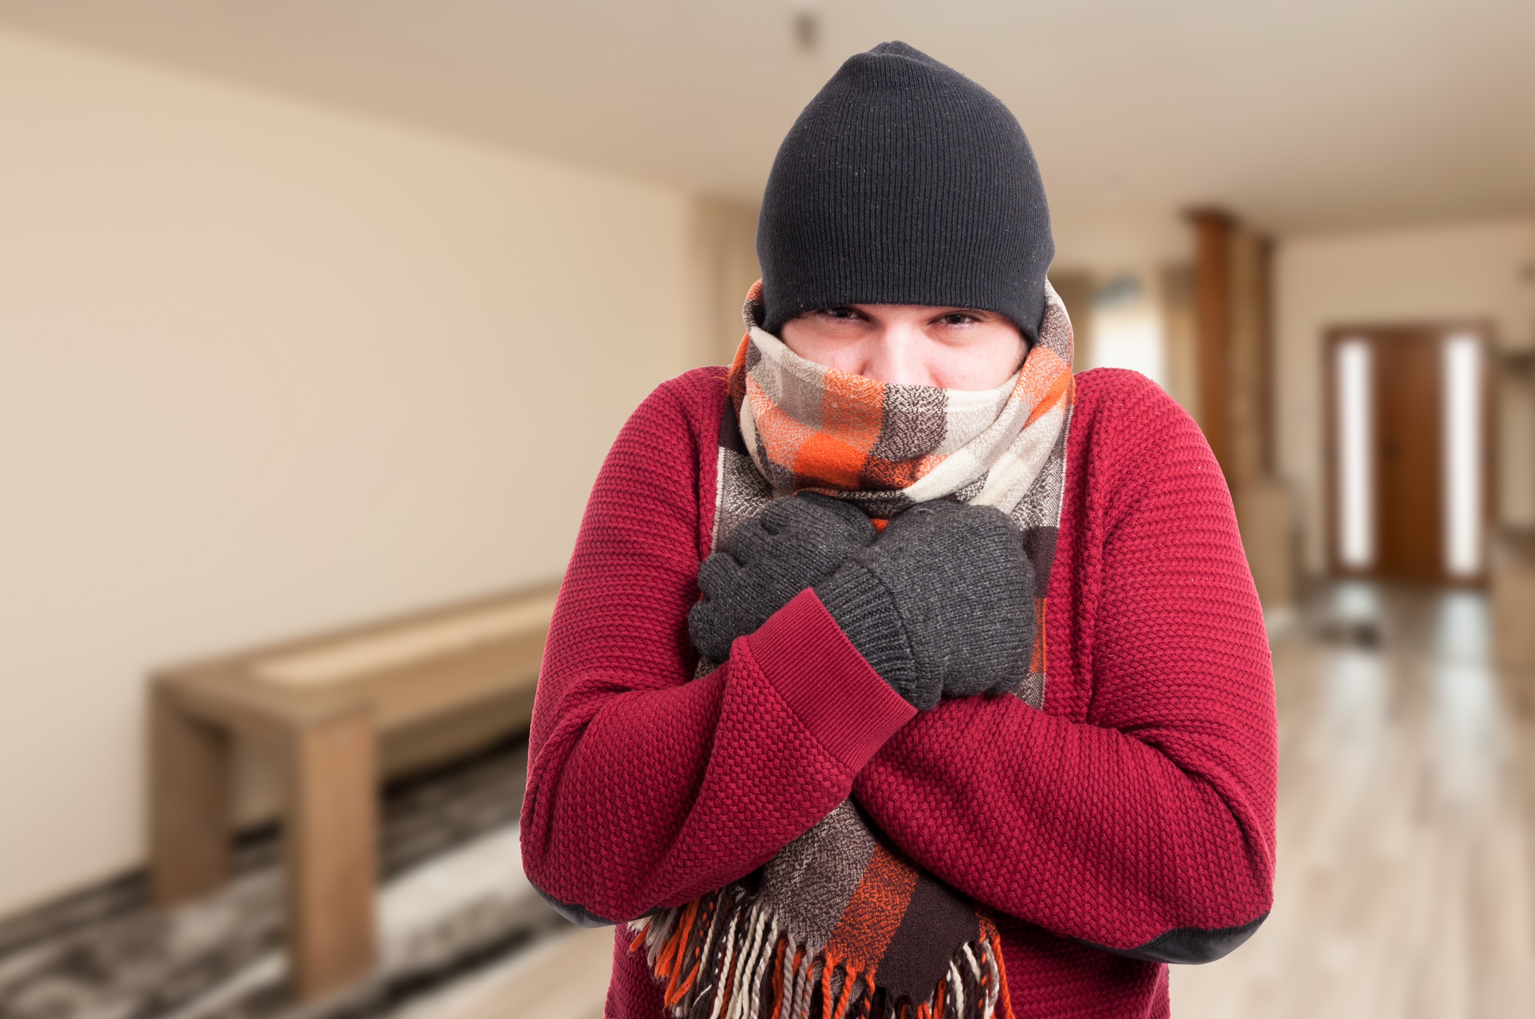
Result Was A Cold Building And…
I2SL Colorado Chapter - Education Day 2018

Slide 26
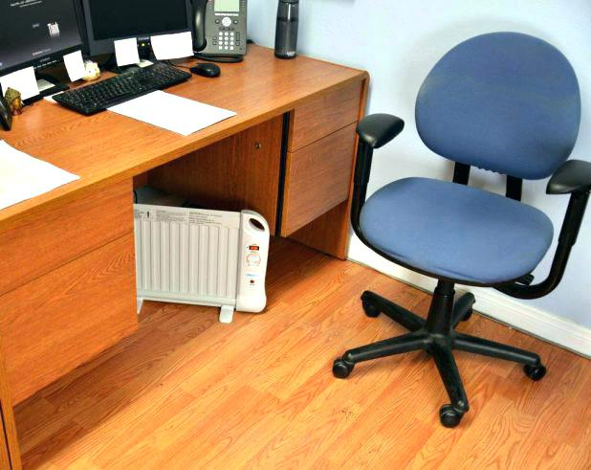
Electric Space Heaters Under Almost Every Desk !!!
I2SL Colorado Chapter - Education Day 2018

Slide 27
Questions:
Heidi Dugan Konvekta USA, Inc.
heidi.dugan@konvekta-usa.com
724.462.972
Mark Labac Edge Mechanical Systems, Inc.
mark@edgemech.com
303.902.1607
I2SL Colorado Chapter - Education Day 2018

